Slide 2
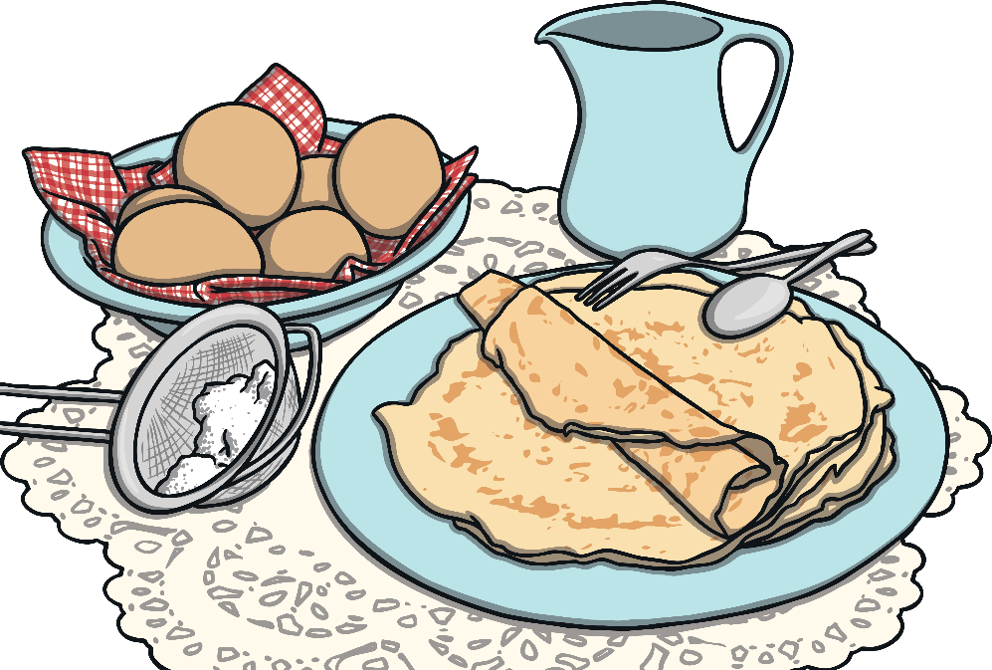
Aim
How is Shrove Tuesday celebrated around the British Isles?
Success Criteria
To learn about why people celebrate Shrove Tuesday.
Understand some of the different ways in which Shrove Tuesday has been celebrated in each of the four countries of the United Kingdom.

Slide 3
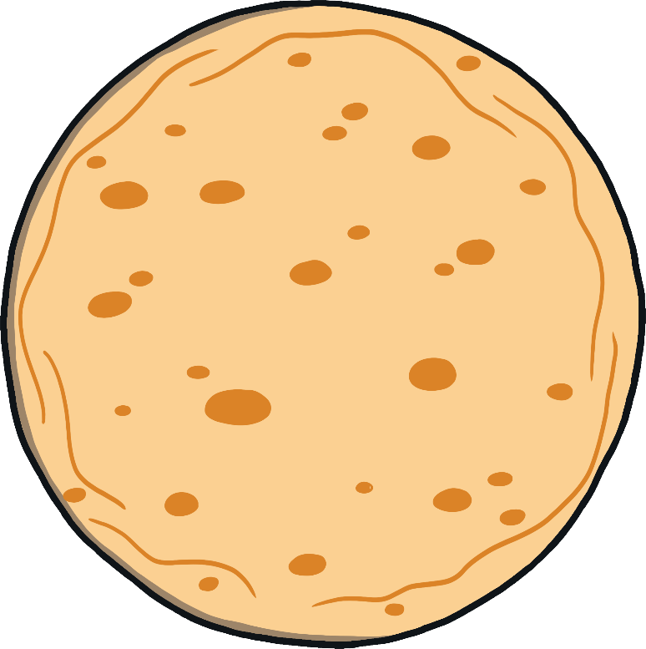
Starter Activity
  What do you know about Shrove Tuesday?
Think, pair, share your ideas.

Slide 4



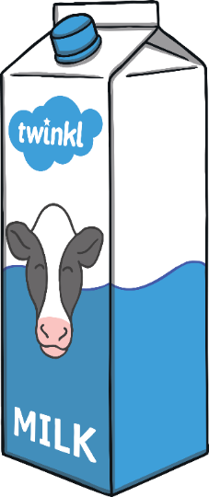
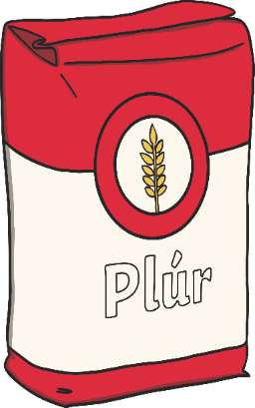
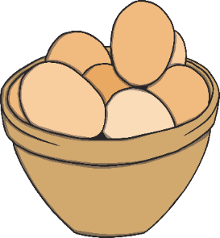
A Few Facts
Shrove Tuesday is also known as Pancake Day.
Lent is the Christian period leading up
to Easter, when people often give
up something.
It is the last day before Lent begins.
  In the past people were not allowed to eat foods such as eggs, so to use them before Lent began, people would mix them with other rich foods such as milk, flour and butter to make pancakes.

Slide 5
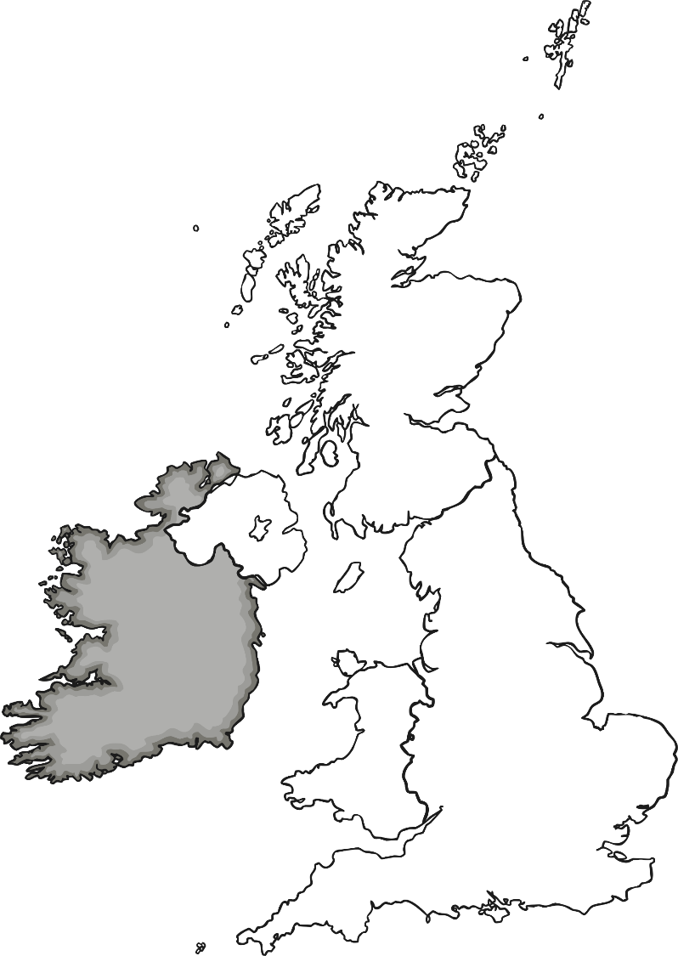
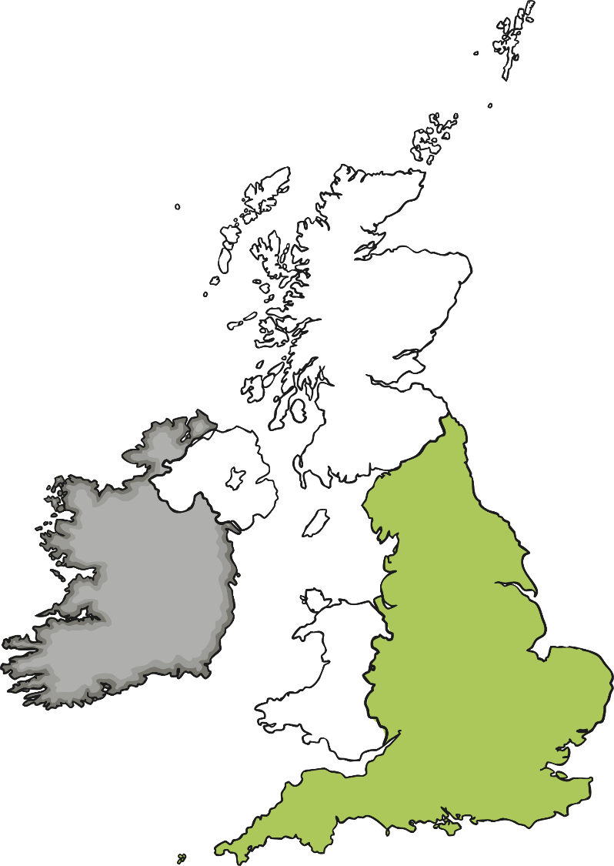
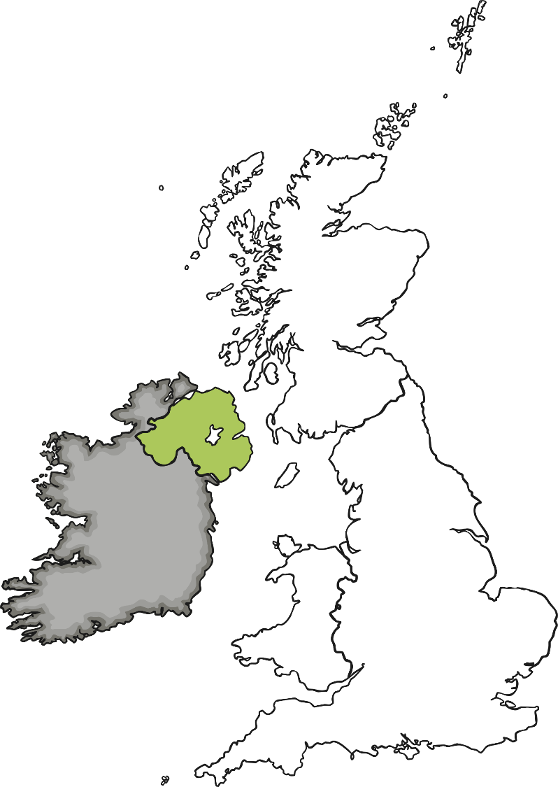
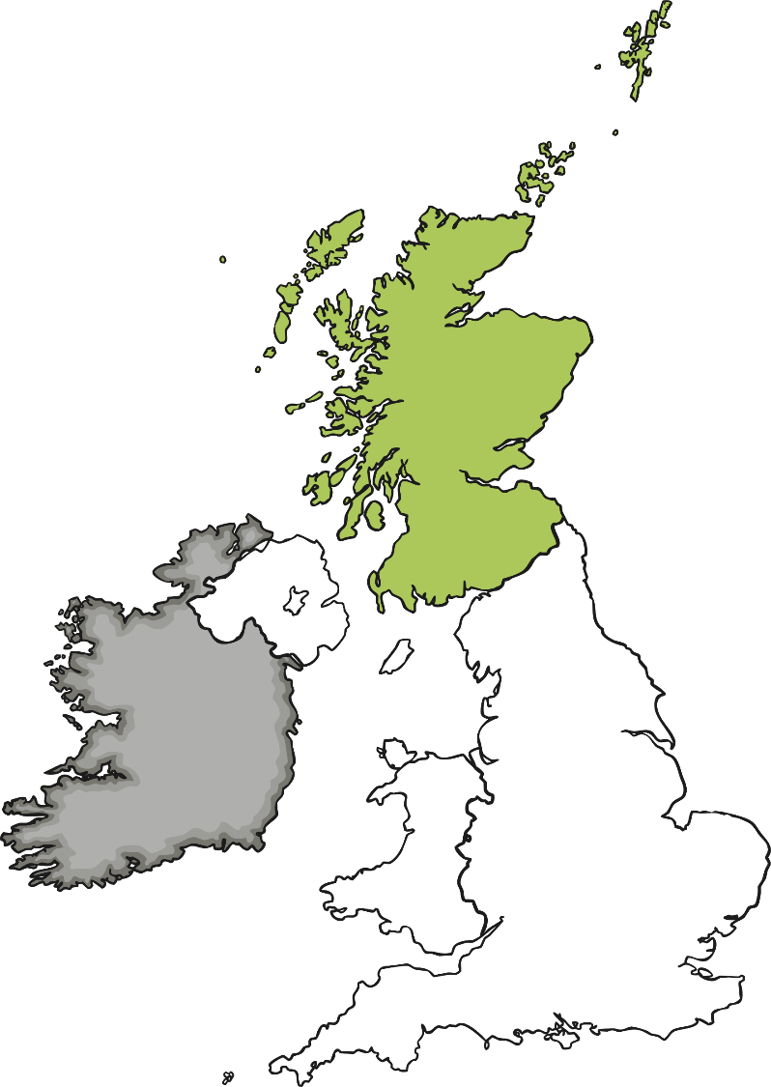
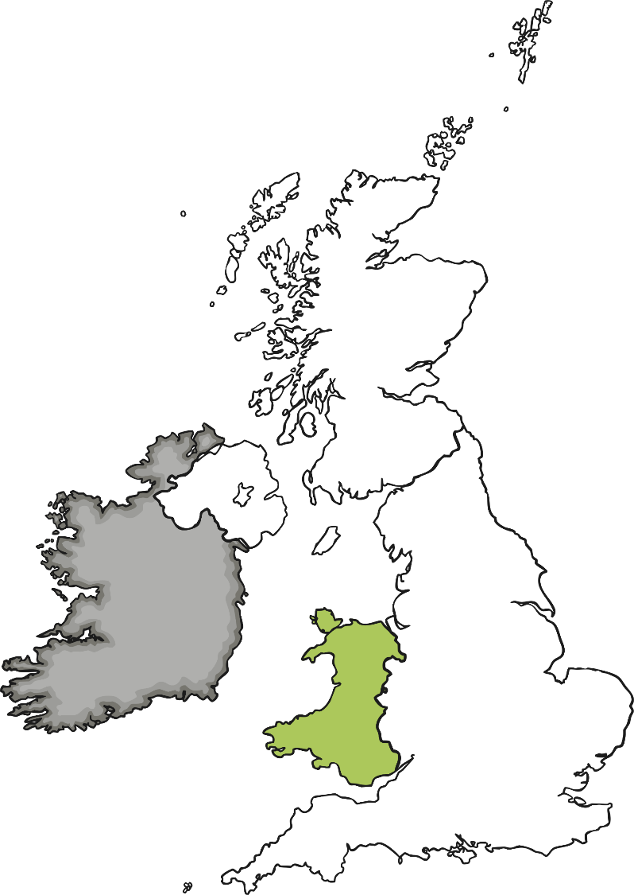
Shrove Tuesday around the UK
  What are the four countries of the United Kingdom?
Scotland
Think, pair, share your ideas.
Northern Ireland
England
Wales

Slide 6

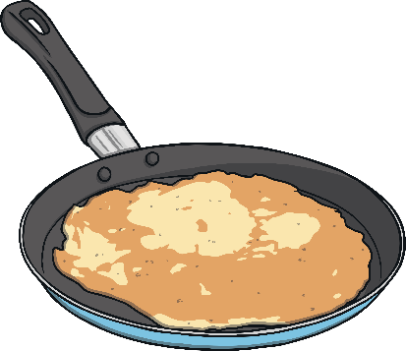
Northern Ireland
In the past, pancakes were cooked over a fire, which families
and friends would gather around, eager to enjoy the food.
The eldest unmarried daughter of the
family would toss the first pancake.
It was thought that if she tossed
it and it landed back in the pan
she would be married that year,
but if it didn't turn over when
tossed or she dropped it, she
would stay single.

Slide 7

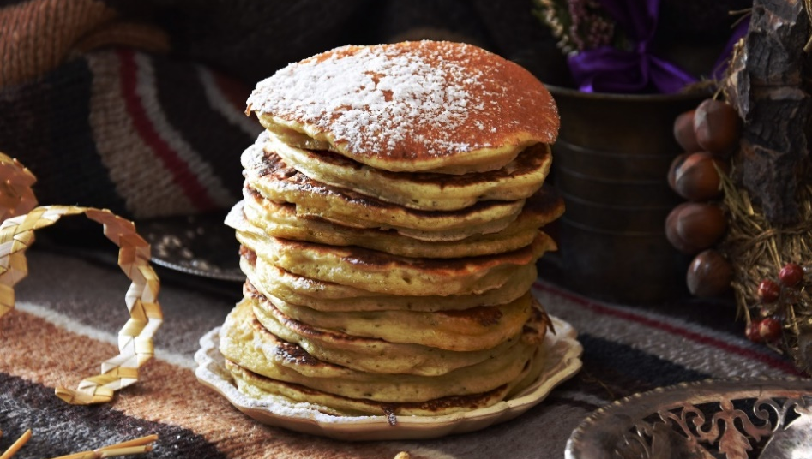
Scotland
Scottish pancakes are much smaller and thicker than traditional pancakes which are often made in England.
In some parts of Scotland they are called “drop scone” or “dropped scone.”

Slide 8

Wales
On the evening before Shrove Tuesday, in some parts of Wales tin cans were kicked up and down the streets.
It is thought this was to remember the task of putting away all the pots, pans and utensils used to make the tastier food that was not allowed to be eaten during the period of Lent.
Crempogs, also known as ffroes, are thicker than the traditional English-style pancakes often eaten on Pancake Day.
Traditionally, they were cooked on a cast-iron bake stone, griddle or ‘planc’.

Slide 9

England
One of the most famous pancake races takes
place in Olney in Buckinghamshire, England.
According to tradition, in 1445 a woman living in Olney heard the church bell while she was making pancakes and, not wanting to be late for the service, ran to the church in her apron, still holding her frying pan!
Today, women who live in Olney take part in
the race, wearing an apron and a hat or scarf
and of course carrying a pan containing a pancake.
They must flip their pancakes three times during the race. The first person to cross the finish line at the church and receive a kiss from
the verger wins the race!

Slide 10

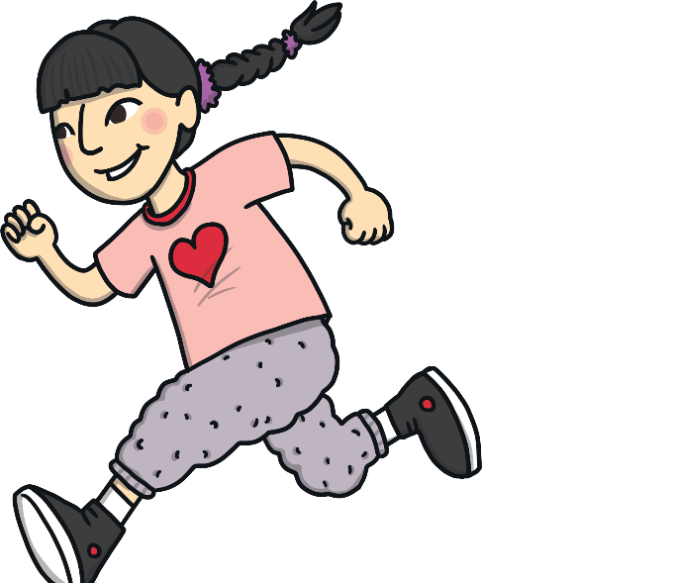
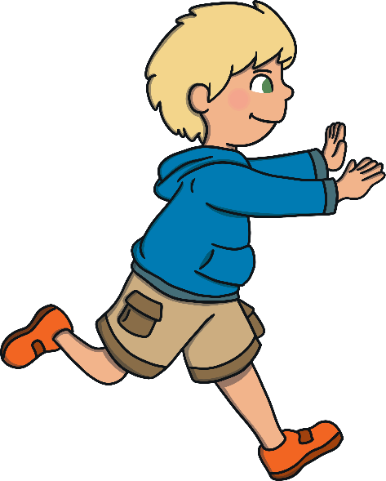
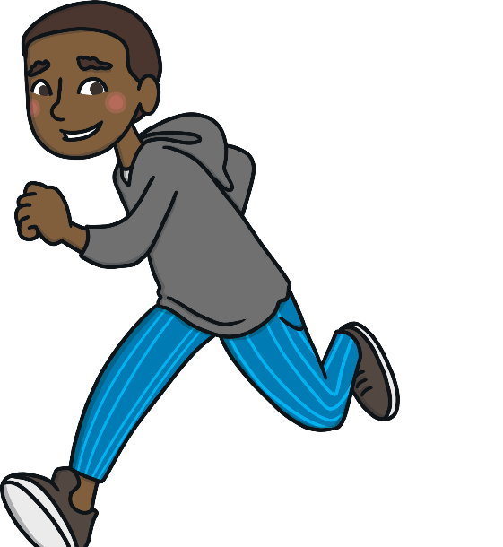
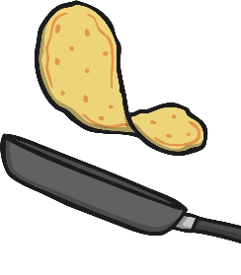

Pancake Races
Across the United Kingdom, pancake races
have often been part of the celebrations.
People run (often dressed in costumes or fancy dress) whilst
tossing a cooked pancake in a frying pan at the same time.
The first person to cross the finish line is the winner.

Slide 11
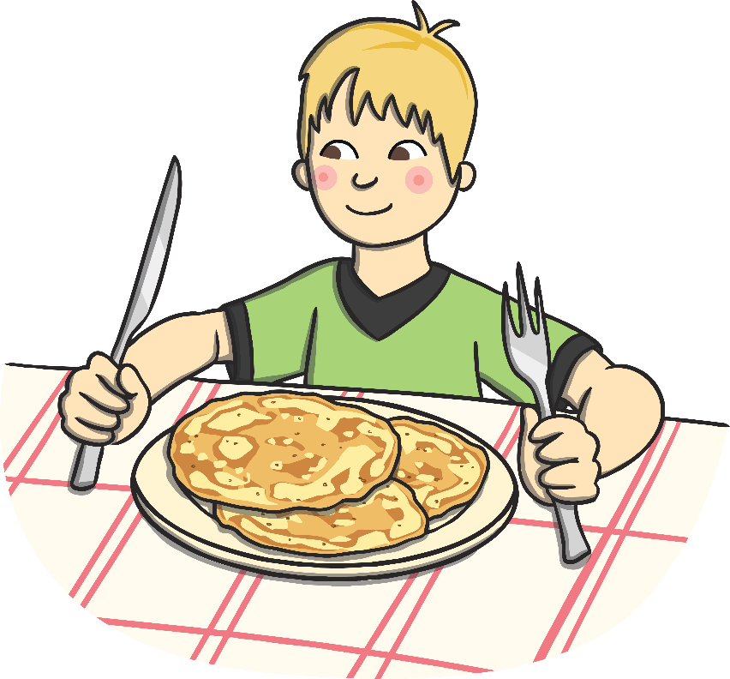
Quiz Time!
How many can you get right?

Slide 12

1
When is Shrove Tuesday?
A
The day before Christmas day.
B
It is the last day before Lent begins.
C
The first day of the year.
D
The last day of the year.

Slide 13
2
How many countries are
in the United Kingdom?
A
2
B
6
C
1
D
4

Slide 14
3
In some parts of Scotland, what
are Scotch pancakes also known as?
A
fairy cakes
B
drop scones
C
biscuits
D
flapjacks

Slide 15
4
What were Welsh crempogs
traditionally cooked on?
A
tray
B
saucepan
C
cast-iron bake stone, griddle or ‘planc’.
D
shelf

Slide 16
5
During a traditional pancake race
what would contestants usually do?
A
run whilst tossing their pancakes in a pan
B
stand still
C
eat all of the pancakes
D
cook pancakes

