Slide 2



What Is a Random Act of Kindness?
Click Here to Play Video
Teacher note - Please do not let the next video automatically play at the end of the clip.
Twinkl accepts no responsibility for the content of third party websites.

Slide 3
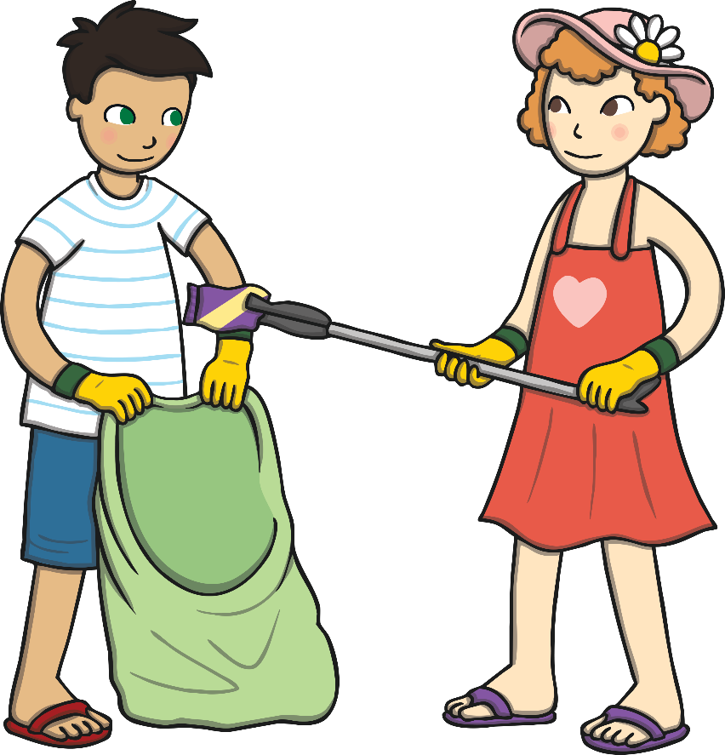
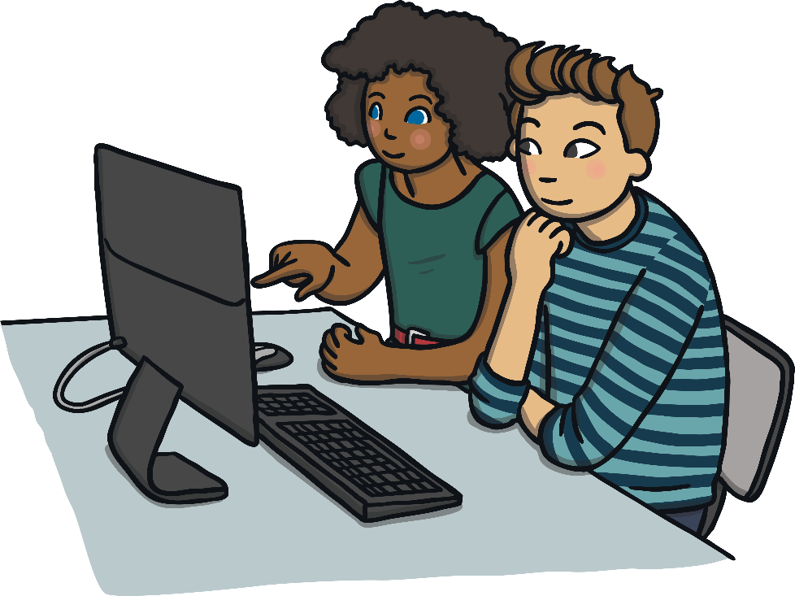
Definition
A random act of kindness is a selfless act which can either help or cheer up a person for no reason other than to make people happier.
You will need
Whilst children are entering the room, you may like to randomly hand out sticky notes containing simple positive messages to both teachers and students, e.g. ‘You rock!’, ‘You are amazing!’, without giving any explanation to the person you are handing it to.

Slide 4

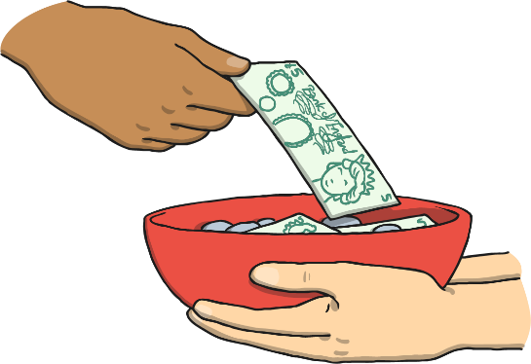
What Is ‘Kindness’?
Kindness is:
being friendly, generous and considerate of others;
showing good will to others;
being concerned when others are upset or worried;
helping people when they need you;
doing something nice for someone else, without expecting anything in return.

Slide 5
One A Day – What Could I Do?
Let somebody else go first.
Share your snack.
Draw someone a picture.
Leave a positive sticky note for someone.
Hold a door open for somebody.
Compliment someone.
Donate toys or clothes to charity.
Wash the dishes without being asked.

Slide 6
Why Be Kind?
Being kind to someone can make them feel happy and it can also make you feel good about yourself too.
By being kind, you can help to make the world a happier place whilst earning the respect of others.

Slide 7
Reflection
What will you do today to make someone else feel happy?

