Slide 1
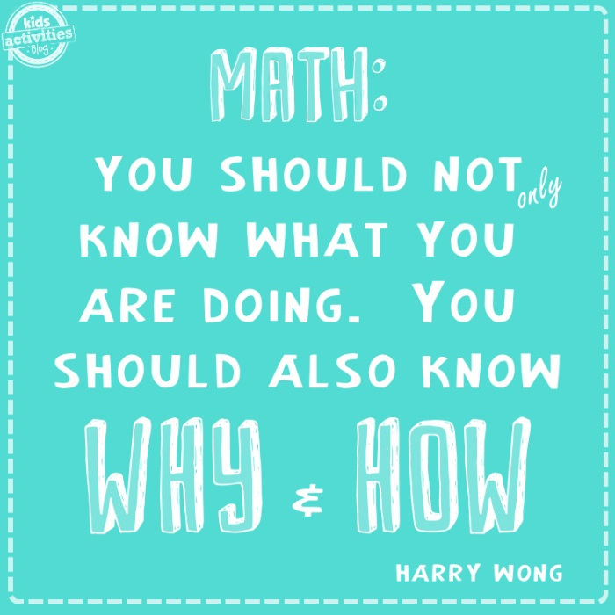
Welcome to our
Maths workshop
https://www.facebook.com/examath/videos/old-math-vs-new-math/1120988625315980/

Slide 2
Session Aims
What does maths look like at Stanley St Andrew’s?
How is maths taught at Stanley St Andrew’s?
How can children be supported at home?

Slide 3
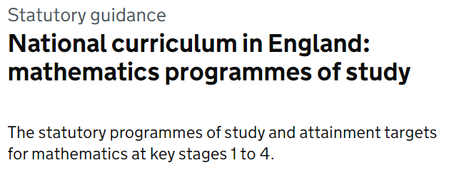
What does Maths learning look like at Stanley St Andrew’s?
Allows children to be exposed to a variety of different types of learning and to ensure coverage of fluency, problem solving and reasoning in different formats to ensure that our maths curriculum is rich and varied.
Notes:
What do we want to achieve with each child when the children start in Reception in terms of reading. Thinking about their journey from Reception to Year 6 and beyond.

Slide 4
The link below will take you to the programmes of study for each year group. This shows you what your child will be learning when at school and what a child of that age is expected to achieve by the end of the year (Age Related Expectations).
What are the National Curriculum Programmes of Study?
National Curriculum Programmes of Study for Key Stage 1 and Key Stage 2
Notes:
What do we want to achieve with each child when the children start in Reception in terms of reading. Thinking about their journey from Reception to Year 6 and beyond.

Slide 5
What does Maths learning look like at Stanley St Andrew’s?
Here are examples of children’s
Notes:
Phonics is a process of teaching children to correlate its individual sound (phoneme) with its corresponding letter or letter group (grapheme). It teaches children how to decode letters into their respective sounds. A skill which is essential for children to read unfamiliar words by themselves. Keep in mind that most words are unfamiliar to early readers in print, even if they have spoken knowledge of the word.

Slide 6
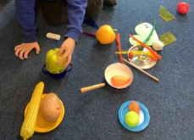
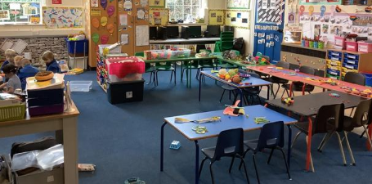
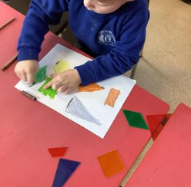
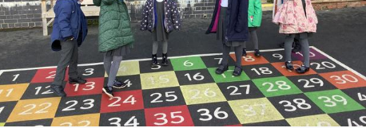
What does Maths looks like in EYFS?
Learning through play.
Outdoor activities.
Counting, counting and more counting!
Pattern spotting
Number recognition and ordering to 10.
Learning numbers bond up to 10.
Shape recognition, 2D and 3D.
Addition and subtraction using single digit numbers.

Slide 7
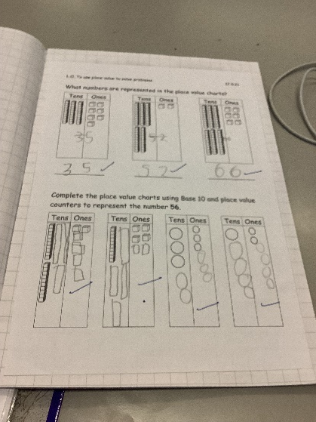
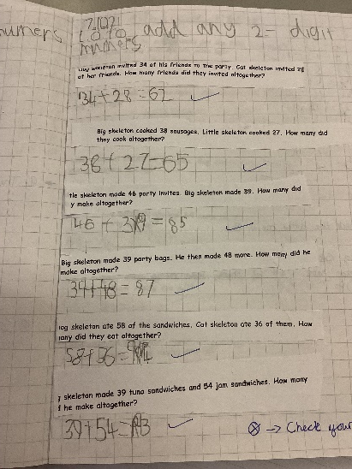
What does Maths look like in Year 2?
Add and subtract within 100 by applying one-digit addition and subtraction facts. To add and subtract any 2 two-digit numbers.
Practical learning using a variety of resources.
To read the time to the nearest five minutes
Recognise the place value of each digit in two-digit numbers.
To describe the properties of 2D and 3D shapes and compare shapes by their properties
Recognise the subtraction structure of ‘difference’ and answer questions such as “How many more…?”.
Secure fluency in addition and subtraction facts within 10.

Slide 8
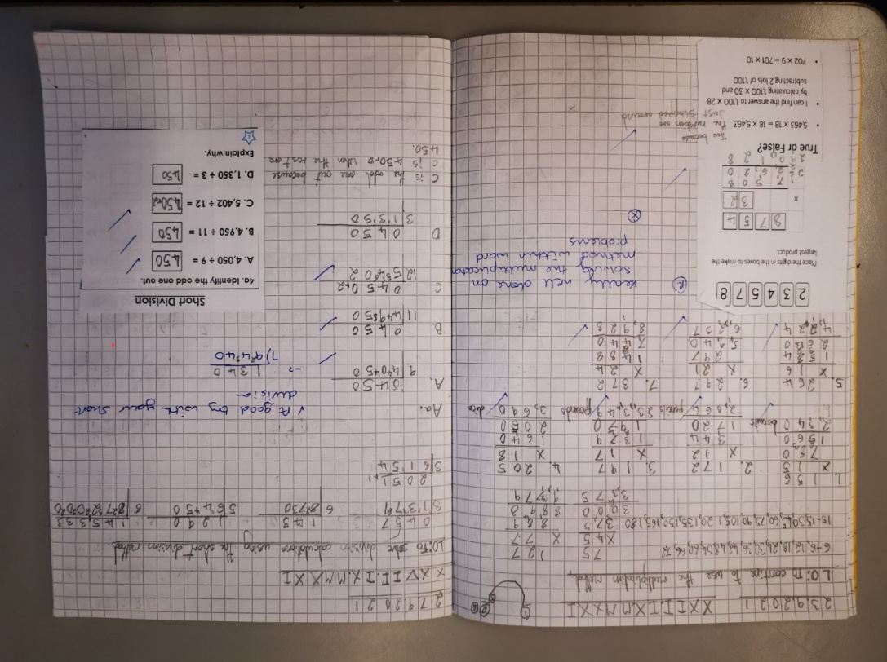
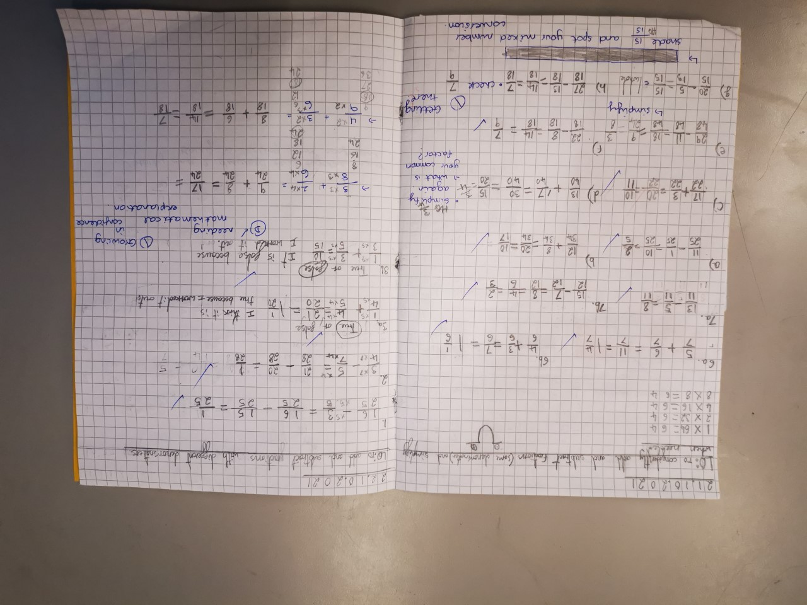
What does Maths look like in Year 6?
Rapid and accurate recall of ALL times tables
Draw, compose and decompose shapes according to given properties, including dimensions, angles and area
Find equivalent fractions, decimals and percentages
Solve problems involving ratio relationships
Solve multi-step word problems
Recognise the place value of each digit in numbers up to 10 million, including decimal fractions
Algebra
To consolidate the formal written methods and use alongside efficient mental strategies
Use common factors and multiples to simplify fractions. To securely use all four operations when calculating with fractions (+ - x ÷)
Working with numbers beyond 6 and 7 digits
Systematic and methodical workings
Draw upon a variety of mental maths strategies to support arithmetic skills

Slide 9
Calculation Policy
Our calculation policy is in line with the programmes of study taken from the National Curriculum for Mathematics (2014).
It is designed to be challenging, focussing on essential core subject knowledge and skills.
This document guides you through the appropriate calculation methods within each year group and the progression of skills throughout the school.
The content of this document is set out in year group blocks under the following headings: addition, subtraction, multiplication and division.
https://primarysite-prod-sorted.s3.amazonaws.com/st-andrews-churchofe-primary-school/UploadedDocument/c8dae0fad7494bb996ef5b99d29c8d1b/maths-calculation-policy-july-2021.pdf
primary_maths_dictionary_tsl.pdf (primarysite-prod-sorted.s3.amazonaws.com)
Notes:
Phonics is a process of teaching children to correlate its individual sound (phoneme) with its corresponding letter or letter group (grapheme). It teaches children how to decode letters into their respective sounds. A skill which is essential for children to read unfamiliar words by themselves. Keep in mind that most words are unfamiliar to early readers in print, even if they have spoken knowledge of the word.

Slide 11
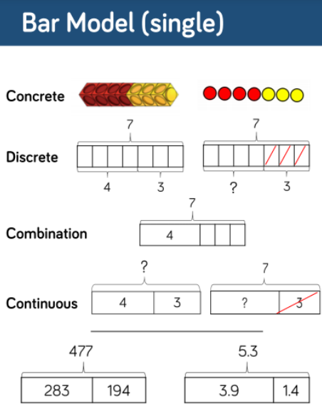
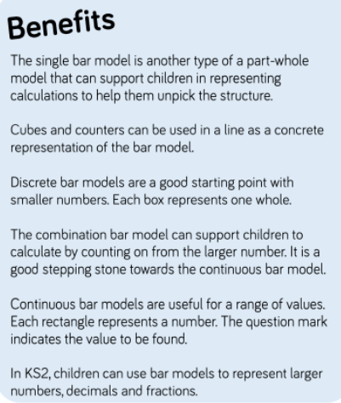

Slide 12
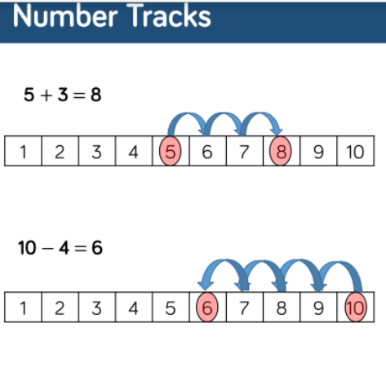

Slide 14
Questioning and Talk
https://primarysite-prod-sorted.s3.amazonaws.com/st-andrews-churchofe-primary-school/UploadedDocument/c8dae0fad7494bb996ef5b99d29c8d1b/maths-calculation-policy-july-2021.pdf
The definition of metacognition is thinking about one’s thinking. More specifically, being metacognitive helps kids understand their own learning process.

Slide 15
Questioning and Talk
https://www.bbc.co.uk/bitesize/articles/zfpfp4j
JUST FOR FUN
Your turn now
https://www.bbc.co.uk/bitesize/articles/zfpfp4j
You can work with the person next to you

Slide 16
Reasoning and Problem Solving

Slide 18
Reasoning is…
The action of thinking about something in a logical, sensible way

Slide 19
Progression in Reasoning

Slide 20
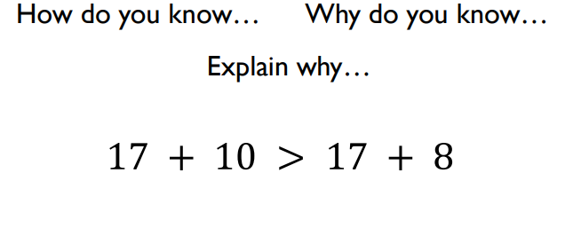
What is the same? What is different?

Slide 25
Using estimation and number bond knowledge will help your child solve this problem.

Slide 26
How can you help your child with Maths at home?
Take away their fear.
Reassure and praise whenever possible. Positive mindset…
Let them see you using Maths in your everyday routines – portioning meals between the family, chopping vegetables into halves and quarters etc.
Play with numbers and shapes through games.
Recognising the importance and value of Maths in our everyday lives e.g. managing money and telling the time.

Slide 27
Maths at Stanley St Andrew’s Resources that I can use at home to support my child’s maths understanding and learning.

Slide 28
CPA Approach
Importance of Resources
C is for concrete. New concepts are introduced through the use of physical objects or practical equipment. can include ordinary household items such as straws or dice, or specific mathematical resources such as dienes or Numicon.
P is for pictorial. Once children are confident with a concept using concrete resources, they progress to pictorial representations. Benefit from the visual support the resources provides.
A is for abstract. Once children have a secure understanding of the concept they are then able to move on to the abstract stage. Here, children are using symbols to solve problems. To be able to access this stage effectively, children need access to the previous two stages alongside it.

Slide 29
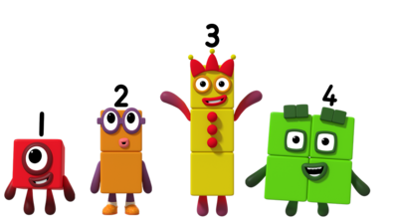
Resources you can use at home
Notes:
Maths dictionary for parents is really useful!

Slide 30
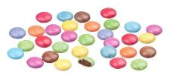
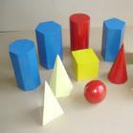
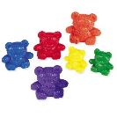
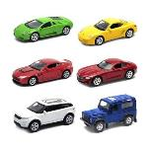
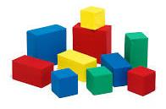
Alternatives to maths resources
Counters or you could use…… Smarties
3D shapes or you could use…… groceries
Counting Bears or you could use…… anything you have a lot of!
Notes:
Maths dictionary for parents is really useful!

Slide 31
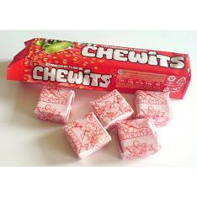
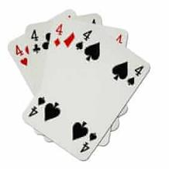
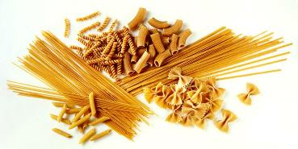
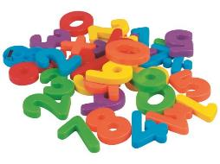
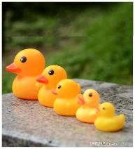
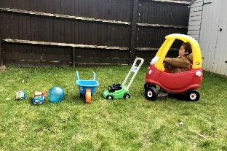
You can use anything you have around the house
Cards for number
recognition and counting
Chewits for counting
Pasta for counting
Toys to put in size order
Magnetic numbers for
number recognition
Notes:
Maths dictionary for parents is really useful!

Slide 32
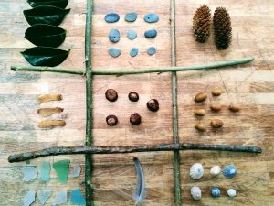
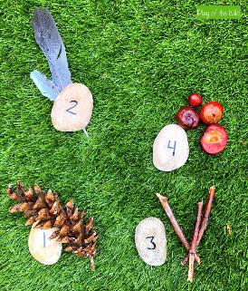
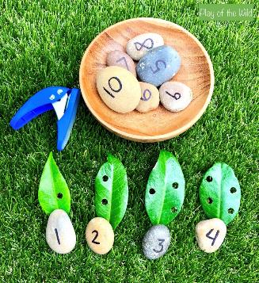
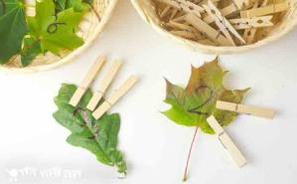
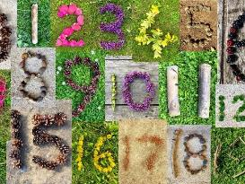
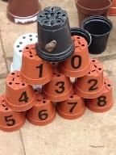
Don’t Forget Outside
Notes:
Maths dictionary for parents is really useful!

Slide 33
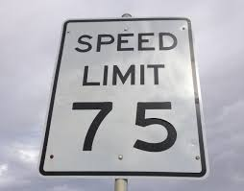
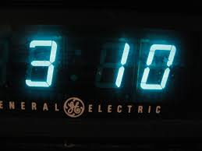
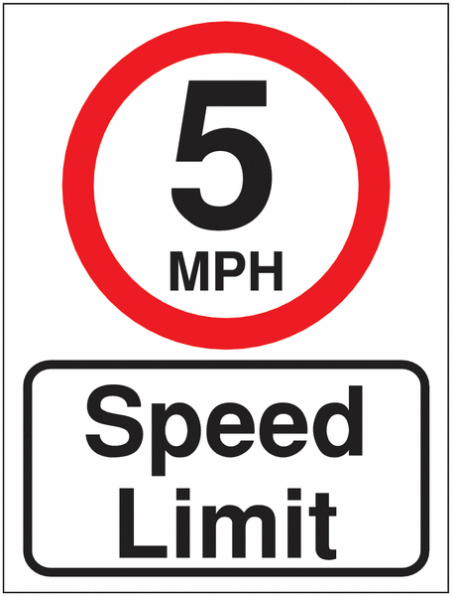
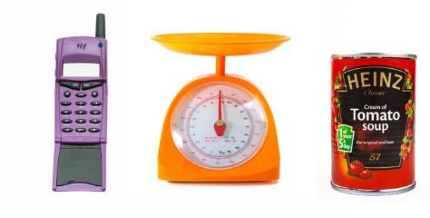
Numbers are all around us!
Notes:
Maths dictionary for parents is really useful!

Slide 34
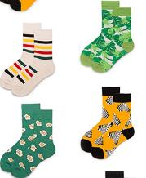
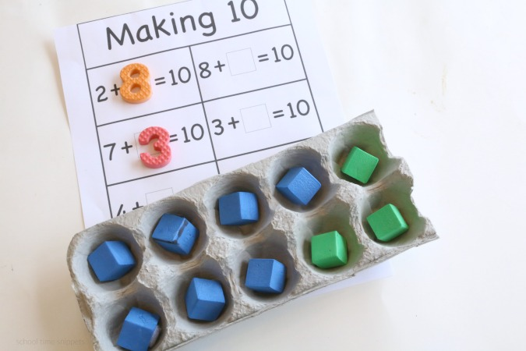
Counting in 2s and 10s
Numicon or you could use…… socks
Numicon or you could use…… gloves
Notes:
Maths dictionary for parents is really useful!

Slide 35
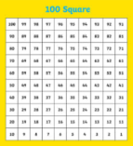
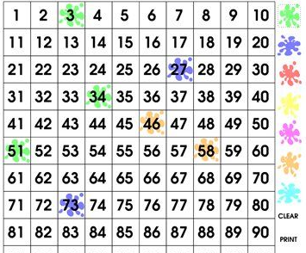
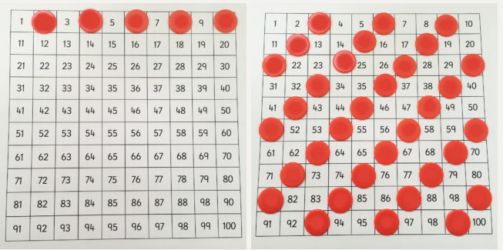
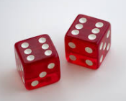
Numbers
100 Square or you could use 100 square splat online game
Games you could play:
Cover Up: Cover up one or more squares using counters. The child has to guess which numbers are hidden under the counter/s.
Patterns: Cover the multiples of 2, 3, 5 and 10 etc (one multiple at a time). Use the patterns to predict which numbers will be in the sequence.
Dice or you could use an Online Dice
Games you could play:
Use dice to help your child recognise numbers at speed.
Knock Out: Each player chooses a “knock out number” – either 6, 7, 8, or 9. More than one player can choose the same number. Players take turns throwing both dice, once each turn. Add the number of both dice for the score. If a player throws a 6, 7, 8 or 9, they are knocked out of the game until the next round.

Slide 36
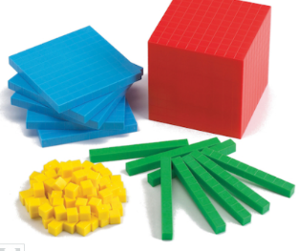
Addition/ Subtraction using sweets instead of dienes
In Year 2 we use dienes for addition/ subtraction. Instead of tens and ones resource you could use sweets (such as Chewits). A whole pack of Chewits are the tens and individual Chewits are the ones. E.g. 18 = 1 tens and 8 ones

Slide 37
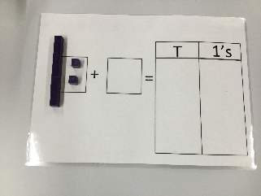
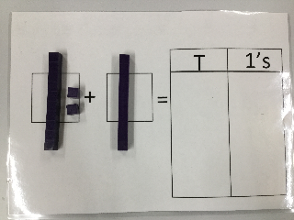
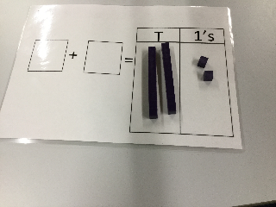
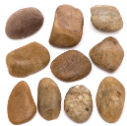
An example of an addition word problem being solved using dienes. This could be solved using sweets (e.g. Chewits)
Big skeleton goes to the shop to buy cakes. He buys 12 chocolate cakes and 10 cream cakes. How many does he buy altogether?
You could also use sticks as tens and stones as ones.

Slide 38
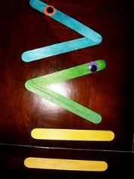
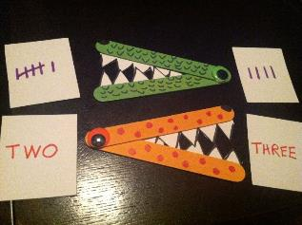
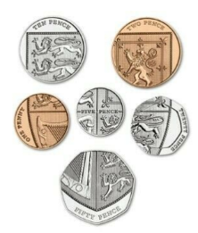
For greater or less than you could use…
For money work or problems you could use your own coins/ notes.

Slide 39
Handouts

