Slide 1
St Andrew's Church of England Primary School An intelligent heart acquires knowledge and the ear of the wise seeks knowledge. Proverbs 18:15
Our ECO committee

Slide 2
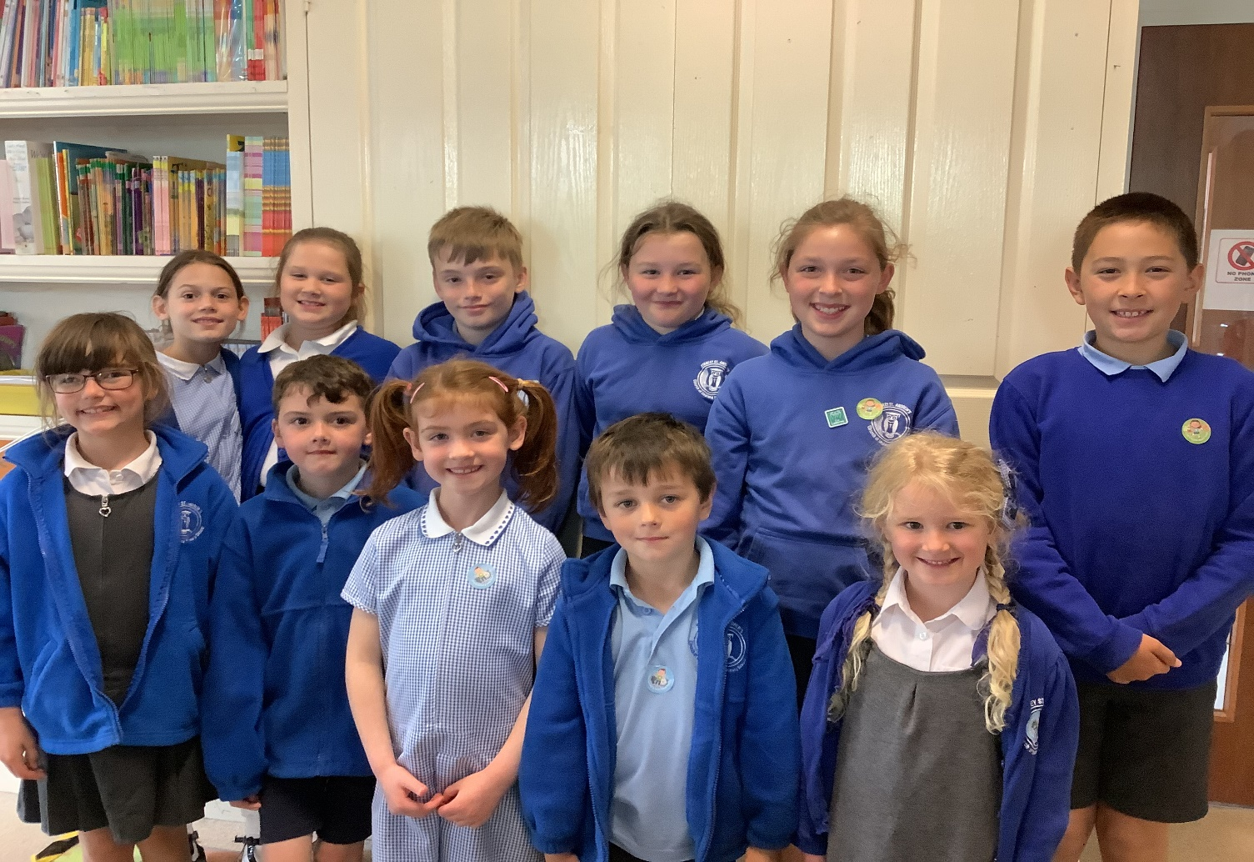
We are the eco committee.

Slide 4
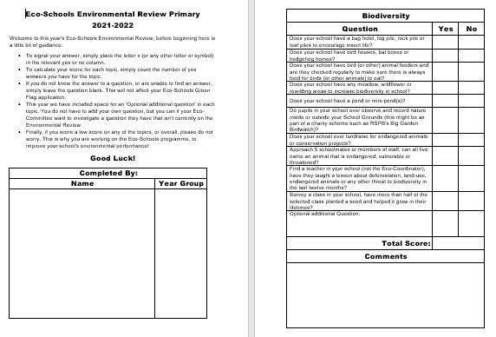

Slide 6
What can you do to help?
Any questions?

