Slide 1
The Macarena dance challenge
By Aimee (art ambassador)

Slide 2
Can you Macarena?
The Macarena is a really fun dance that you can do to loads of different songs!
Your challenge is to find as many songs as you can that you can do this dance routine to.
Get your adults to join in and see how many you can find.
Please send your videos to Mrs Adshead at
Puffins@st-andrews-pri.derbyshire.sch.uk

Slide 3
How to do the Macarena
Click on the photo and follow Aimee as she dances The Macarena.

Slide 4
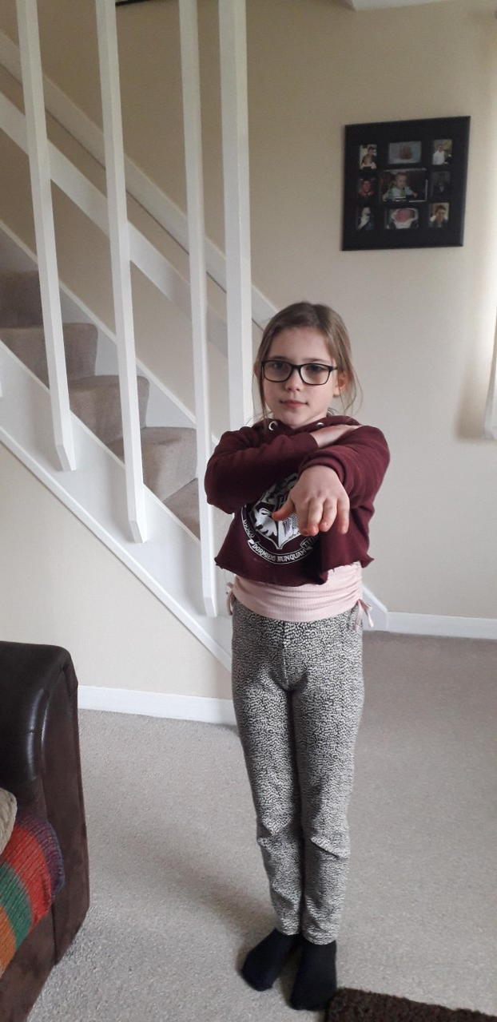
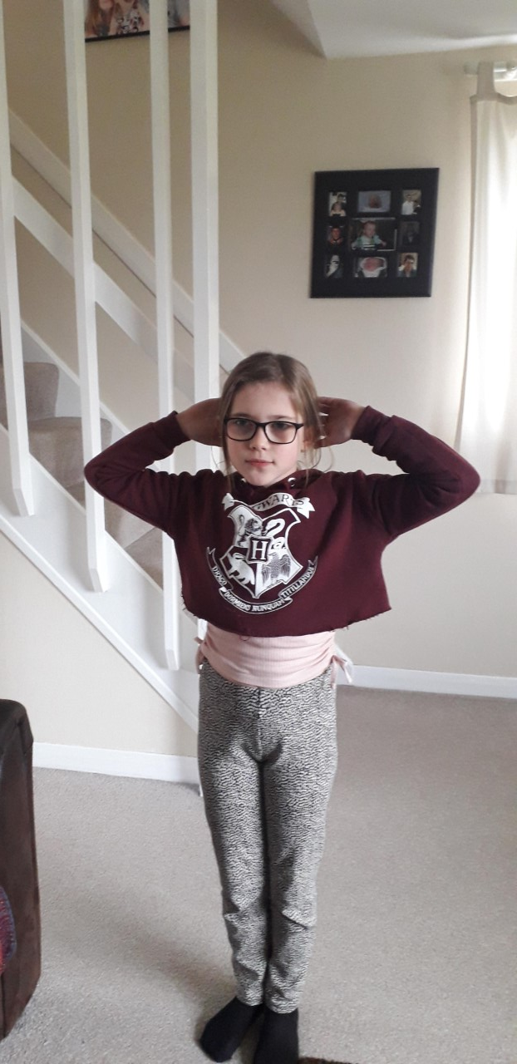
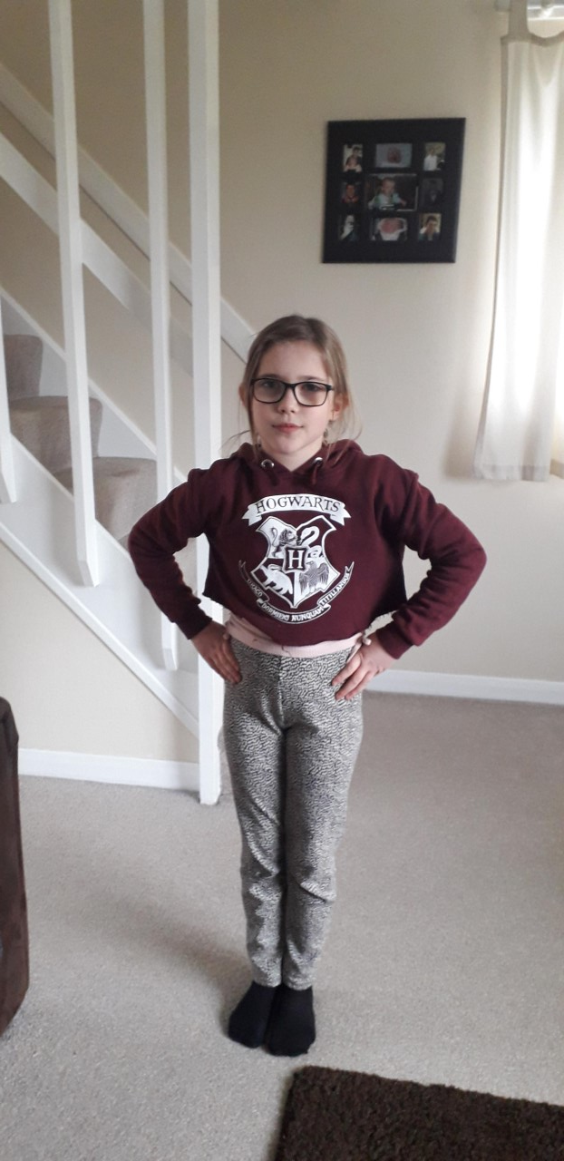
Here are my examples
1st song is Lady Gaga Born this way
2nd song is More than a feeling
3rd song is Riptide by Vance joy
Click on the photos to see Aimee dance to the different songs.

Slide 5
Have Fun!!!
Can’t wait to see your videos.
by Aimee (Art ambassador)

