Slide 1
Portfolio of photos “new beginnings”
Molly rowan, Golden eagles

Slide 2
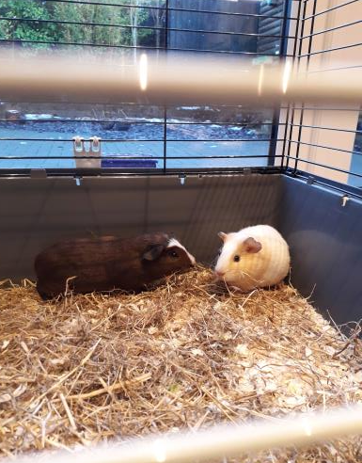
Coco and rocky
Our new guinea pigs

Slide 3
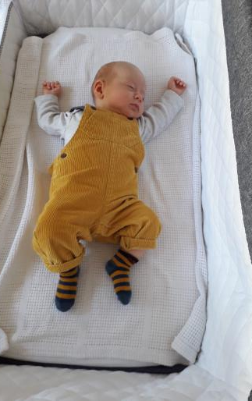
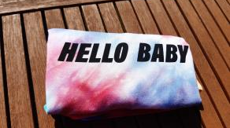
Babies being born
Cousins
Nephews
Grandchildren
new life

Slide 4
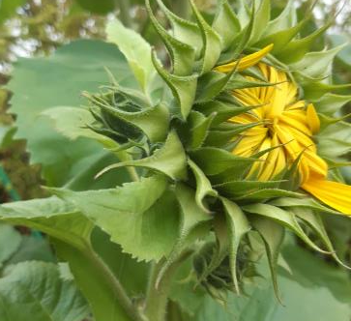
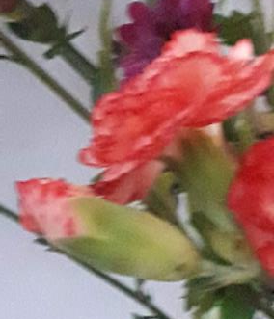
New flowers blooming
The beauty of nature

Slide 5
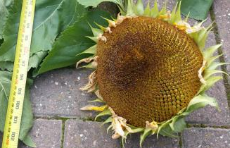
sunflowers
Reaching from tiny seeds
Get taller and taller
and brighten our world

Slide 6
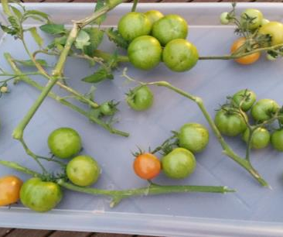
Vegetables growing
from colour to colour

Slide 7
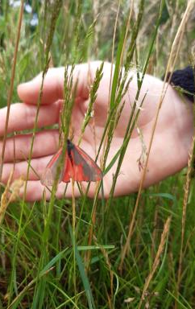
Butterflies inside and out
Growing from caterpillars and being released into the wild

Slide 8
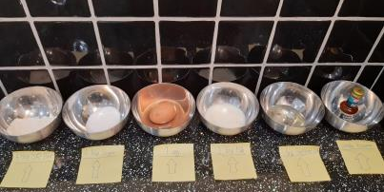
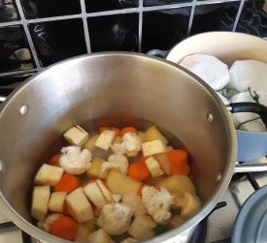
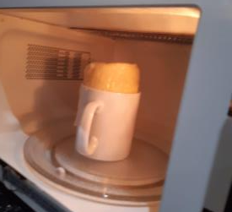
Baking new foods
Trying new things

Slide 9
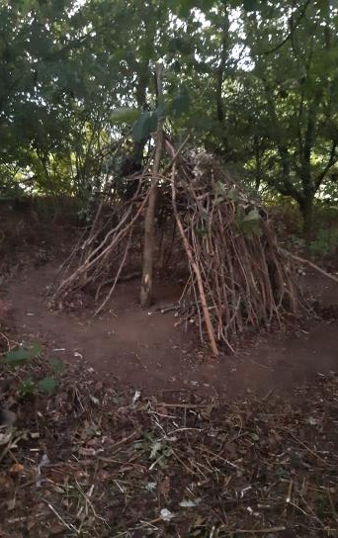
Building a den
A new chapter for fallen trees

