Slide 1
Stanley Village Community Association

Slide 3
Community
A group of people living in one place (Stanley, Oakwood)
A group of people or all ages with the same purpose.
A group of people with the same interest.

Slide 4
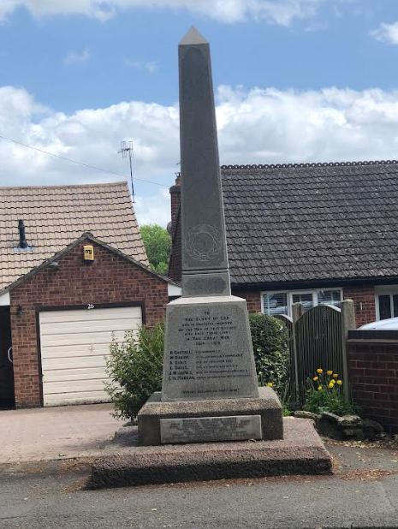
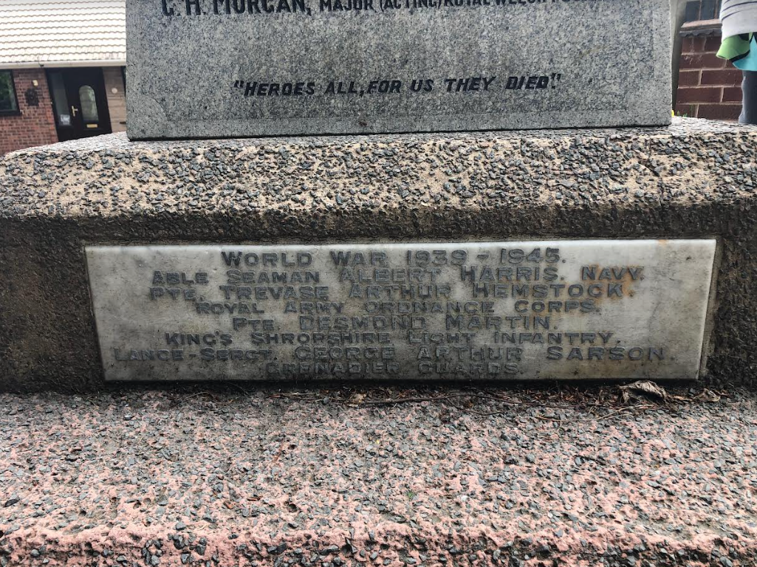
Stanley Gala Saturday July 2nd

Slide 5
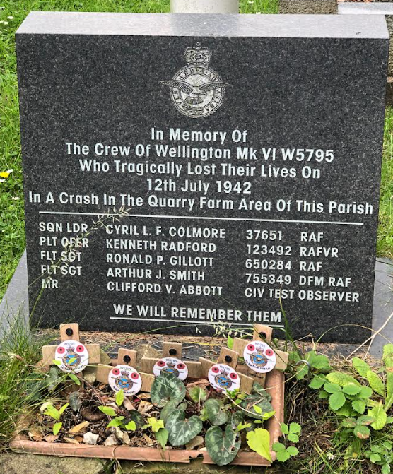

Slide 6
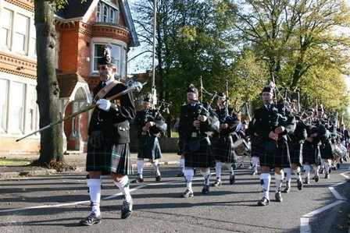
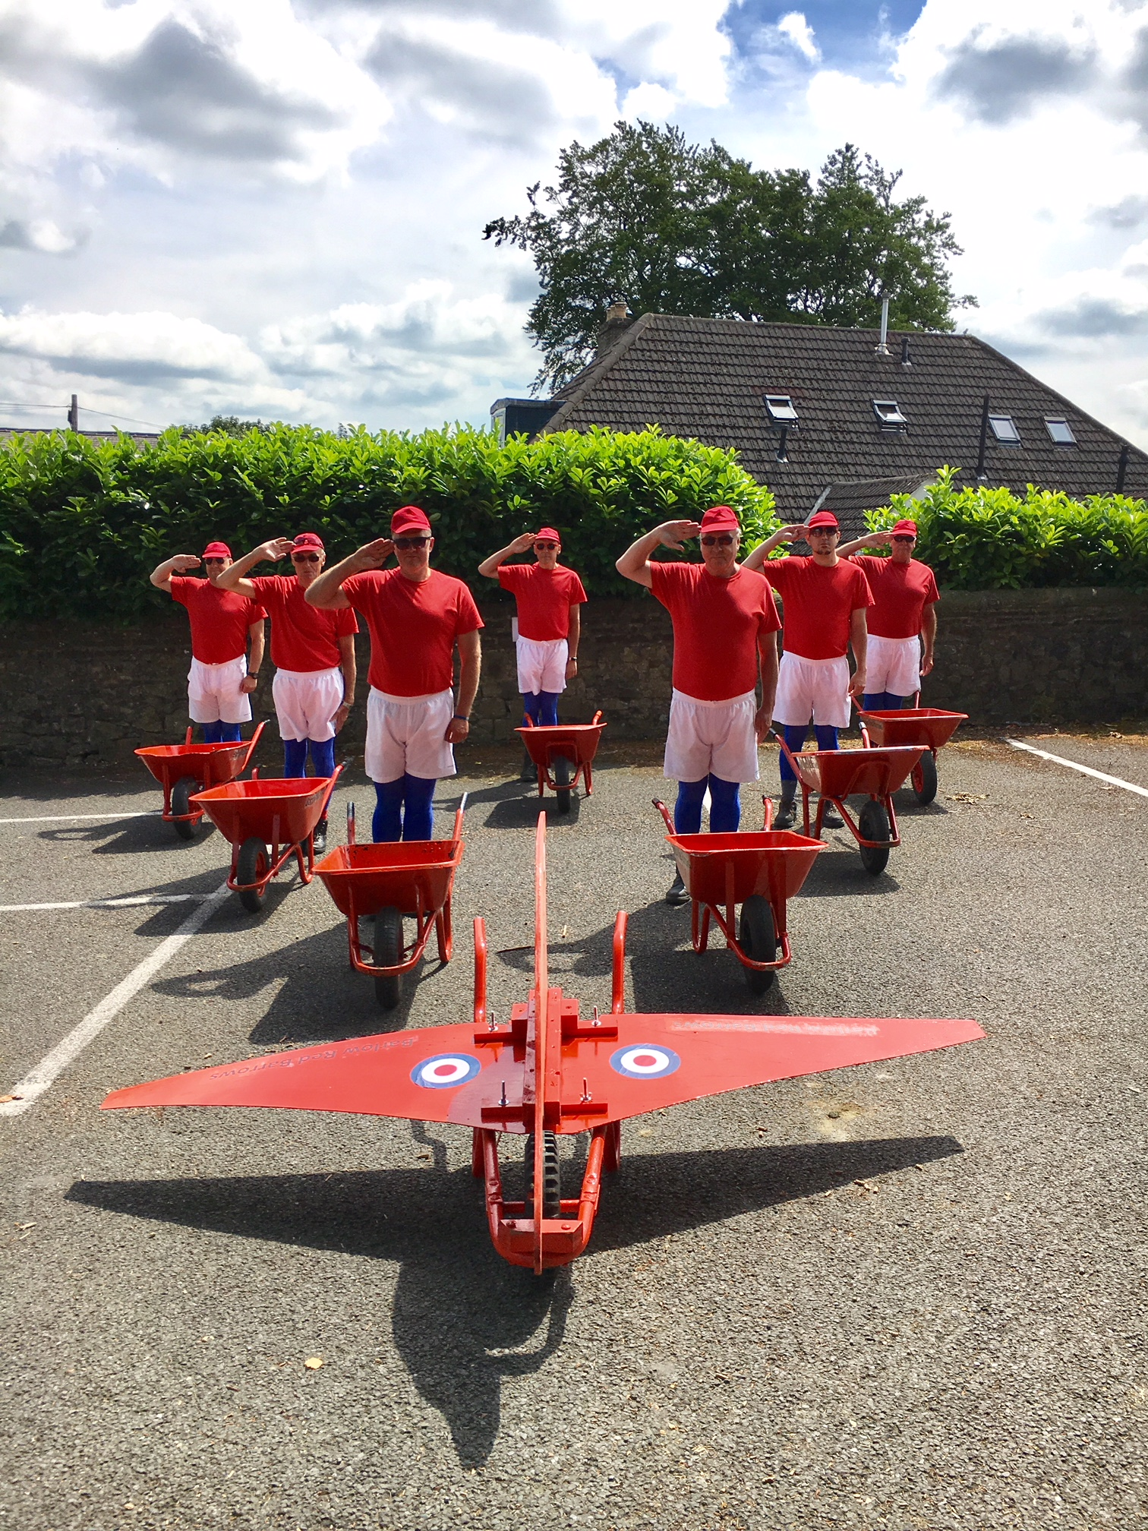
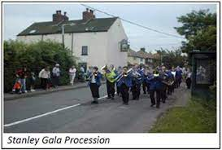
Parade
Fancy Dress Parade
Prizes to be won!
Seaforth Highlanders Pipe Band
Barlow Red Barrows

Slide 7
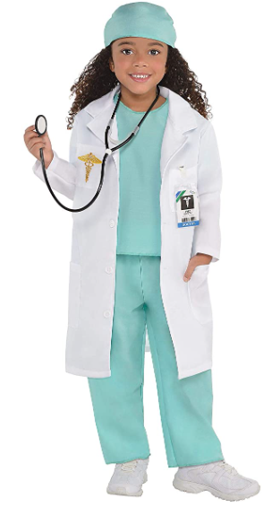
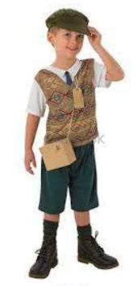
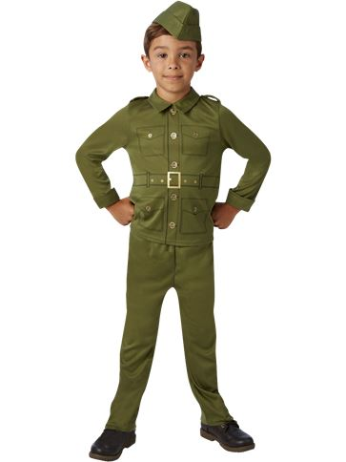
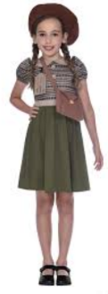
Fancy Dress Ideas

Slide 8
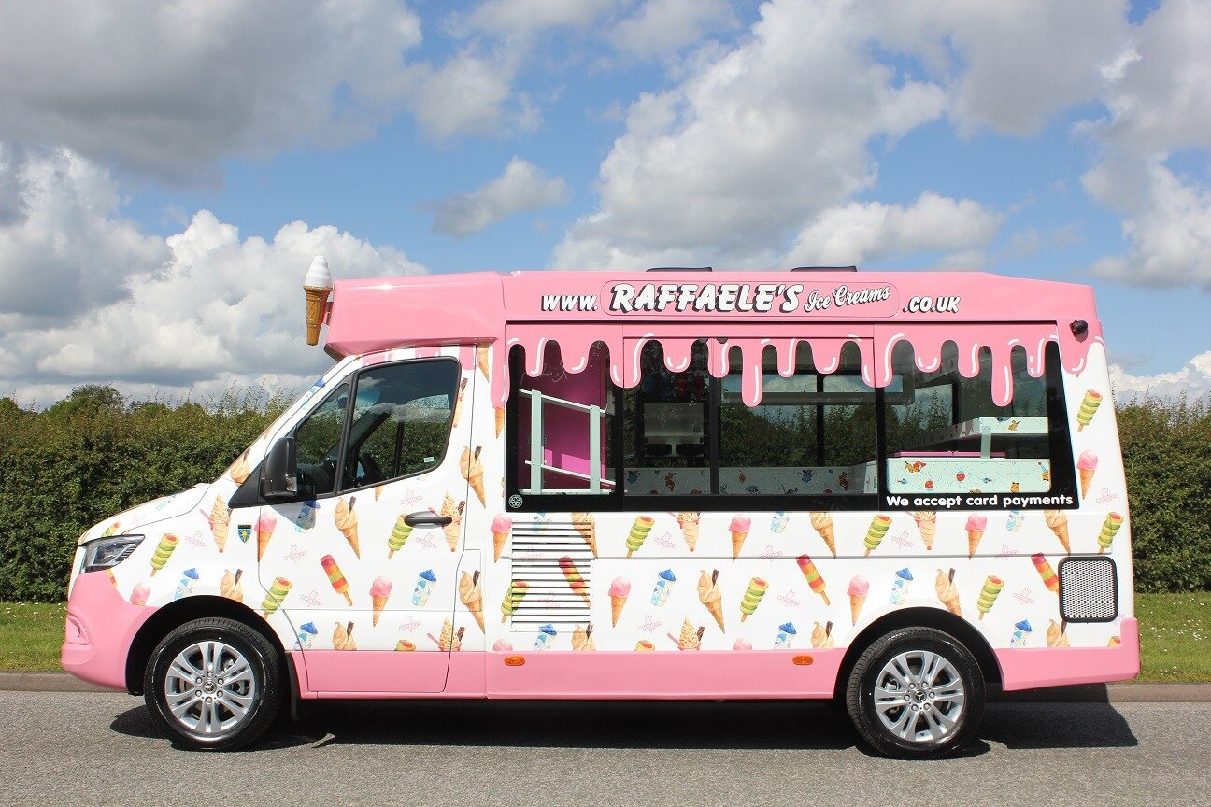
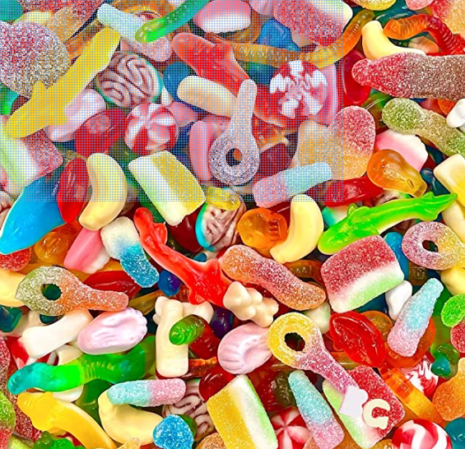
Events
Dog show
Acrobats
Red Barrows
Live band

