Slide 1
How to make a poem in a hand
By Molly

Slide 2
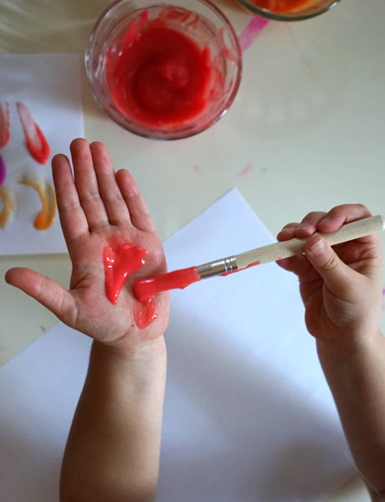
Step 1
First, find some paints(any type are fine but preferably acrylic) and brushes.
Select any colour of your choice and paint your hand with it.

Slide 3
Step 2
Find some paper(preferably plain white) and press your hand down anywhere you like.
You can repeat this step several times with different colours until you’re happy with your picture.

Slide 4
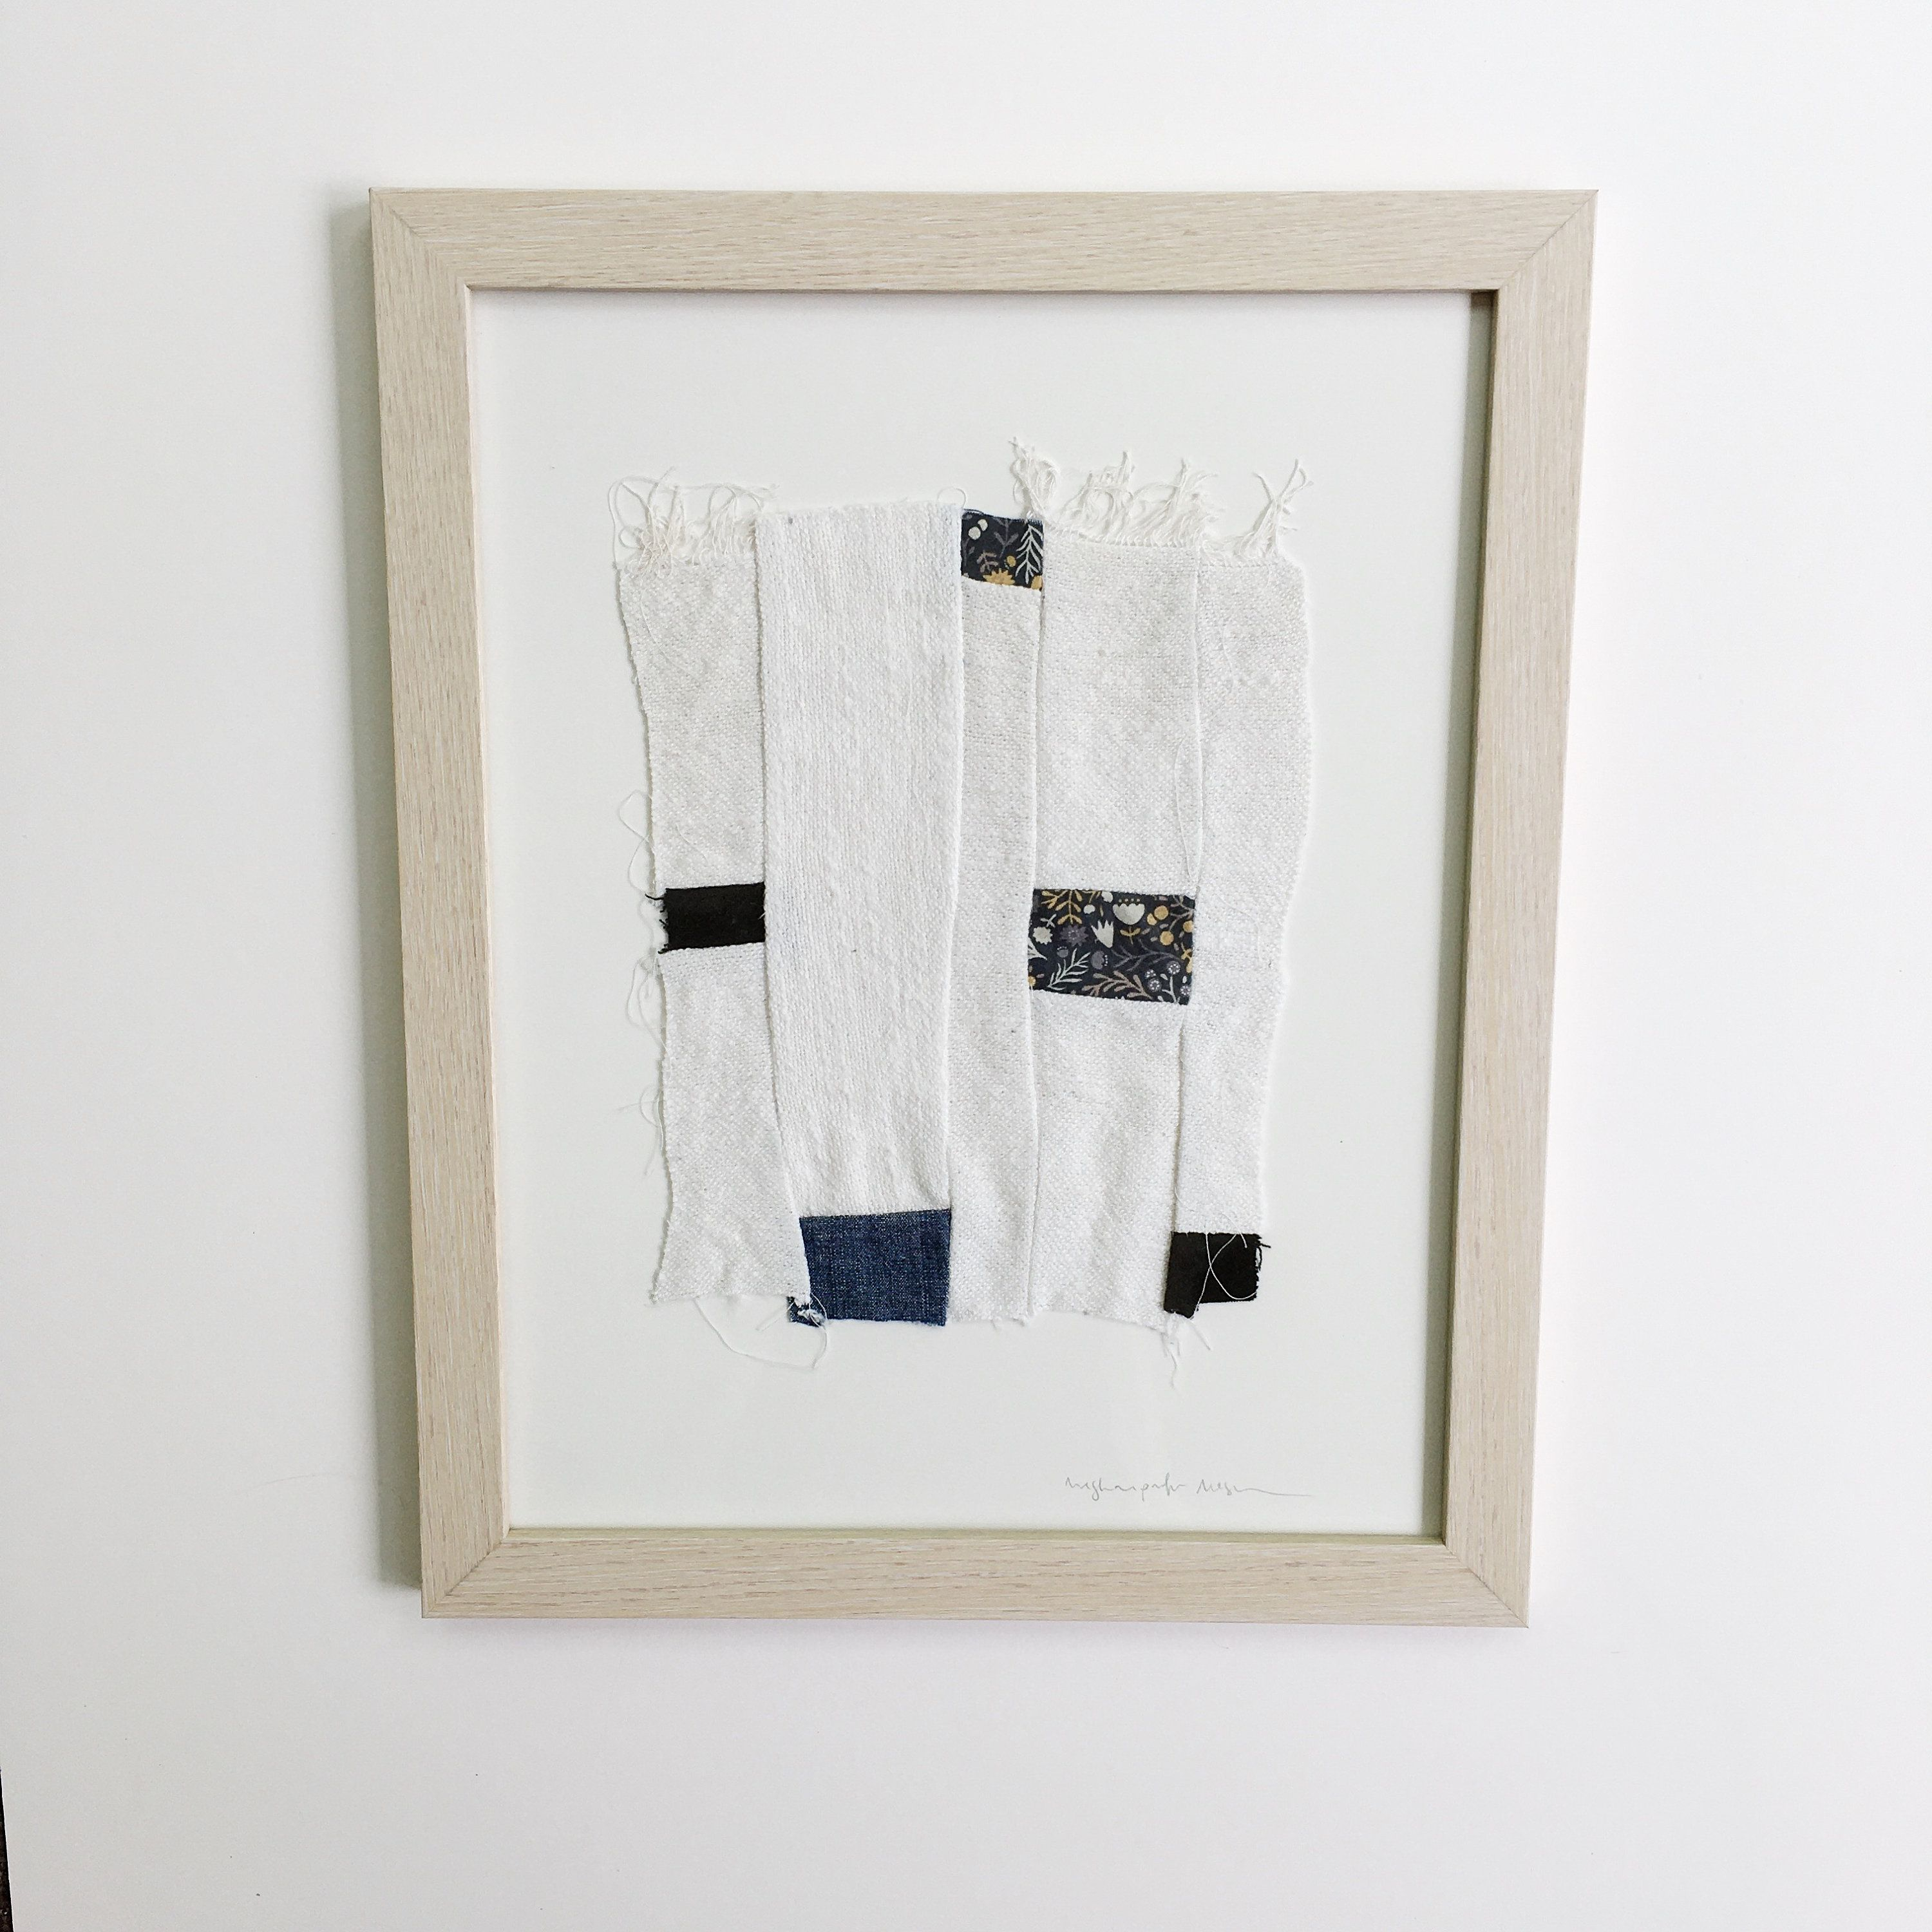
Step 3
Use a black paint or a dark pen or pencil to write a short poem/ positive message/or word anywhere you want on your picture then hang it up somewhere so people can see it.

Slide 5
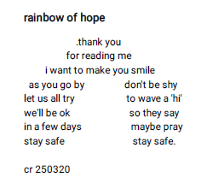
Step 4 choosing a poem
You can chose any type of poem, such as a limerick or a haiku, or something that can be read in different ways like the one below. A poem does not have to rhyme either!
Haikus are 3 lines long.
The 1st and 3rd have
5 syllables and
the middle line has 7
Pale green shoots of grass Bright hyacinths and tulips Soon cherry blossoms
Limericks are 5 lines long, the 1st, 2nd and 5th lines rhyme and the 3rd line rhymes with the 4th
An ambitious young fellow named Matt
Tried to parachute using his hat.
Folks below looked so small
As he started to fall,
Then got bigger and bigger and SPLAT!
-Graham Lester

Slide 6
BBC RaDIO DERBY: Make a Difference Campaign
@HebLongbottom works for the NHS and has written a poem, about daffodils.
https://twitter.com/BBCDerby/status/1362658174281474053
Join with BBC Radio Derby’s Make a Difference campaign.
Download your daffodil to colour here.
http://downloads.bbc.co.uk/england/radioderby/pdf/bbc-radio-derby-daffodil-black-and-white.pdf
Add your poem to the daffodil and display in a window. Send a photo of your daffodil to Puffins@st-andrews-pri.derbyshire.sch.uk for our website.

Slide 7
Thank you for watching!

