Slide 1
How to make a wand!!!
By Art Ambassador Aimee

Slide 2
Before we start...
Do you feel magical today?
Are you upset that you didn’t get your Hogwarts letter?
Or are you just bored?
Well, if you are, what about you have some fun and make you very own magical wand!
There are two ways to do this, one you can do solo, and the other you will need to get your adult to help.
Ok, lets get started!!!
Have fun!

Slide 3
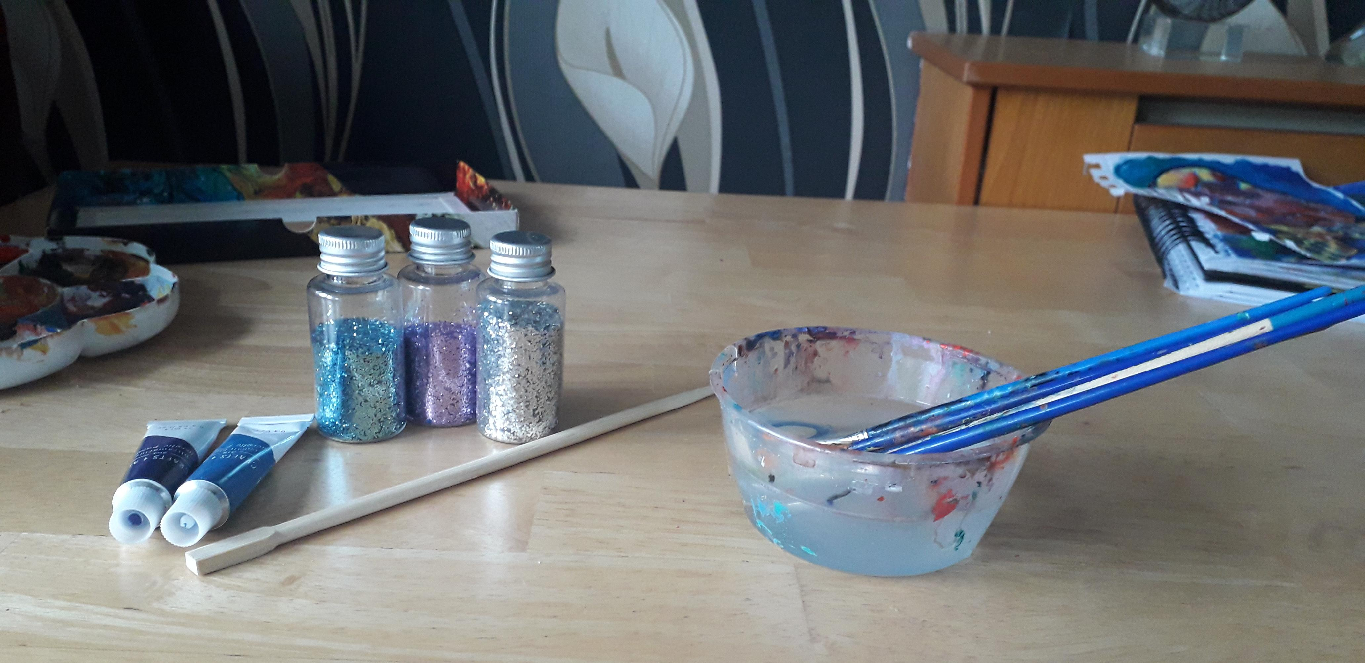
Option one... you’ll need:
Chopstick/clean stick from your garden (make sure it isn’t longer than 20cm)
Paint/nail varnish (any colours of your choice)
Glitter/other decorations e.g. sequins or stickers
PVA glue (optional if you aren’t using paint)
Paper – so you don’t make a mess on the table
Brushes – to apply your colours or glue
Paint pot – for water
Paint pallet/margarine lid – if you want to mix colours

Slide 4
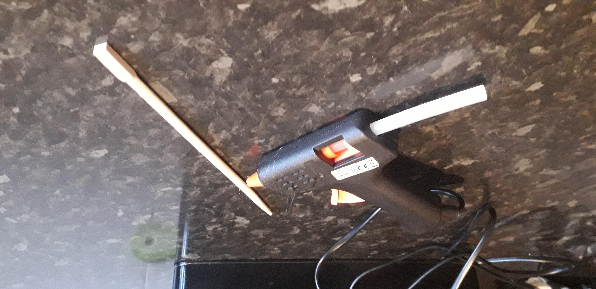
Option two... you’ll need:
Chopstick/clean stick from your garden (make sure it isn’t longer than 20cm)
Parental guidance
Glue gun (so you can make a pattern – this is where you’d need parental guidance)
Paint/nail varnish (any colours of your choice)
Glitter/other decorations e.g. sequins or stickers
Paper – so you don’t make a mess on the table, paint pot – to add water, paint pallet/margarine lid – if you want to mix colours

Slide 5
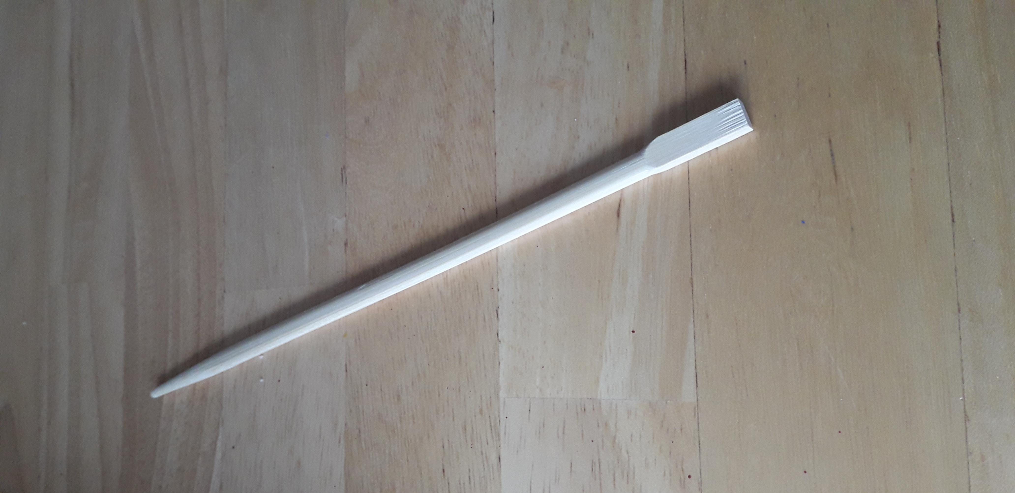
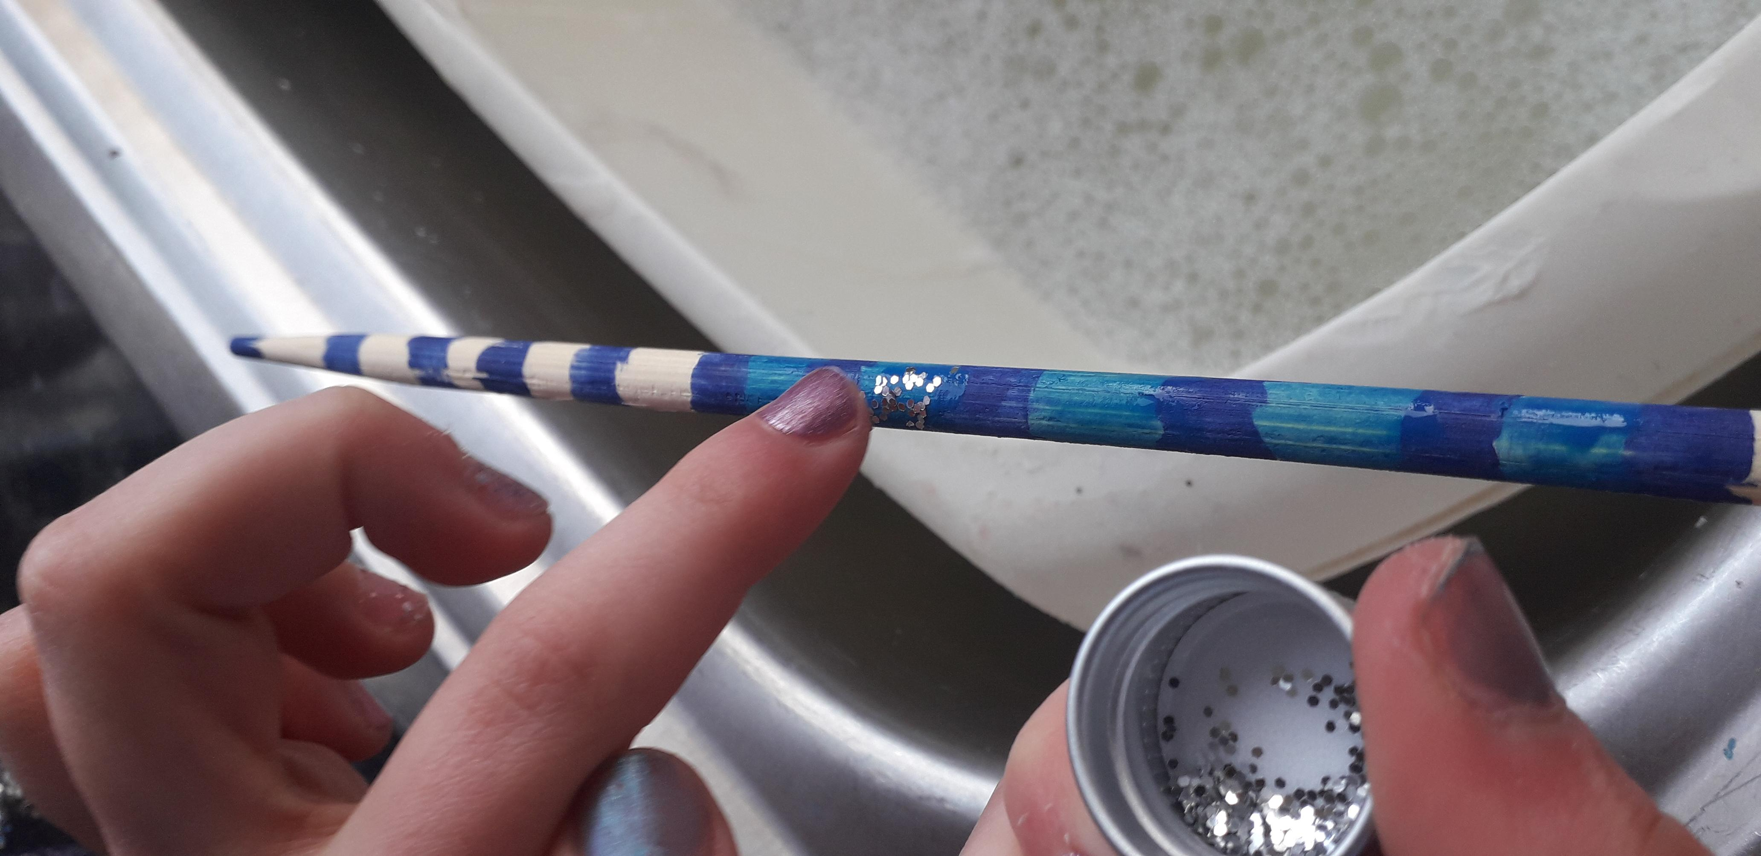
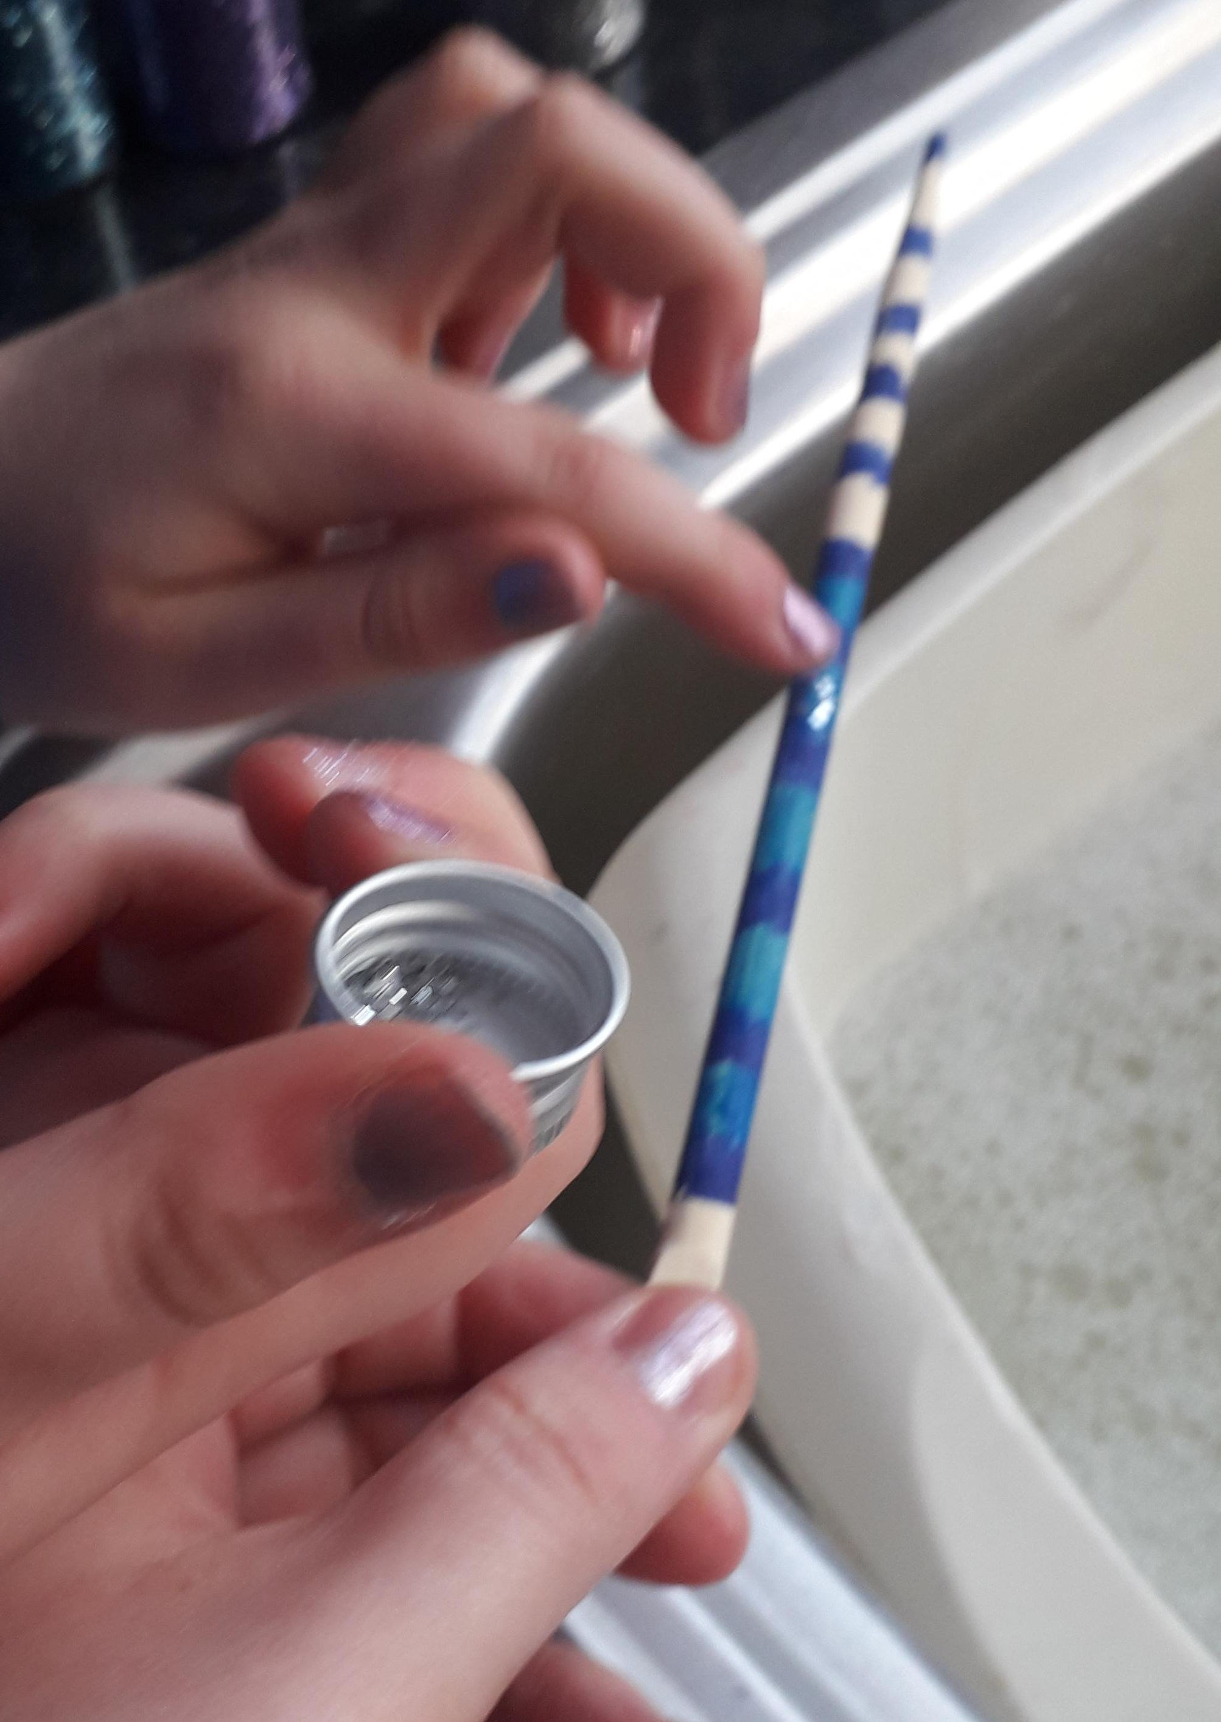
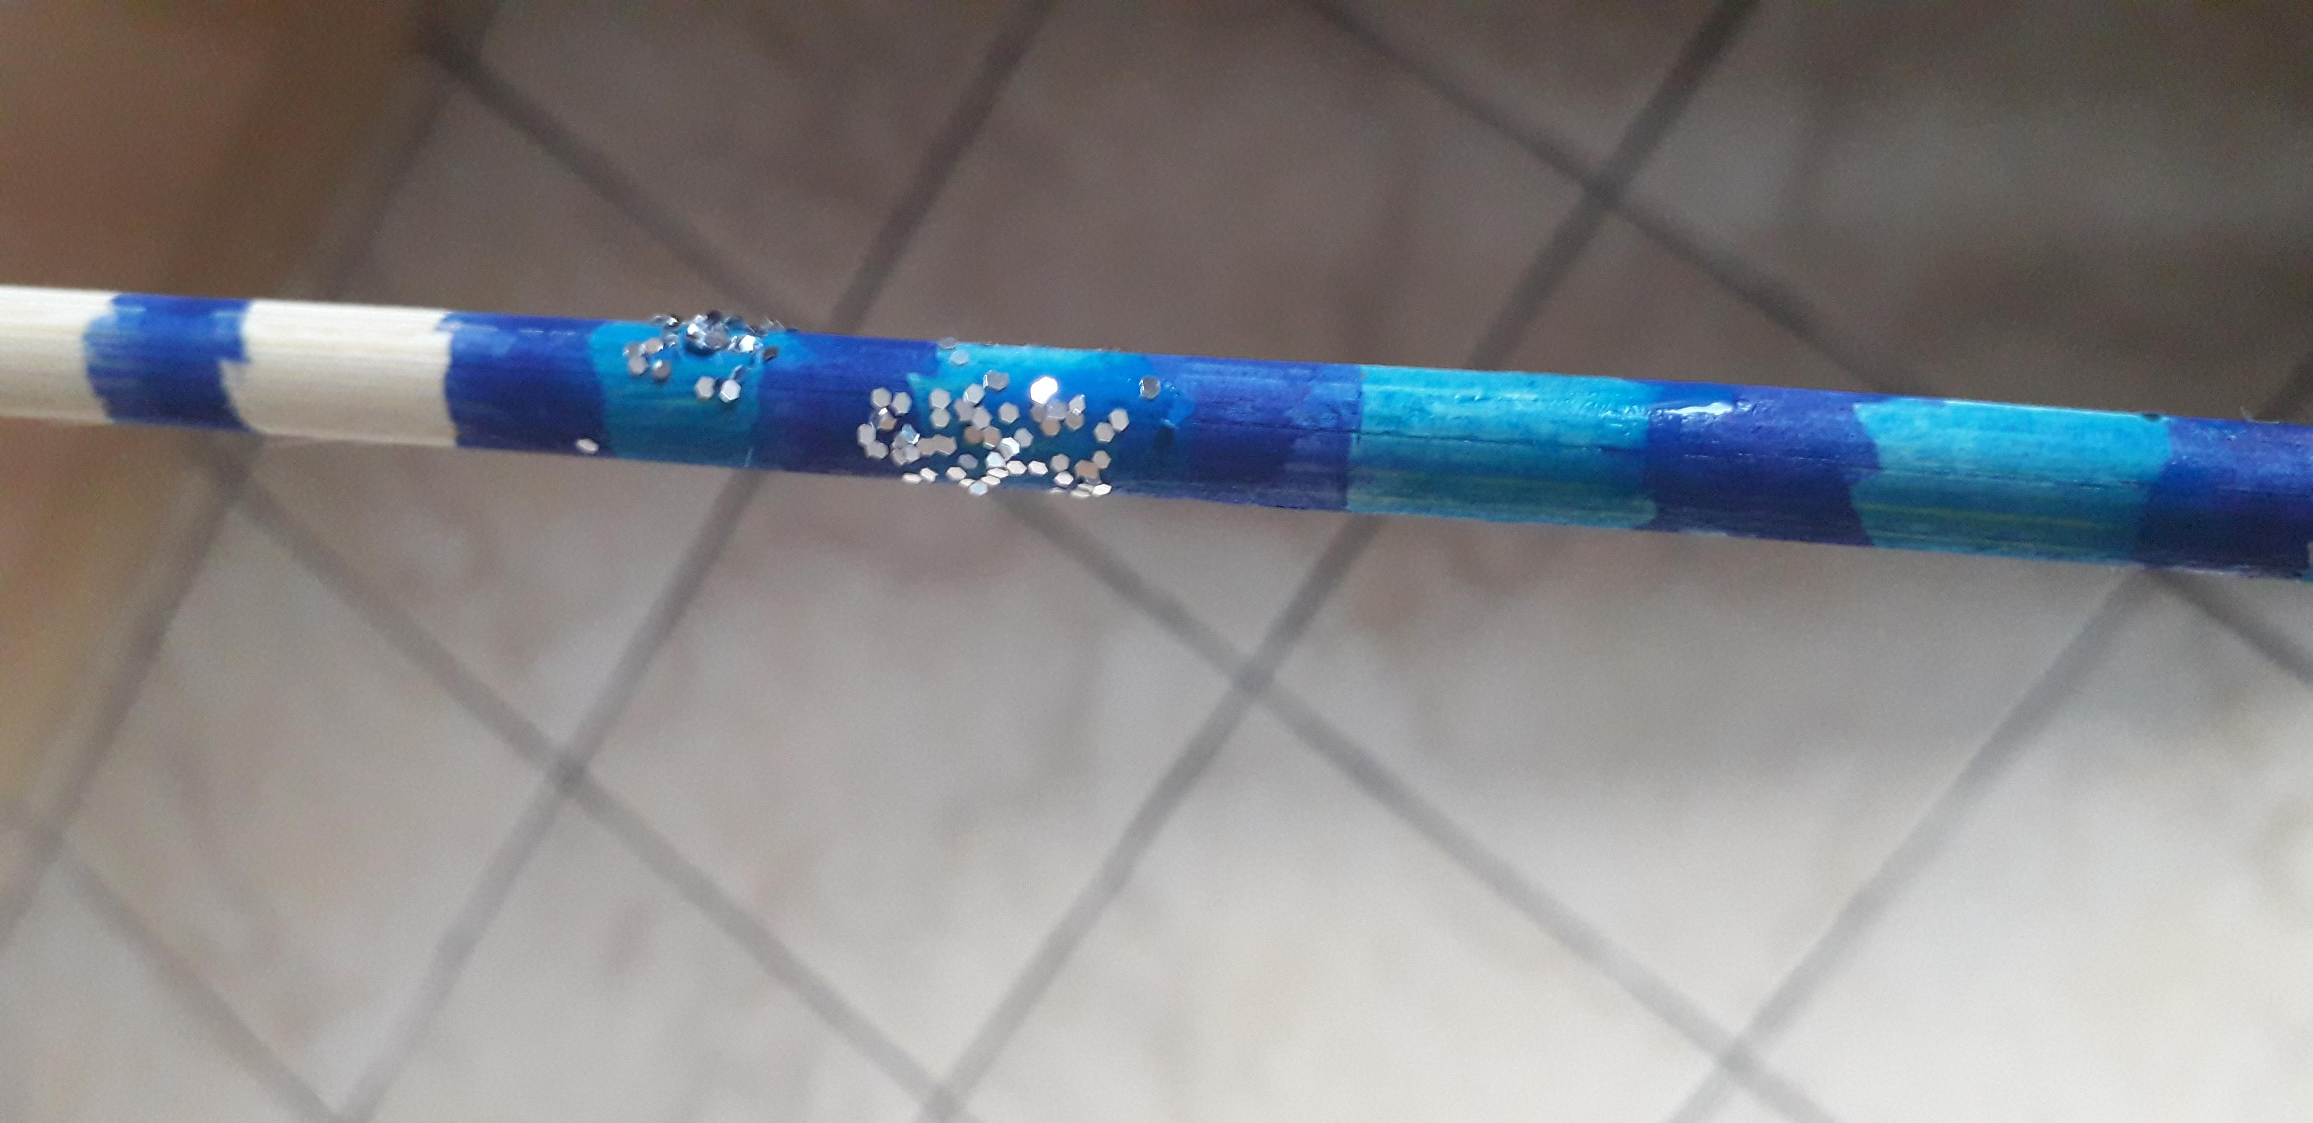
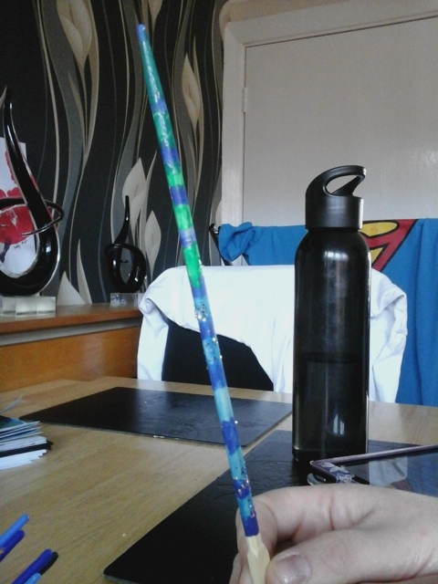
If doing option one you need to:
1.
2.
3.
4.
First, get your chopstick or stick from out side.
Then add on you paint to give it colour, if you don’t want to paint you can add on glue instead.
Next, add on your glitter and your other decorations.
Now you are done, all you need to do now is keep your wand in a cool place to let it dry.
Have fun with your new wand!

Slide 6
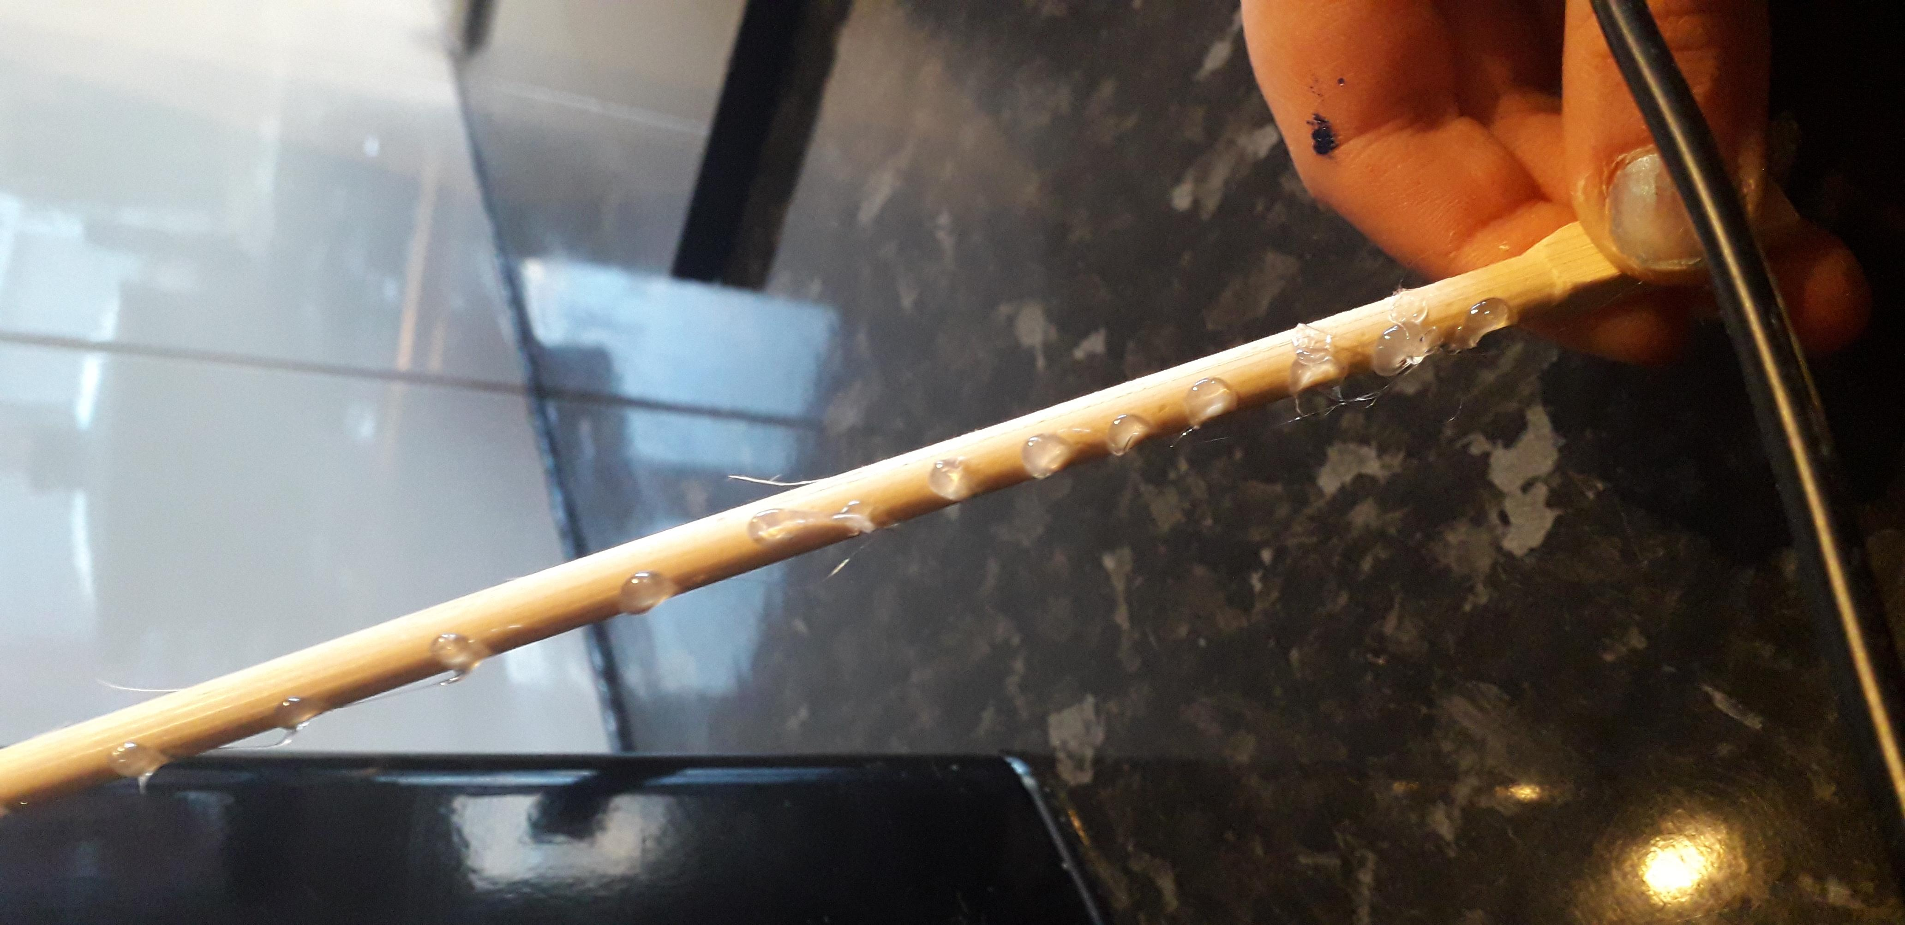
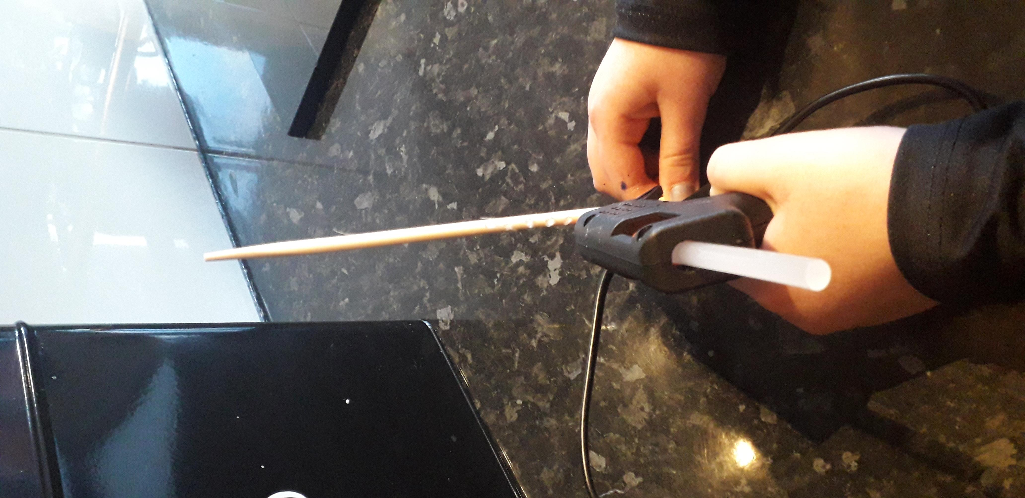
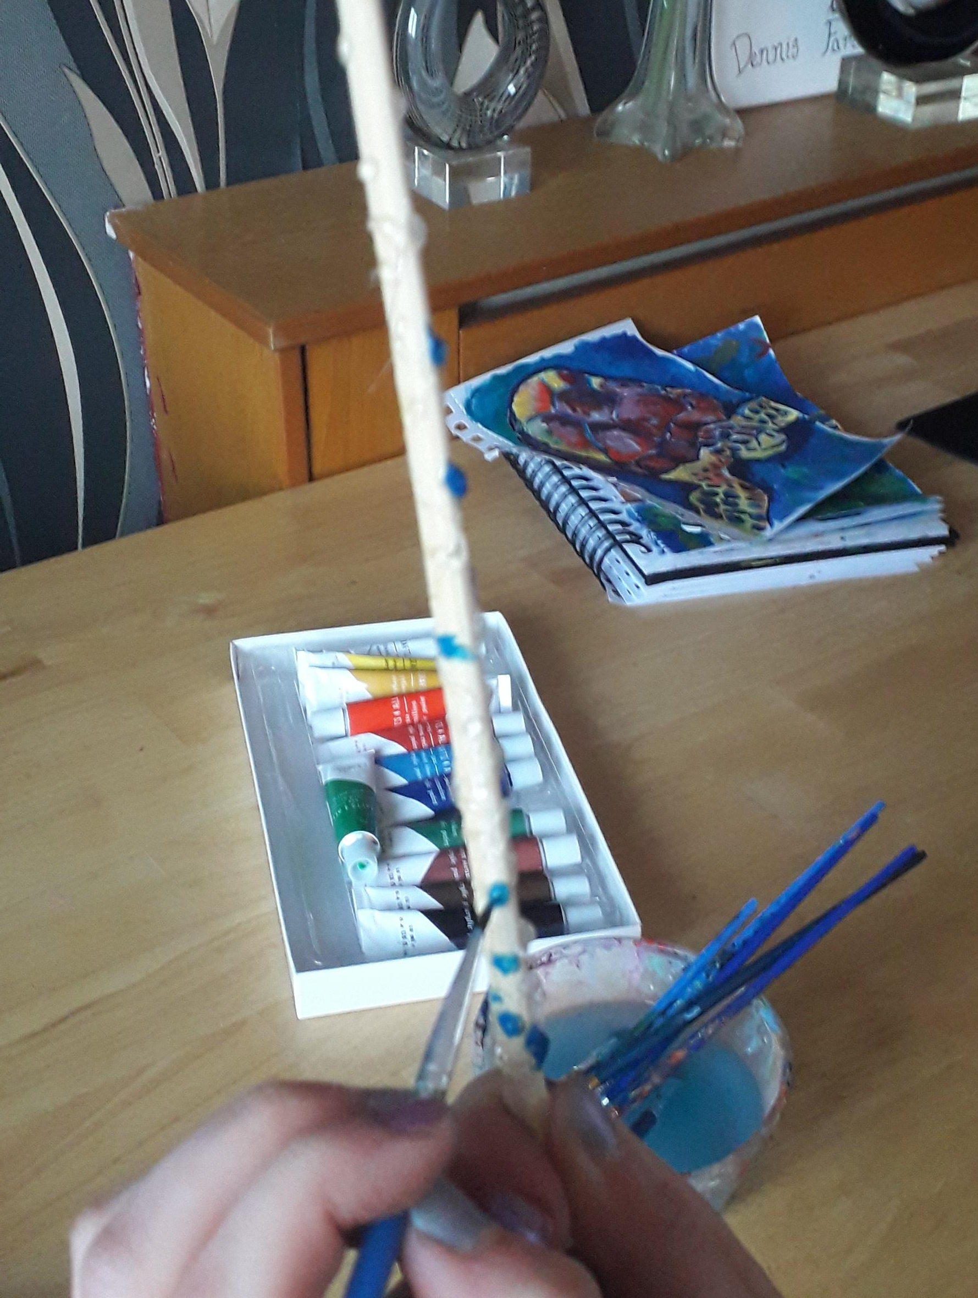
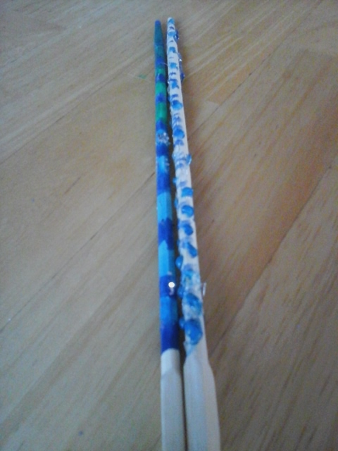
If you are doing option two you need to:
1.
2.
3.
4.
First, get your chopstick or stick from out side.
Then (getting your adult to help) start to add your pattern onto your wand using a glue gun.
After this, you can start painting over your pattern, and maybe add a bit of decorations onto it.
Let it dry and then you are all done!
Have fun with your new wands!

Slide 7
Here is what mine looks like!!!

Slide 8
Hope you have a magical time with your wands!
We would all love to see your beautiful wands so, if you want, could you send a picture of your wands to Mrs Adshead.
By Art Ambassador Aimee

