Slide 1
Mary seacole
By Lewis

Slide 2
This is Mary

Slide 3
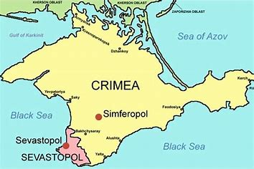
Here is why Mary is amazing
She was a nurse.
Mary asked the war office if she could help fix the wounds on the soldiers.
She was told no because she was black
Mary went on her own and got her own ticket to Crimea.

Slide 4
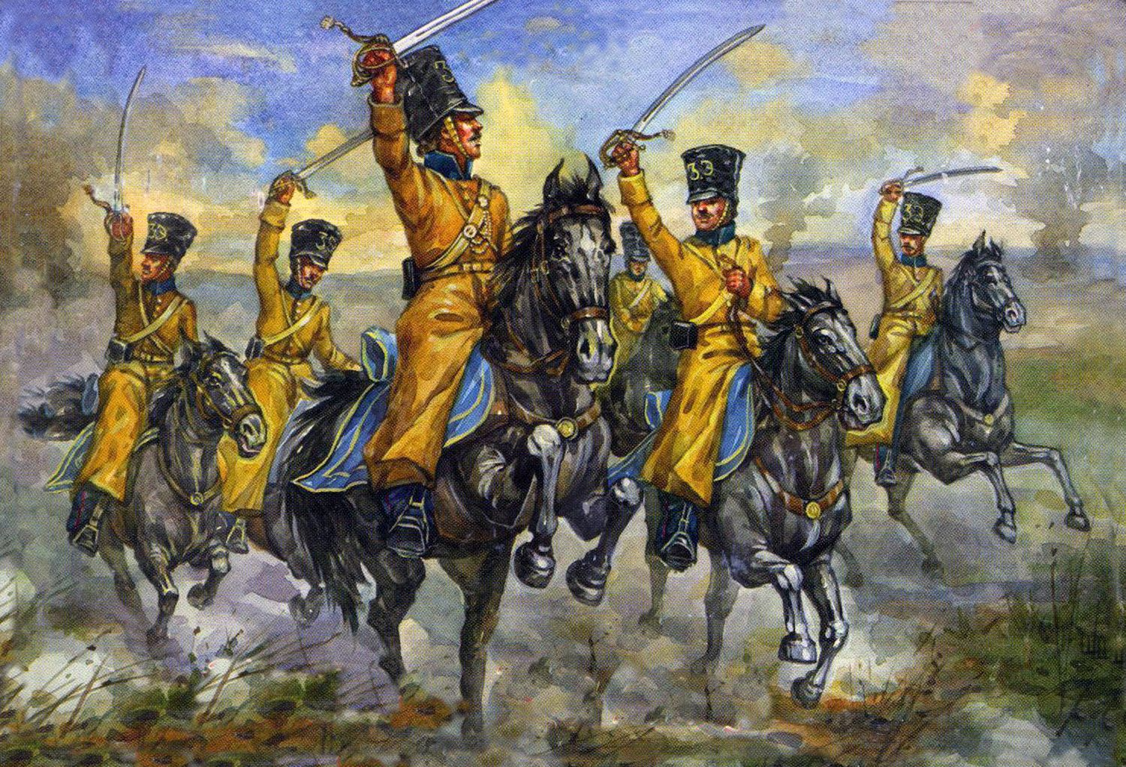
Mary helped the wounded people in the war.
This is Mary’s hotel where she helped people.

Slide 5
The end
Thank you

