Slide 1
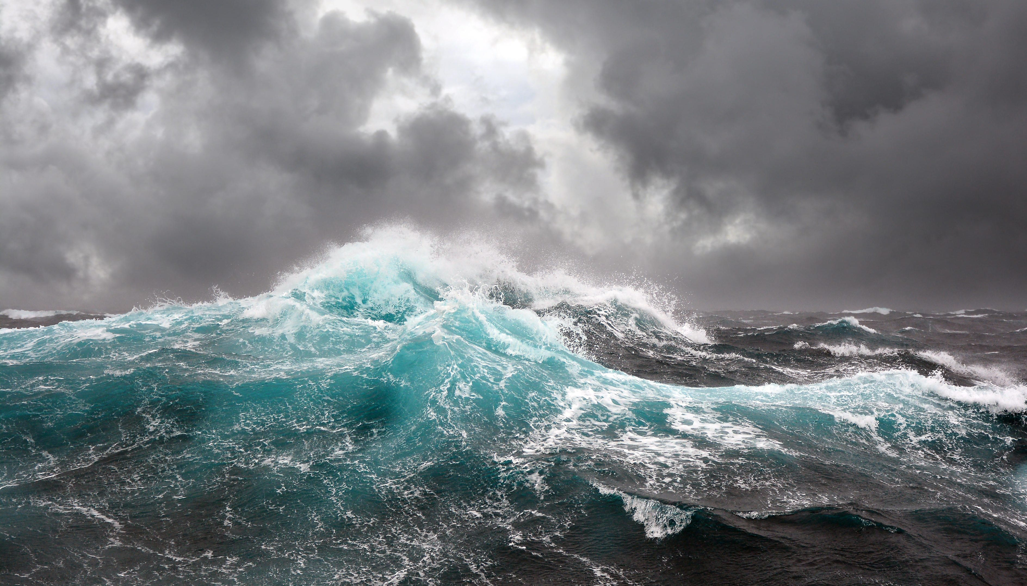
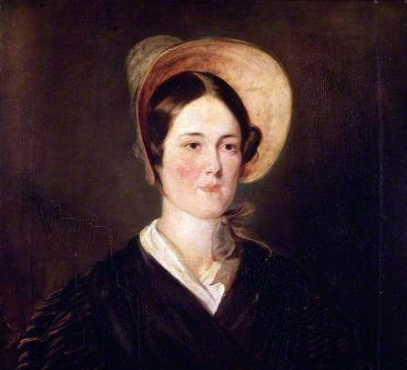
Grace Darling

Slide 2
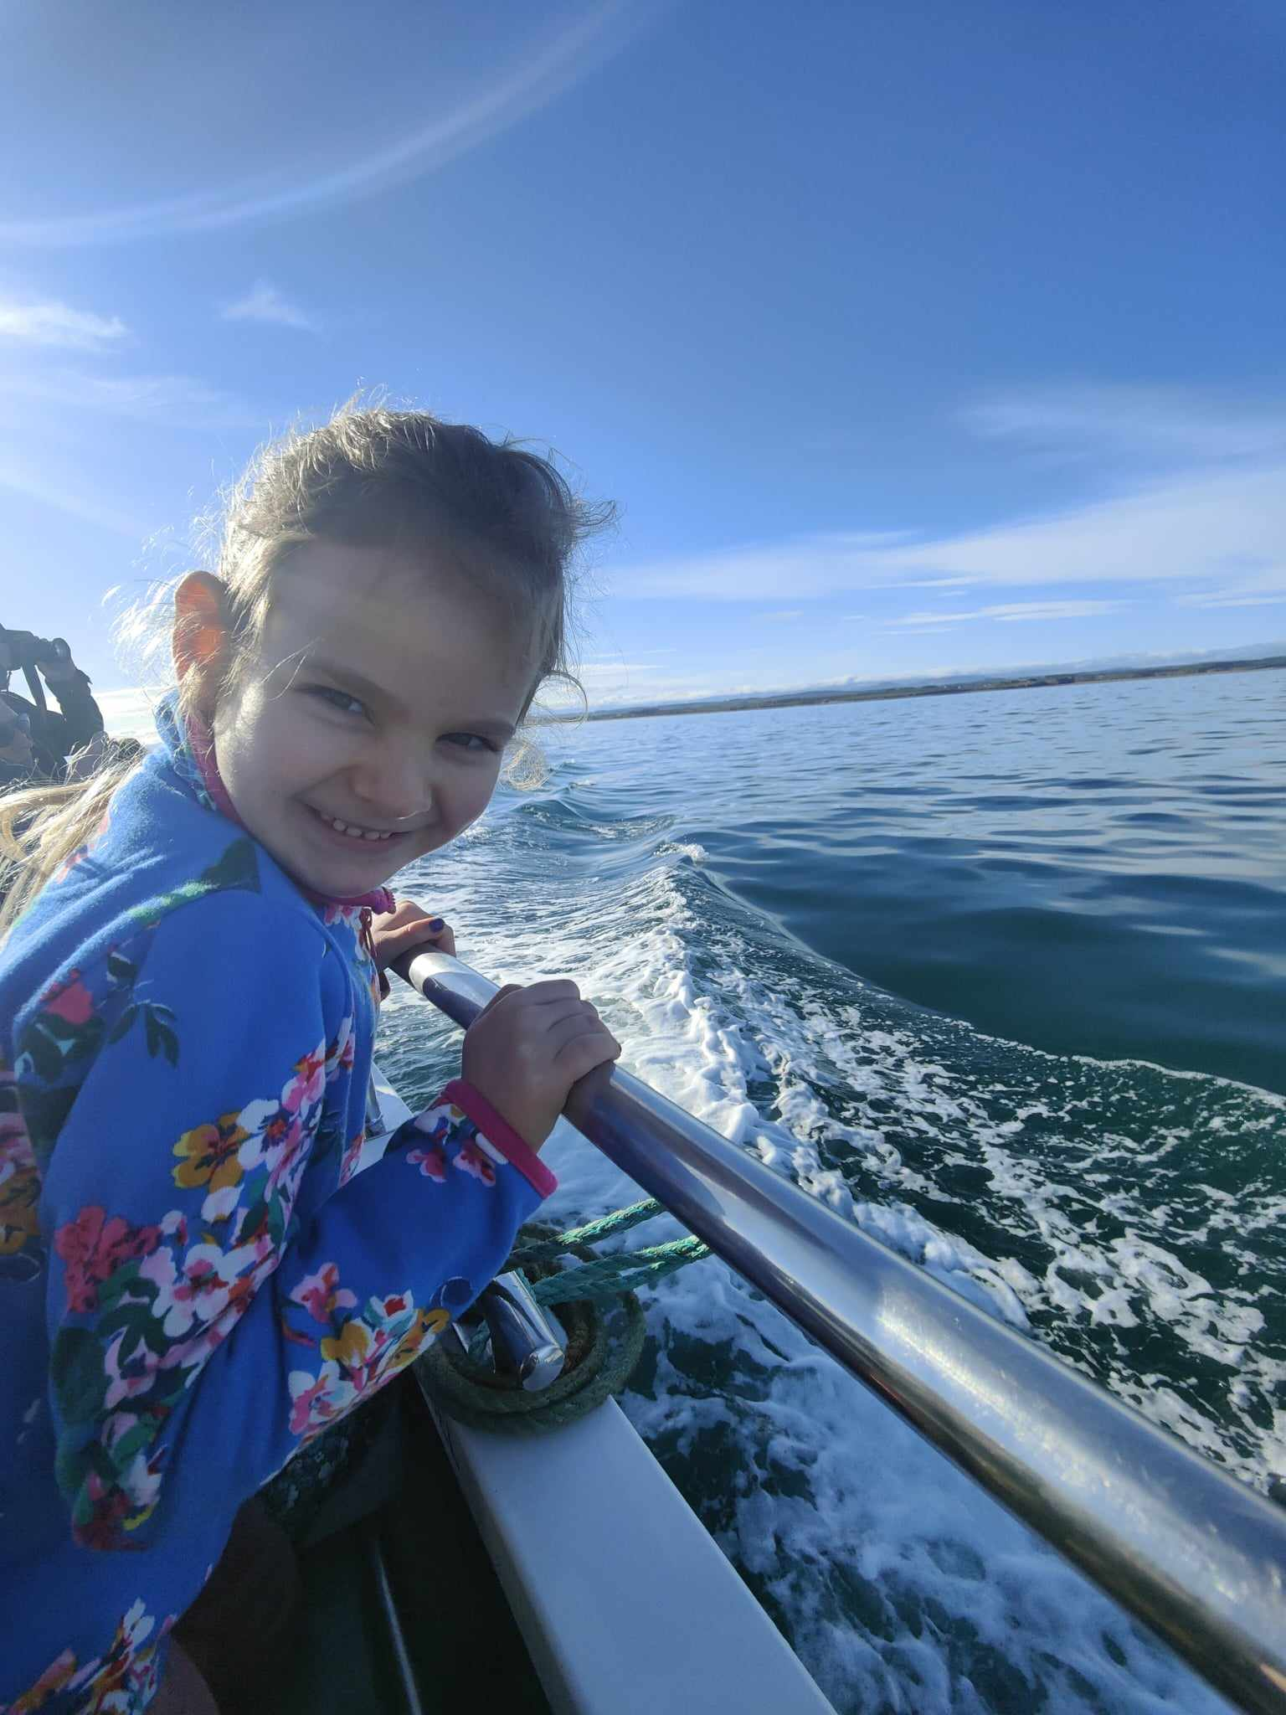
In February I went on a special boat trip to see the lighthouses where Grace Darling lived.

Slide 3
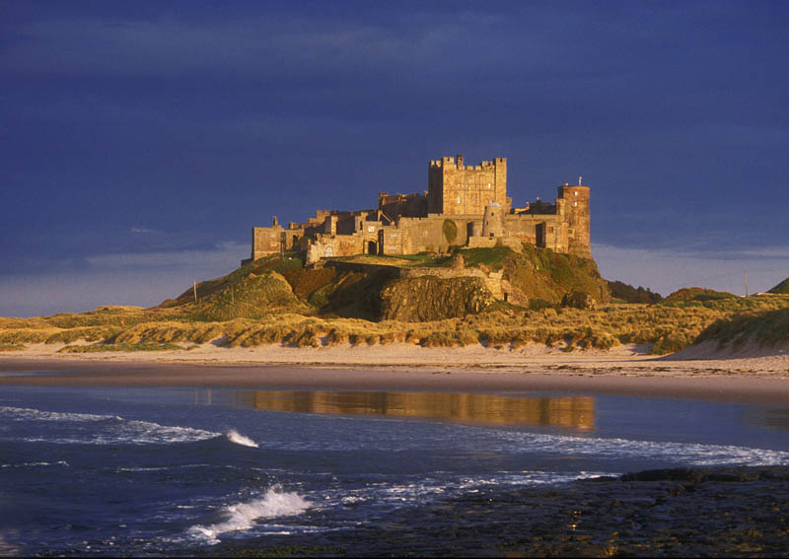
Grace Darling was born in Northumberland in a place called Bamburgh in 1815, over 200 years ago.

Slide 4
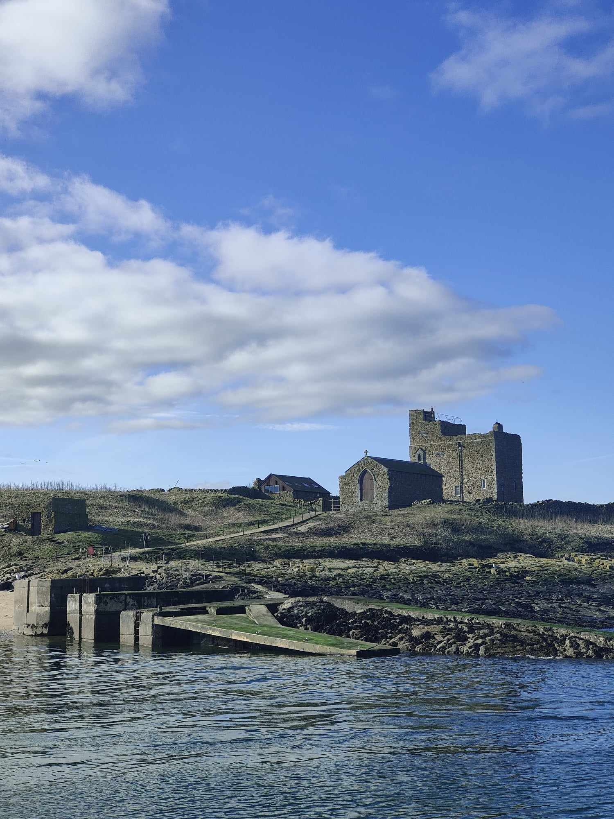
When she was a few weeks old she went to live on Brownsman island. Her Dad looked after the lighthouse.

Slide 5
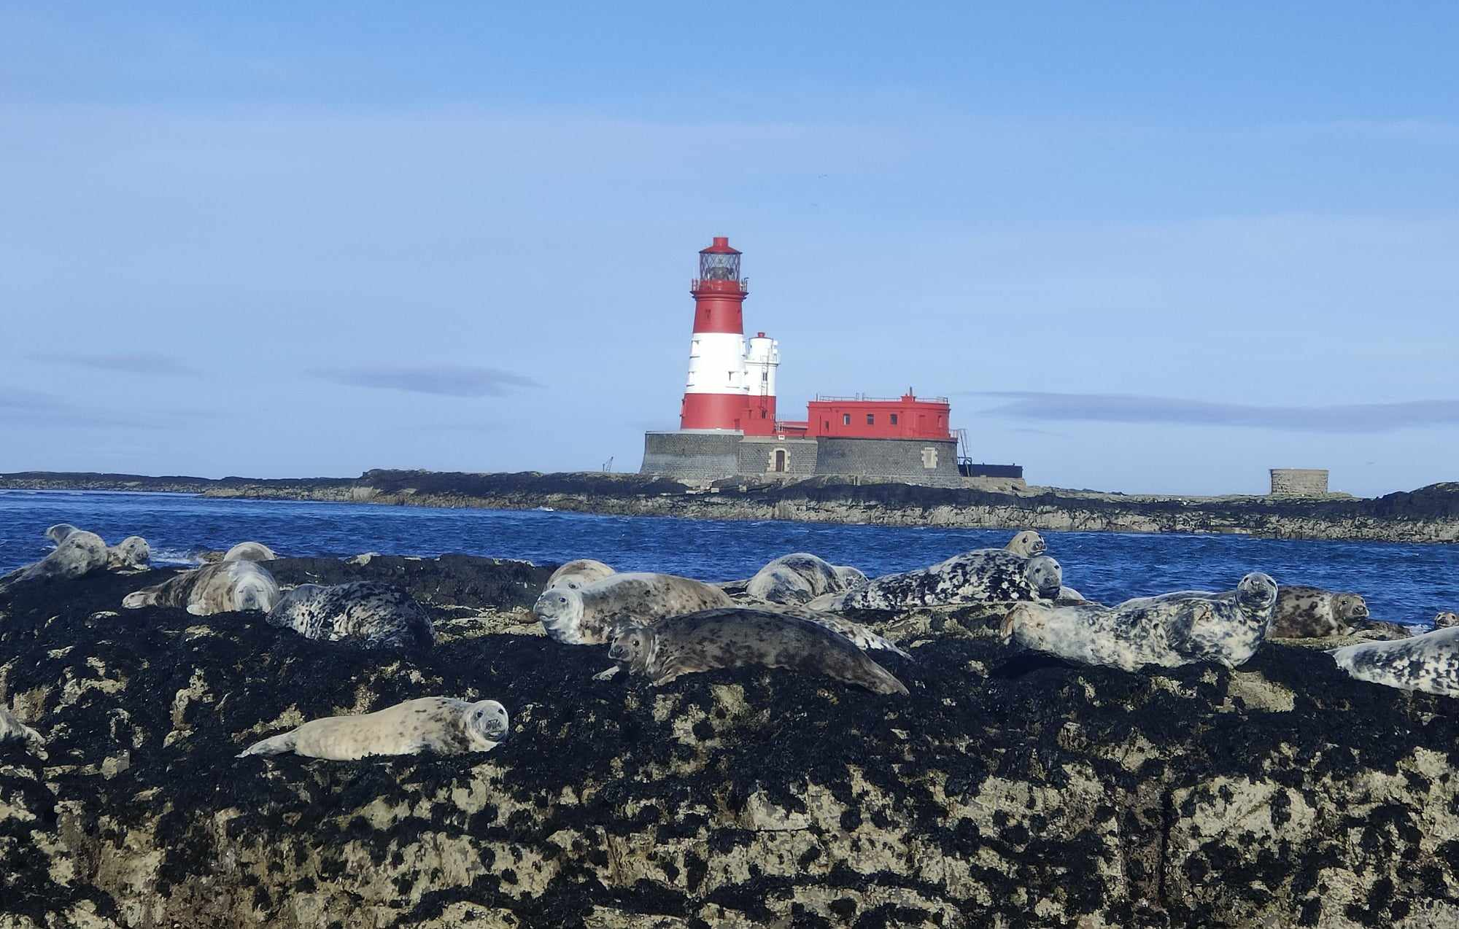
When she was 10 she moved to Longstone lighthouse.
This was her bedroom.
Have you spotted the seals?

Slide 6
Grace Darling was 22 years old when she looked out of her bedroom window. It was stormy and she saw a shipwreak.

Slide 7
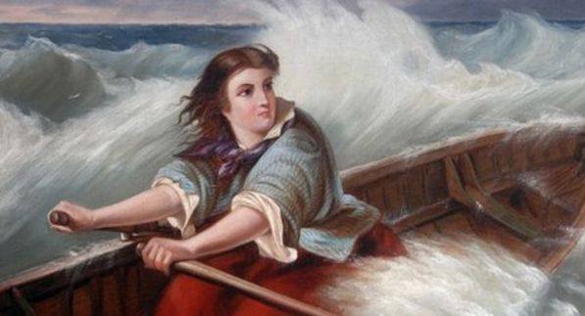
Grace had to wait until morning when it was light. Then she rowed out to sea with her Dad

Slide 8
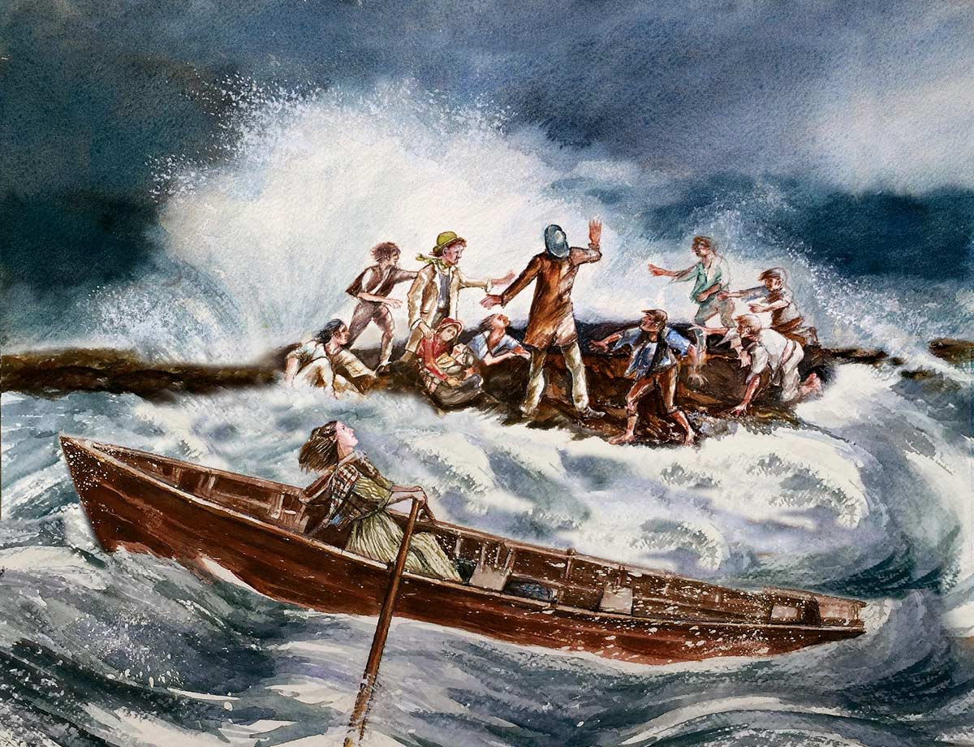
They made two trips and saved 9 people!

Slide 9
Grace had been so brave. Everyone thought she was a hero!

Slide 10
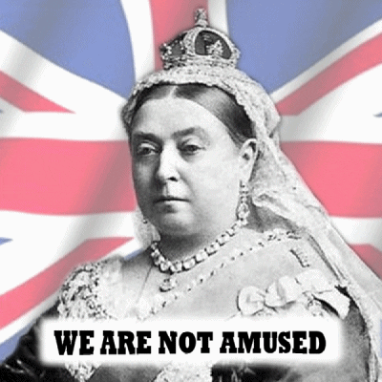
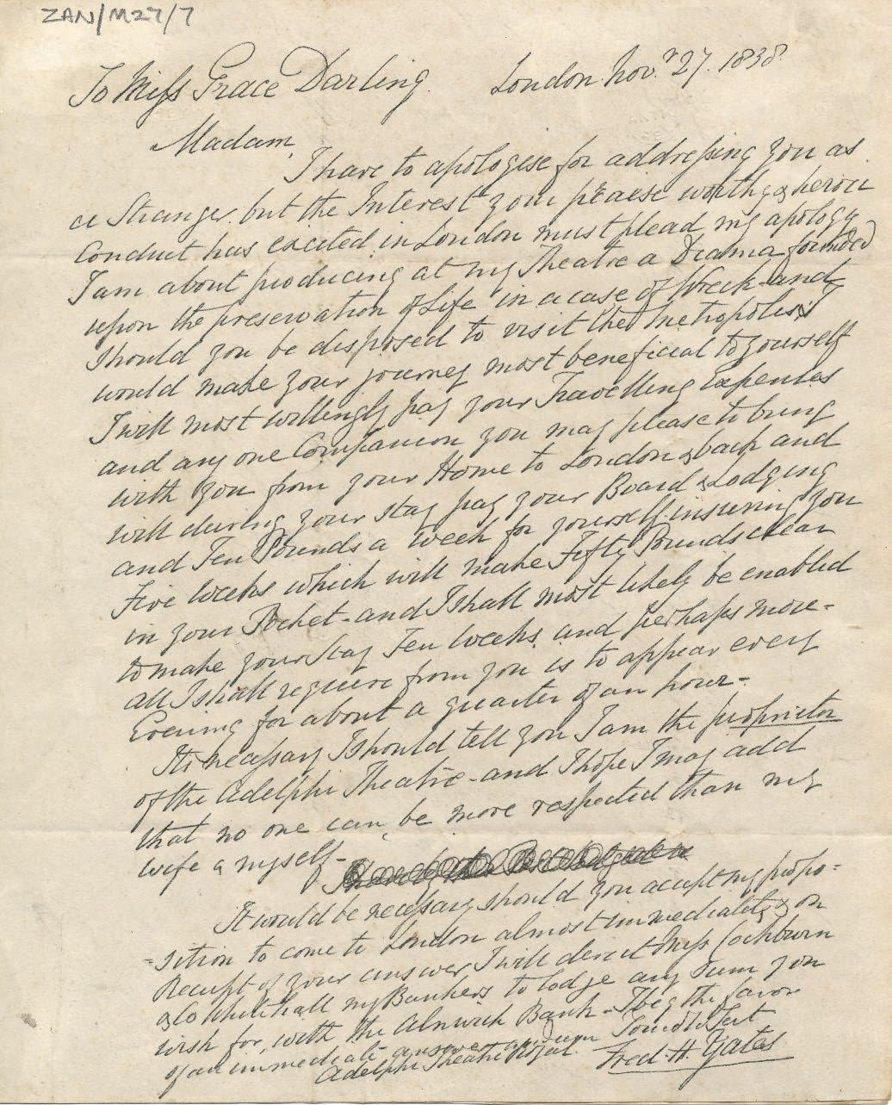
She was so famous!
Even Queen Victoria sent her a letter to say thank you.

Slide 11
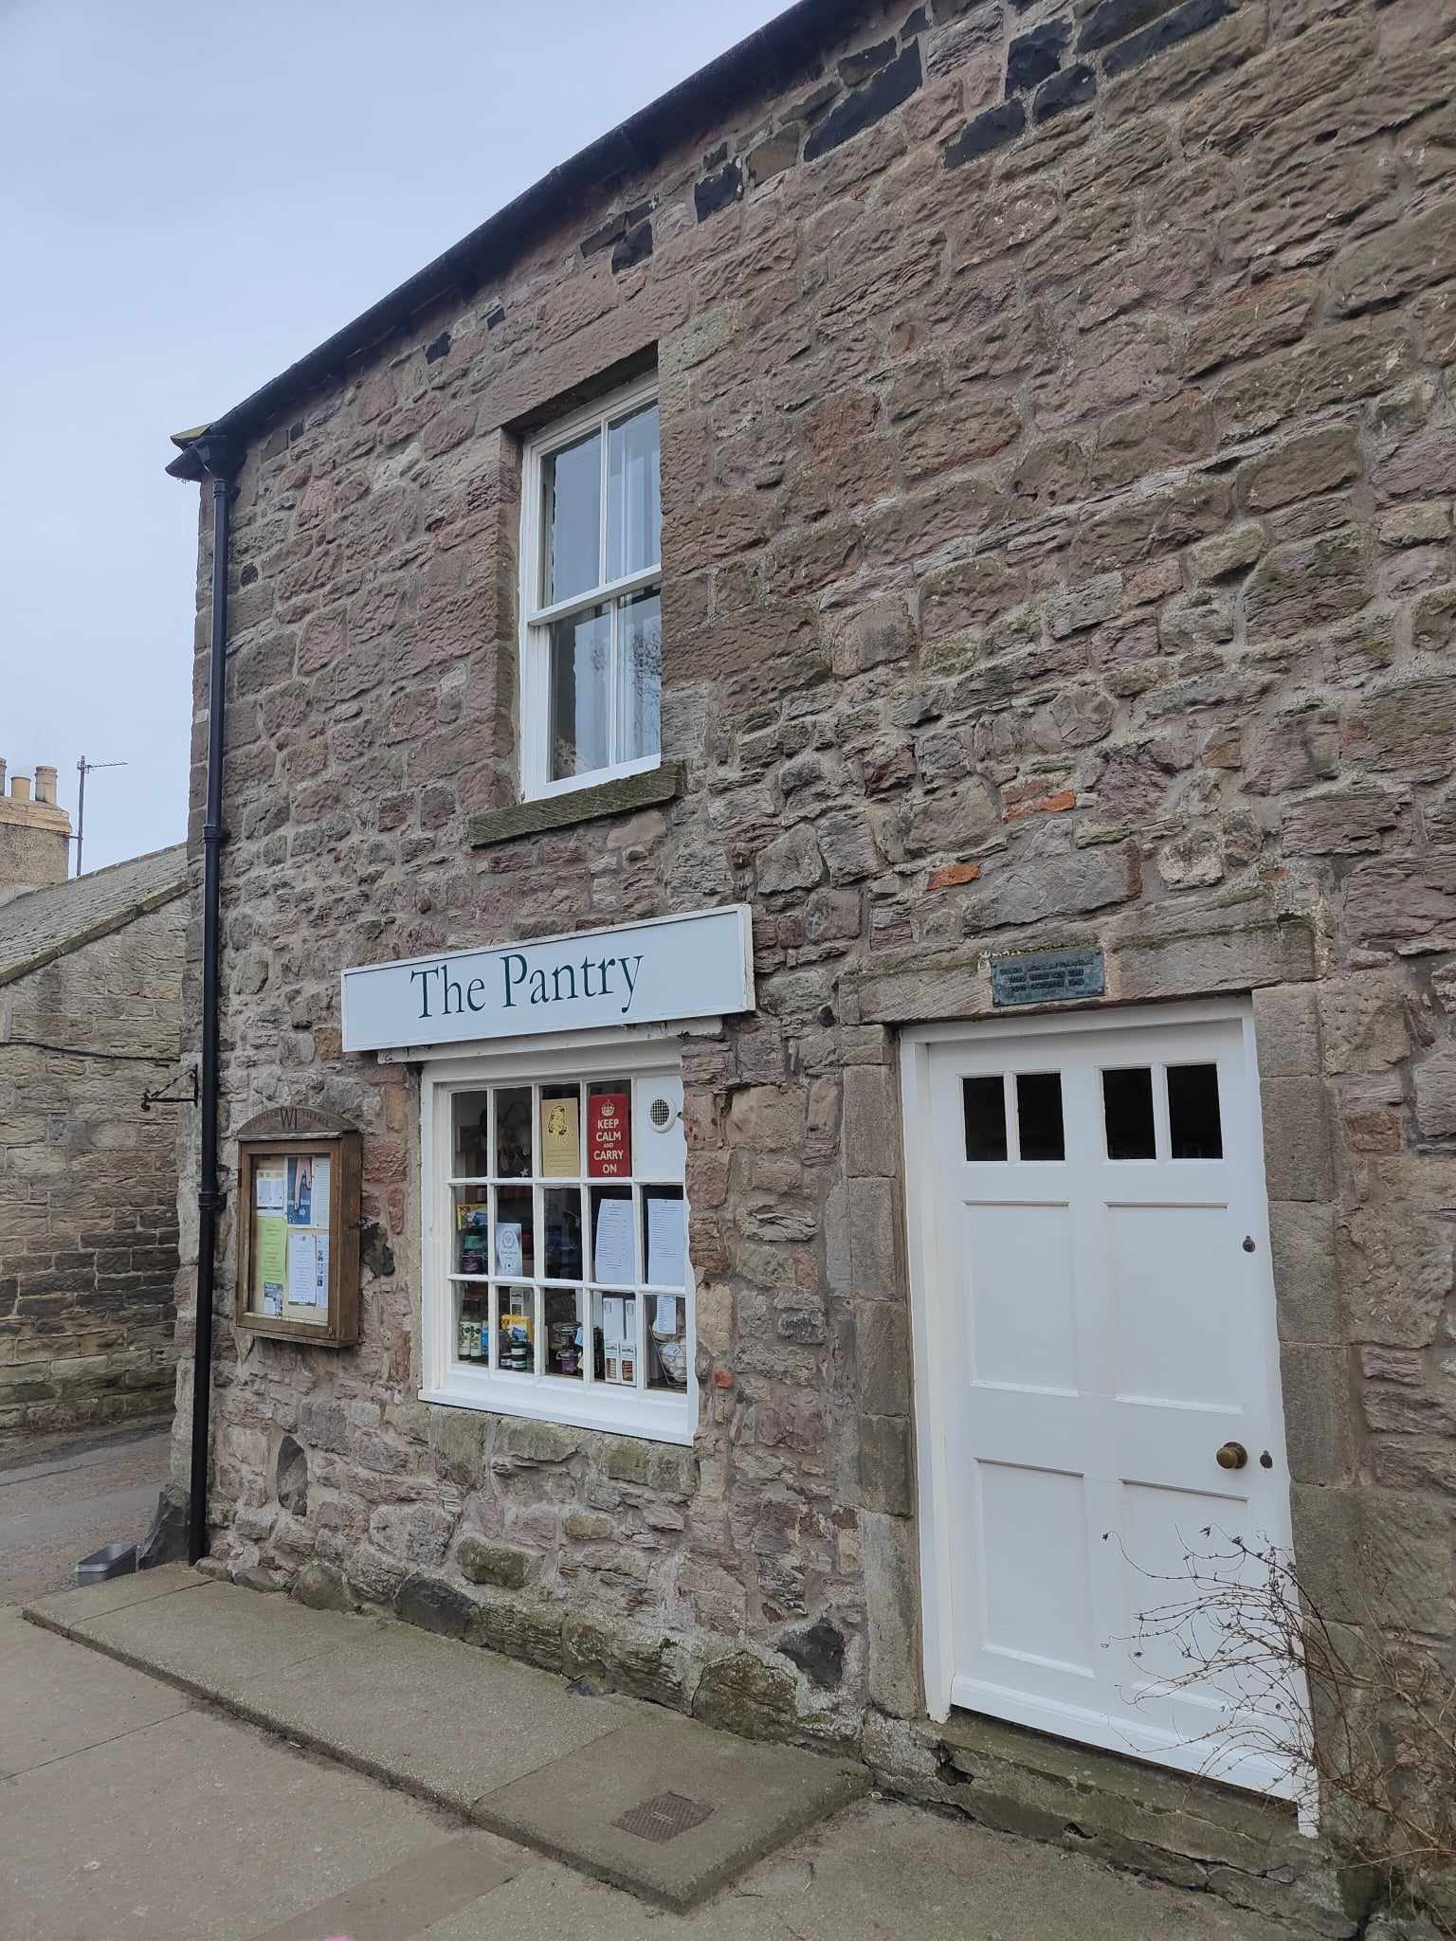
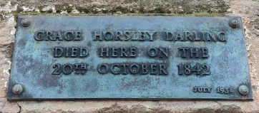
But 4 years later, when Grace was only 26, she died of Tuberculosis in this house.

Slide 12
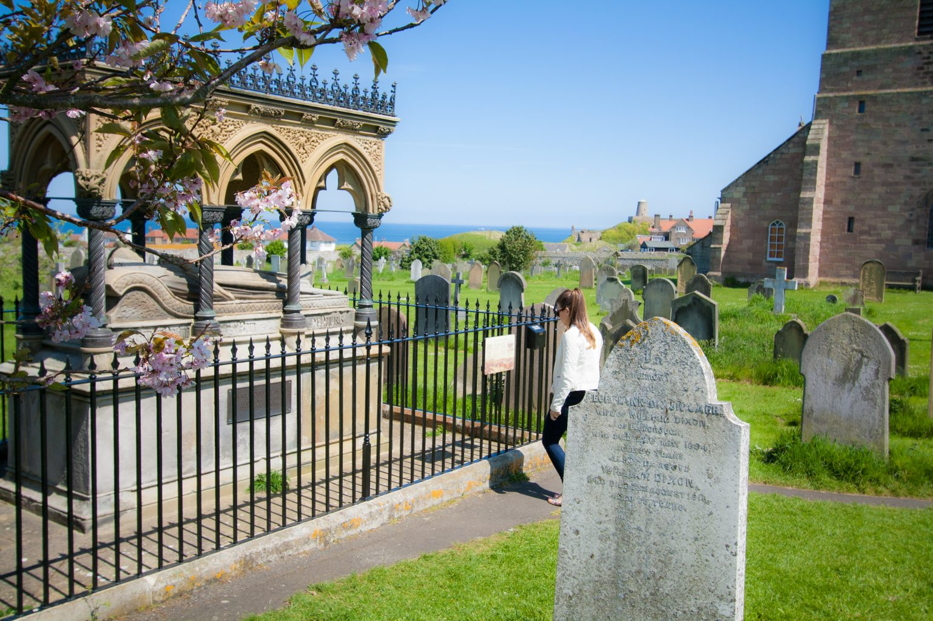
She is buried here, in a cemetery in Bamburgh. She looks at her island home.

Slide 13
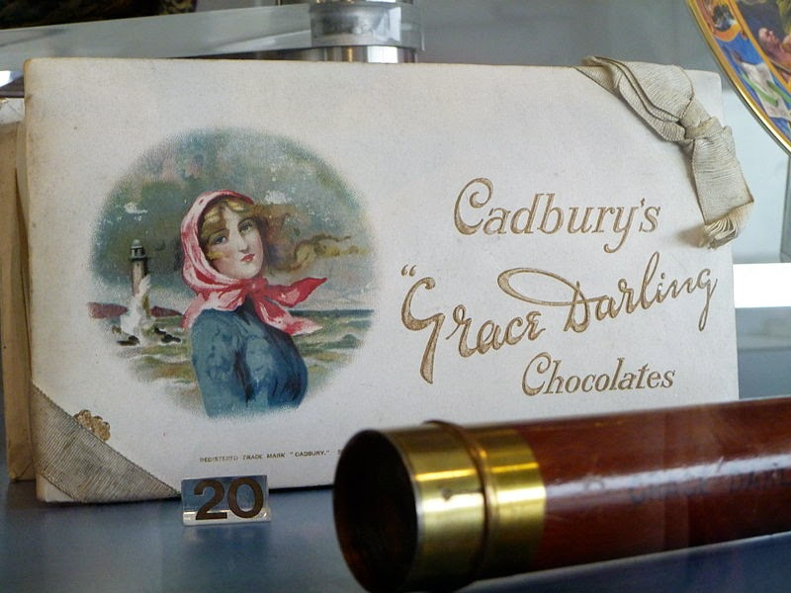
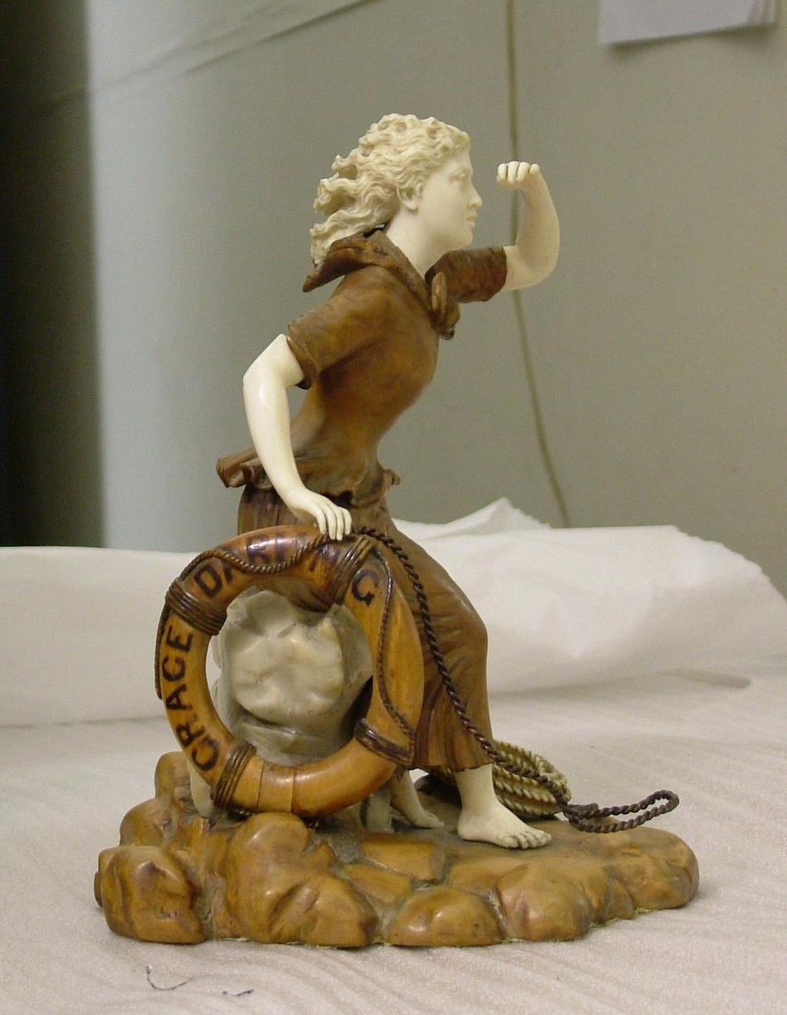
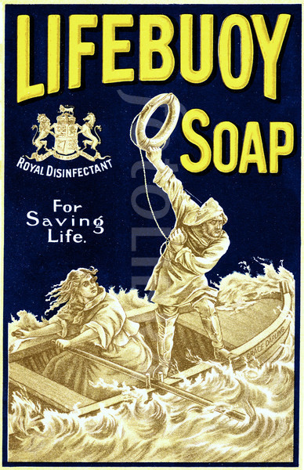
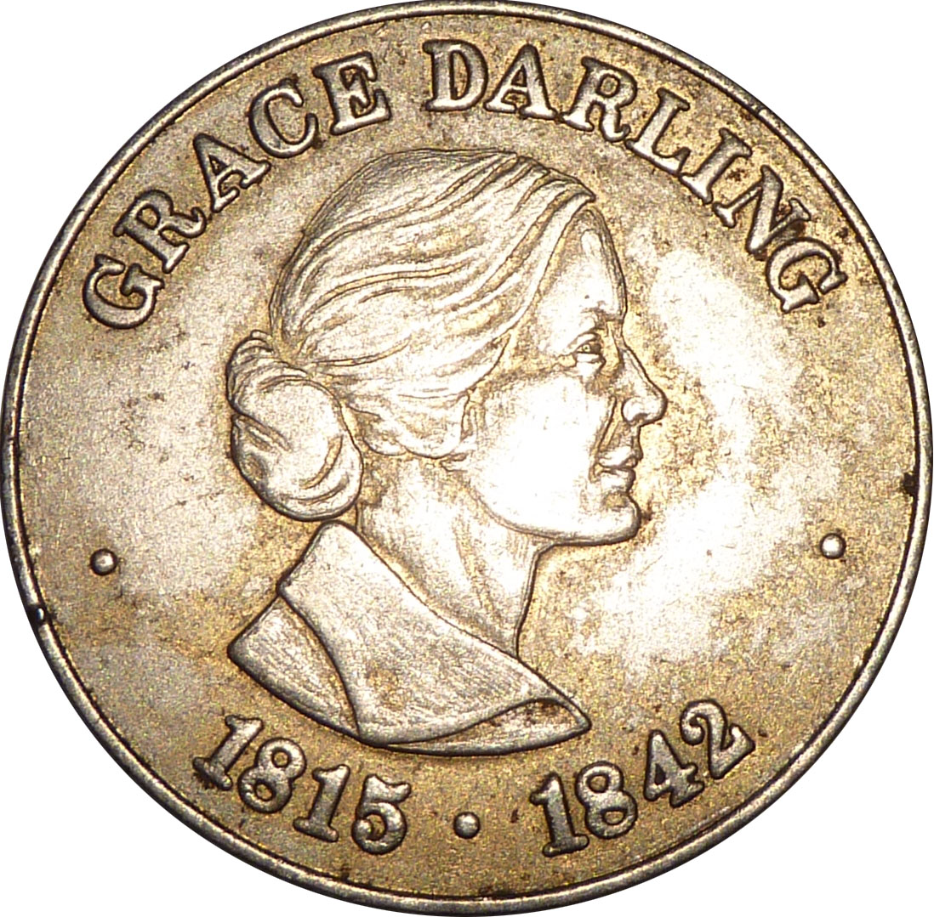
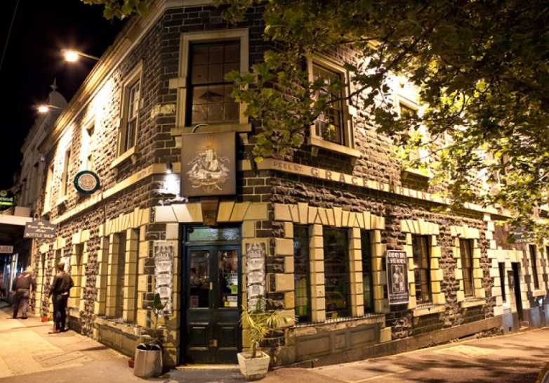
She is still famous!

Slide 14
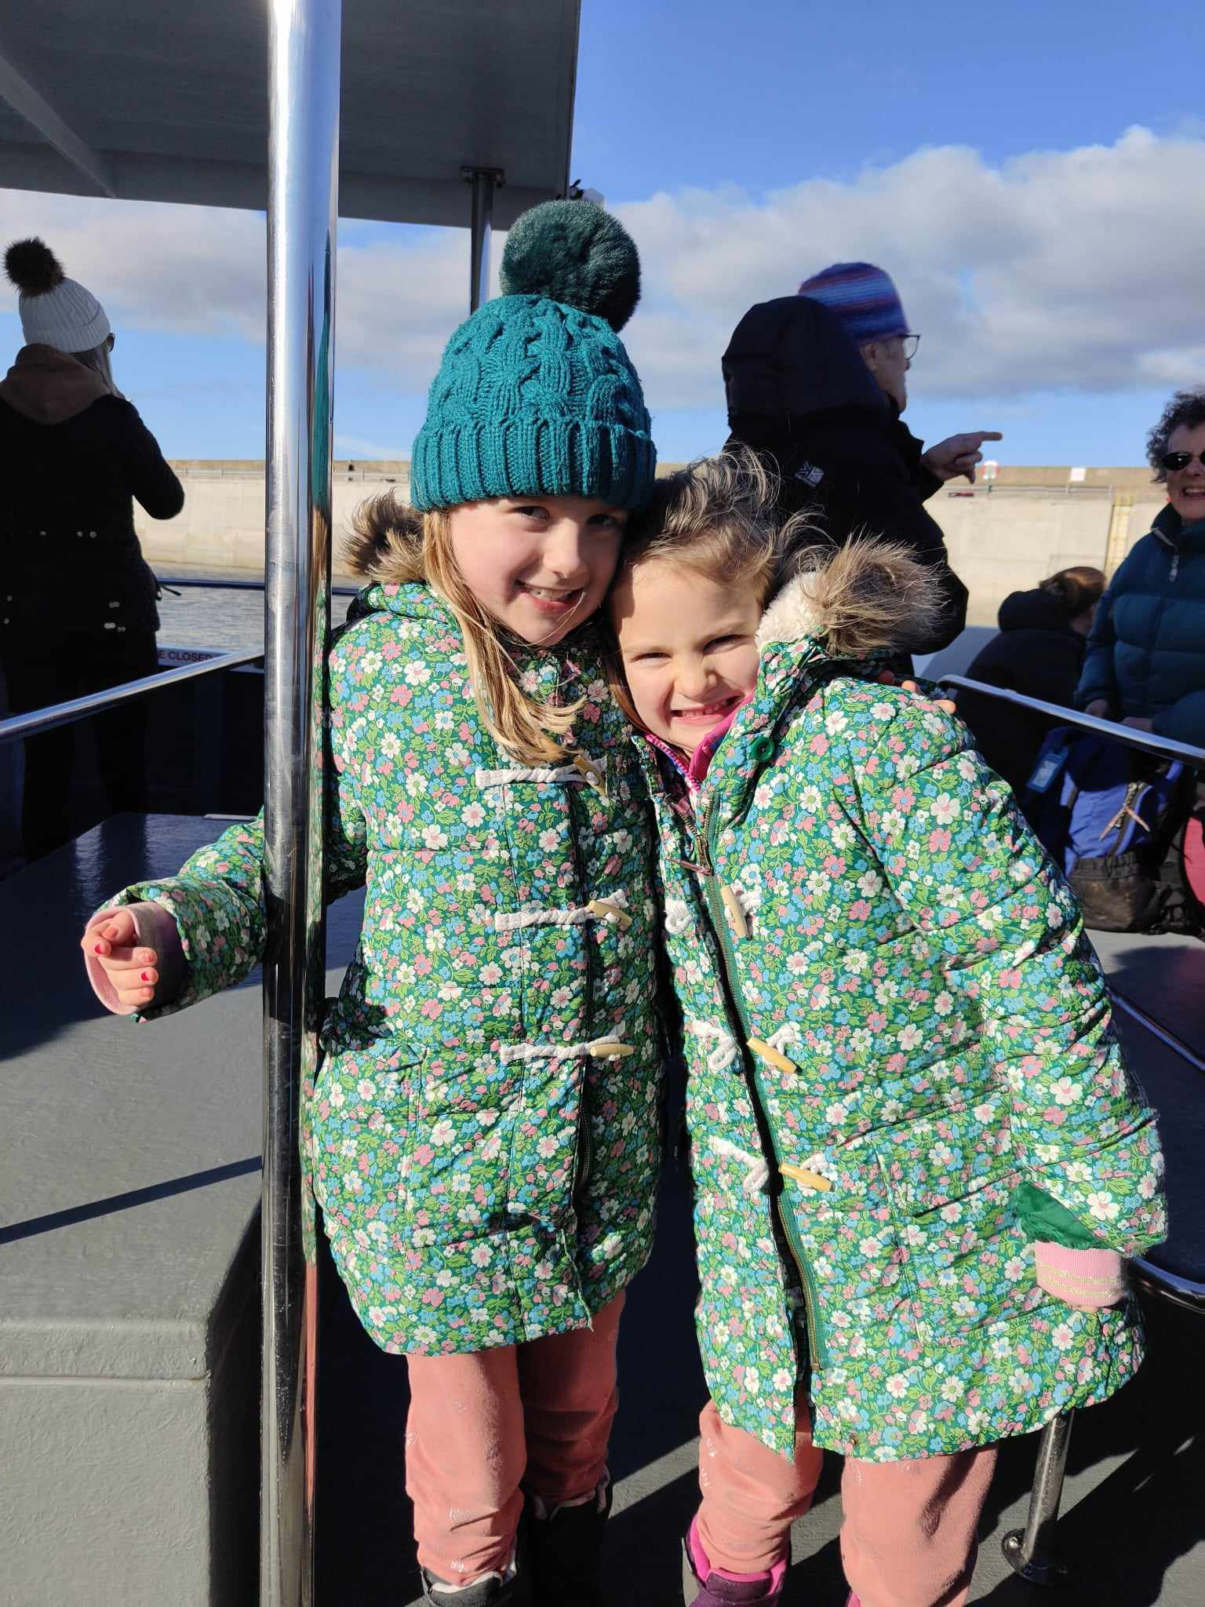
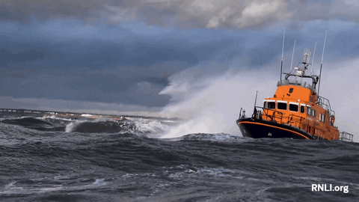
Thank you for listening!

