Slide 1
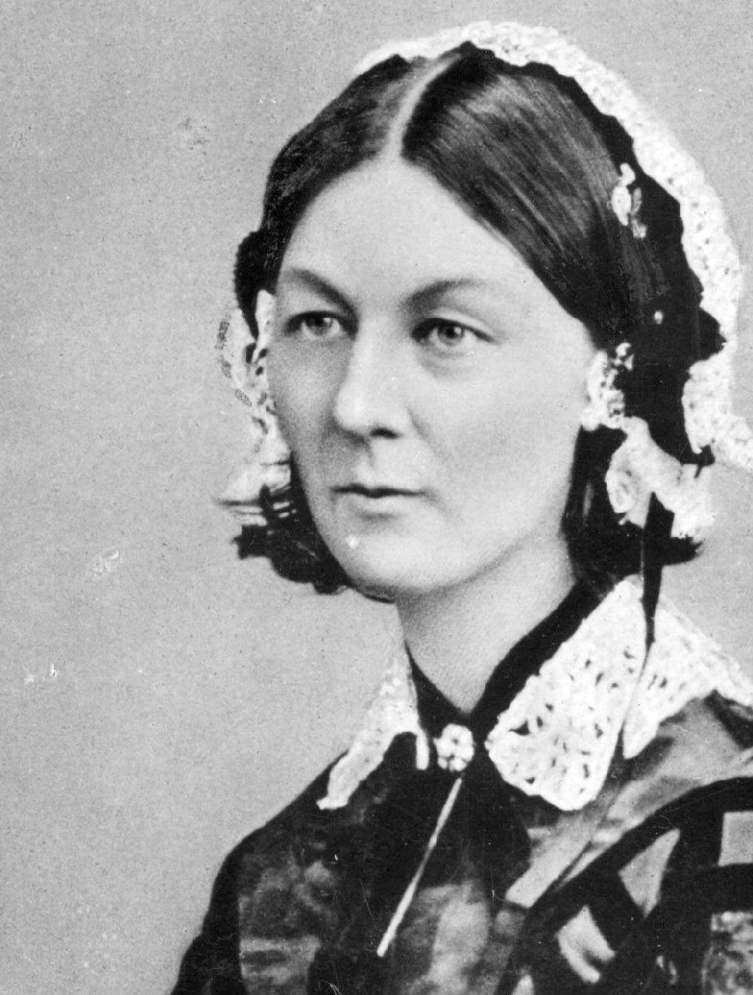
Florence Nightingale

Slide 2
Interesting Facts
She was born in 1820 in Florence, Italy
She nursed injured soldiers and was called ‘The Lady with the Lamp’
She spoke 4 different languages
She set up the first nurses training school in London
She had a pet owl called Athena

Slide 3
Royal Invites
Queen Victoria invited Florence Nightingale to meet her at Balmoral Castle in Scotland.

Slide 4
Wash your Hands!
Nightingale said people should wash their hands in hospitals.
This helped bring the number of deaths down from 41% to 2%.

Slide 5
Quiz Time
Q1
What was Florence Nightingale's job?
Nurse
Inventor
Singer

Slide 6
Answer
Nurse

Slide 7
Quiz Time
Q2
What was Florence Nightingale known as?
The Nurse with the Watch
The Lady in the Hospital
The Lady with the Lamp

Slide 8
Answer
The Lady with the Lamp

Slide 9
Quiz Time
Q3
Where did Florence Nightingale start the first nursing training school in the world?
Edinburgh
Paris
London

Slide 10
Answer
London

Slide 11
Quiz Time
Q4
Which British monarch did Florence Nightingale meet at Balmoral Castle?
Queen Elizabeth II
Queen Victoria
King George VI

Slide 12
Answer
Queen Victoria

Slide 13
Quiz Time
Q5
Which pet did Florence Nightingale have
Dog
Goat
Owl

Slide 14
Answer
Owl

Slide 15
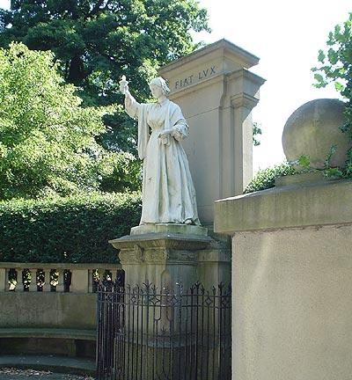
THANK YOU FOR TAKING
PART IN MY QUIZ

