Slide 1
Florence Nightingale

Slide 2
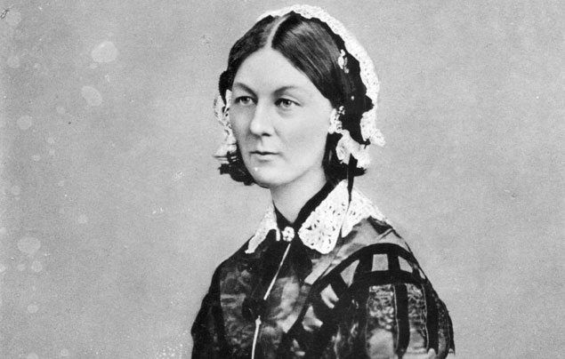

Slide 3
Who was Florence Nightingale?
Born: 12 May 1820 in Florence, Italy Lived in: England, UK Job: Nurse Died: 13 August 1910 Also known as: Lady with the Lamp

Slide 4
What did Florence Nightingale do?
When she was 16 years old, she believed she heard a voice from God calling for her to carry out important work to help those suffering. She wanted to be a nurse.

Slide 5
The Crimean War

Slide 6
In 1854, the Crimean War started. Britain, France and Turkey fought against Russia.
British soldiers went to fight in the Crimea, in Russia.
Soldiers were dying because they were injured, hungry, sick and cold. There was no proper medical care or nurses to treat them.
Florence and a team of nurses went to help.

Slide 7
The army hospital awful. There were too many sick soldiers there. It was dirty. The toilets were broken and there were rats running everywhere.
There weren’t enough medical supplies or equipment. The soldiers had to sleep on the dirty floor without any blankets. They didn’t have any clean water or fresh food. Most of the soldiers died.

Slide 8
Florence got some money to buy better medical equipment and food to help the soldiers to get better. She paid workmen to clear the drains. Florence and the other nurses cleaned the wards, set up a hospital kitchen. The nurses looked after the wounded soldiers very well.

Slide 10
At night, when everyone was sleeping, Florence would visit the soldiers to make sure they were comfortable. She used to write letters for the soldiers who could not write themselves.
Florence used to carry a lantern with her on her night visits. The soldiers would call her ‘The Lady with the Lamp’.

Slide 11
After the War
Florence went back to England after the war. She wrote letters to important people, telling them about the Army hospitals. She even met the queen to talk about ways to make things better.
The Army started to train doctors. Hospitals became cleaner and soldiers were given better clothes, food and care.
In 1860, the Nightingale Training School for Nurses opened in London to train ladies to become nurses.

Slide 12
Florence was ill as she grew older and spent a lot of time in bed.
Florence became the first woman to receive the Order of Merit which is an award from the queen for very special work.
Florence died in 1910.
She will never be forgotten.

