Slide 1
Florence Nightingale
The lady with the lamp.

Slide 2
Florence Nightingale was born on 12th May 1820 In Florence Italy.
Her mother and father were very rich.
She was able to go to school as her father though girls should learn.

Slide 3
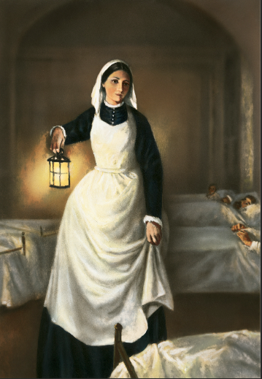
CRIMEAN WAR
In 1854 she was sent out to help in the Crimean war. Florence believed that sick people would get better with good food fresh air and lots of rest.
She made all the nurses wash their hands

Slide 4
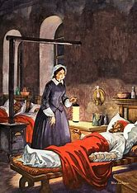
The Lady with the lamp.
When it is was pitch black at night Florence came up and down the beds to check on the sick men.

Slide 5
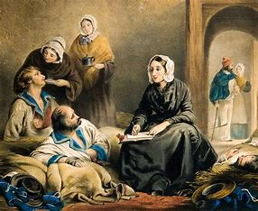
After the war Florence was able to start her own nursing school in St Thomas hospital London.
Florence was awarded lots of medals for her nursing. You can see them in the Nation Army Museum.

Slide 6
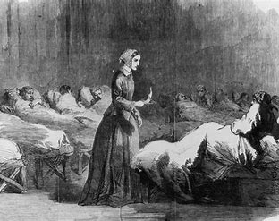
Florence died in London on 13th August 1910 at the age of 90, which was very old for back then.

