Slide 1
KS1 Writing Parent/ Carer Workshop

Slide 2
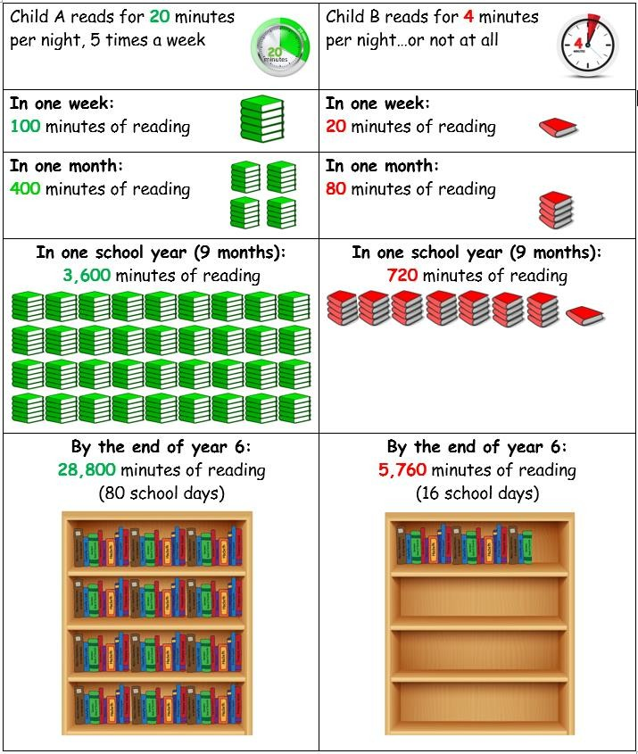
Why is it important to read at home?
Hearing your child read every day helps them with their decoding and fluency skills.
Reading stories to your children helps develop their love of reading and increases heir vocabulary significantly.

Slide 3
Task – write the start of a story.
Why was that difficult?
Ideas
Imagination
Handwriting
Spelling and Grammar
Sentence starters

Slide 4
Writing
How can I support with handwriting at home?
What are fine motor skills and how can I support with developing my child’s pencil grip?
What should my child be able to do by the end of each year group?
How is writing taught at school?
How can I support my child with their writing?

Slide 5
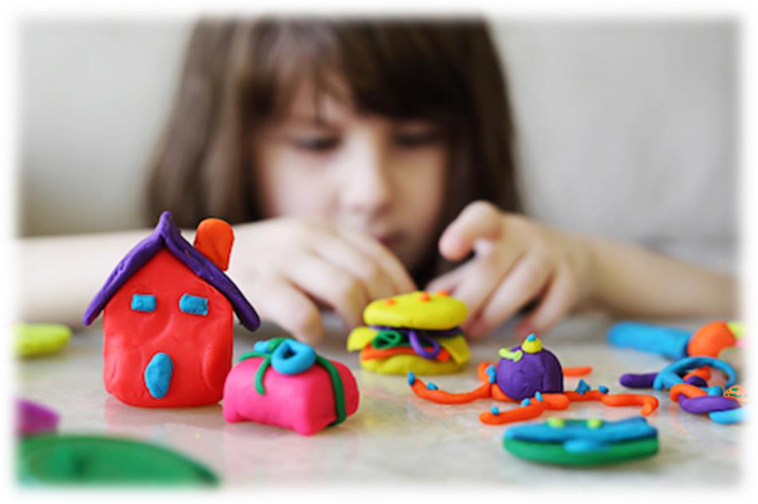
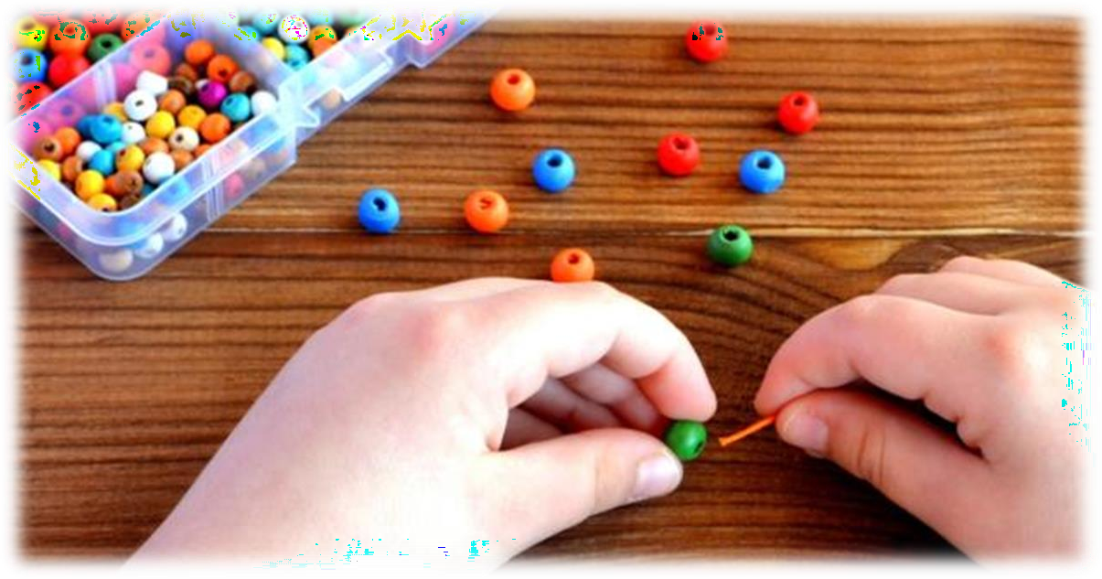
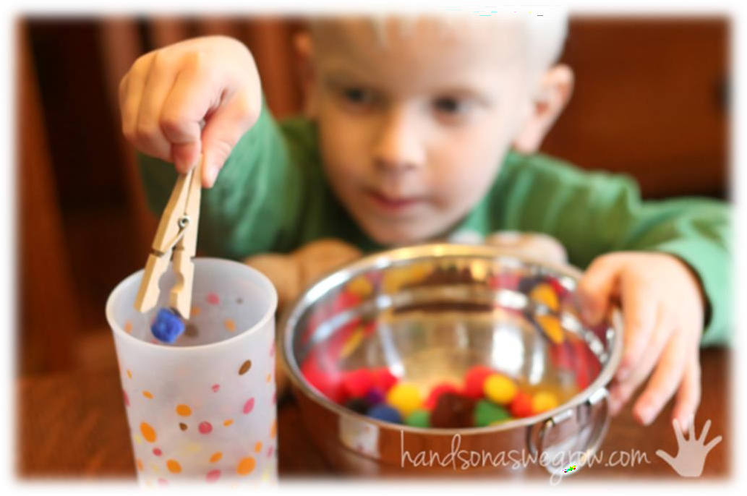
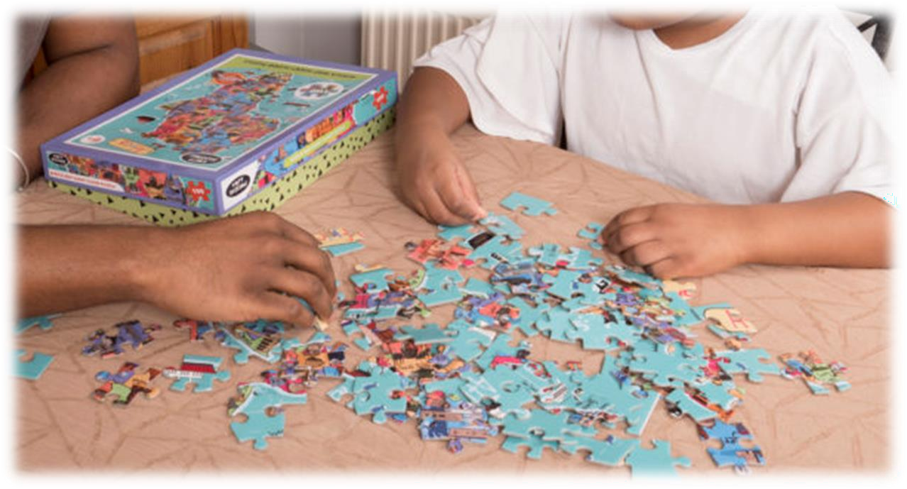
Fine Motor Skills

Slide 6
What Are Fine Motor Skills?
Fine motor skills involve the use of the smaller muscle of the hands, commonly in activities like using pencils, scissors, construction with lego or duplo, doing up buttons and opening lunch boxes.
Efficient fine motor skills require a number of
independent skills to work together to appropriately handle the object or perform the task.

Slide 7
Pencil Grip
How a child holds a pencil is also dependent on their age and the stage of their development.
We use language like:
“Use your birdy fingers.”

Slide 8
Letter Families

Slide 12
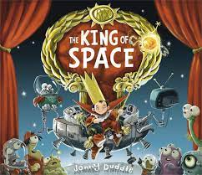
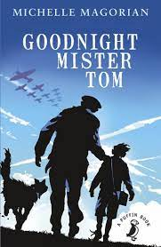
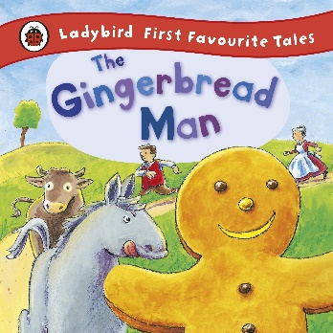
Examples of Genres and Topics
Early Years/Year 1 | Year 2/Year 3 | Year 3/Year 4 | Year 5/Year 6
The Barnabus project | The Gingerbread Man | The King of Space | Goodnight Mr Tom
Instructions about how to take care of an animal Setting / character description Fact file for their creature | Instructions about how to make a gingerbread man A recount of the events in the story Writing a story using different characters | Explanation – how to make a robot. Information writing about robot designs Writing a persuasive letter. | World War Two poems Letters sent home about evacuation Diary entries about unfair treatment

Slide 13
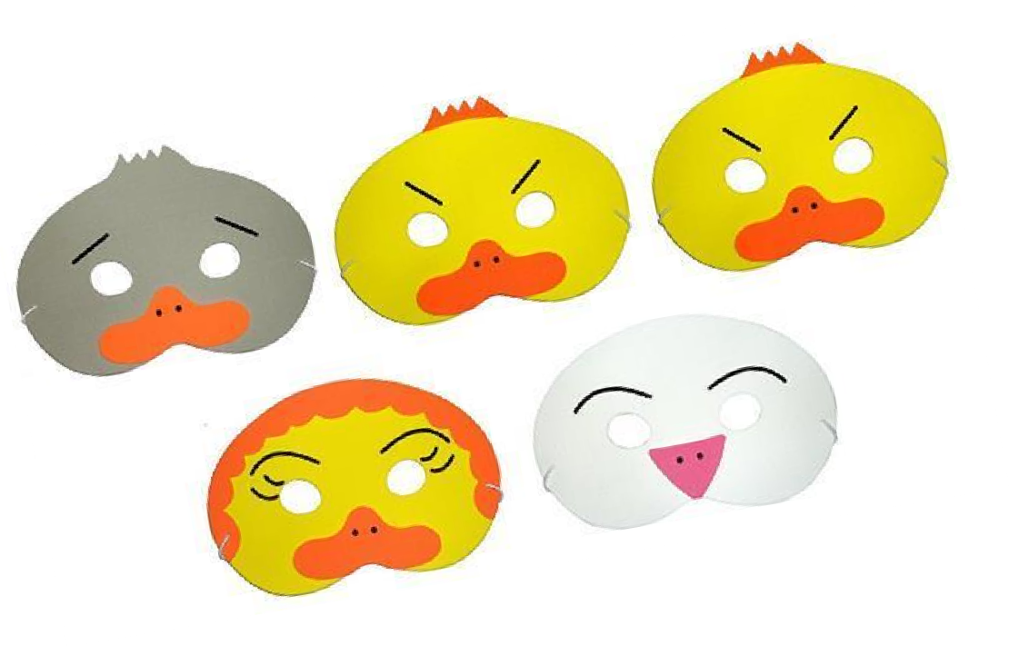
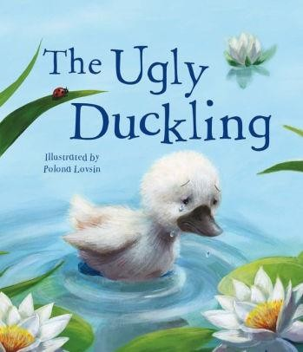
EYFS
Learn a story through drama and immersion.
Plan a new story based on the structure of the original story.
Write the new version of the story.

Slide 14
5 Step Approach
Identify and examine the genre
Look at good quality text
Focus on key vocabulary and planning
Shared write
Independent write

Slide 15
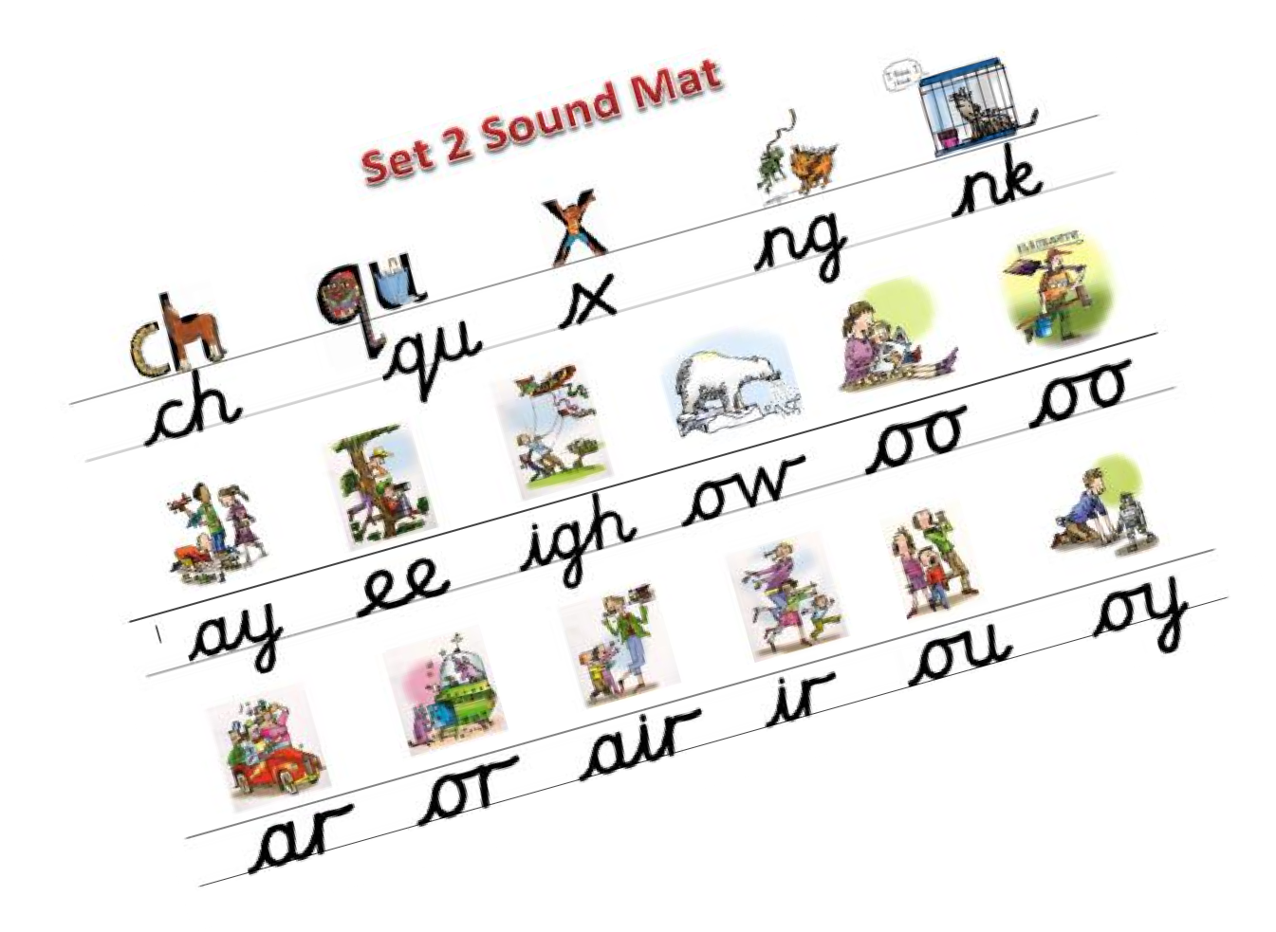
Year 1 Writing Targets
Say the sentence out loud before you write
Sound out words before attempting to spell
Use capital letters and full stops most of the time
Form most letters correctly (using letter families) and begin to use cursive handwriting, keeping letters on the line
Leave a space between each word (finger spaces)
Spell some high frequency words correctly e.g. said, come, was, of

Slide 16
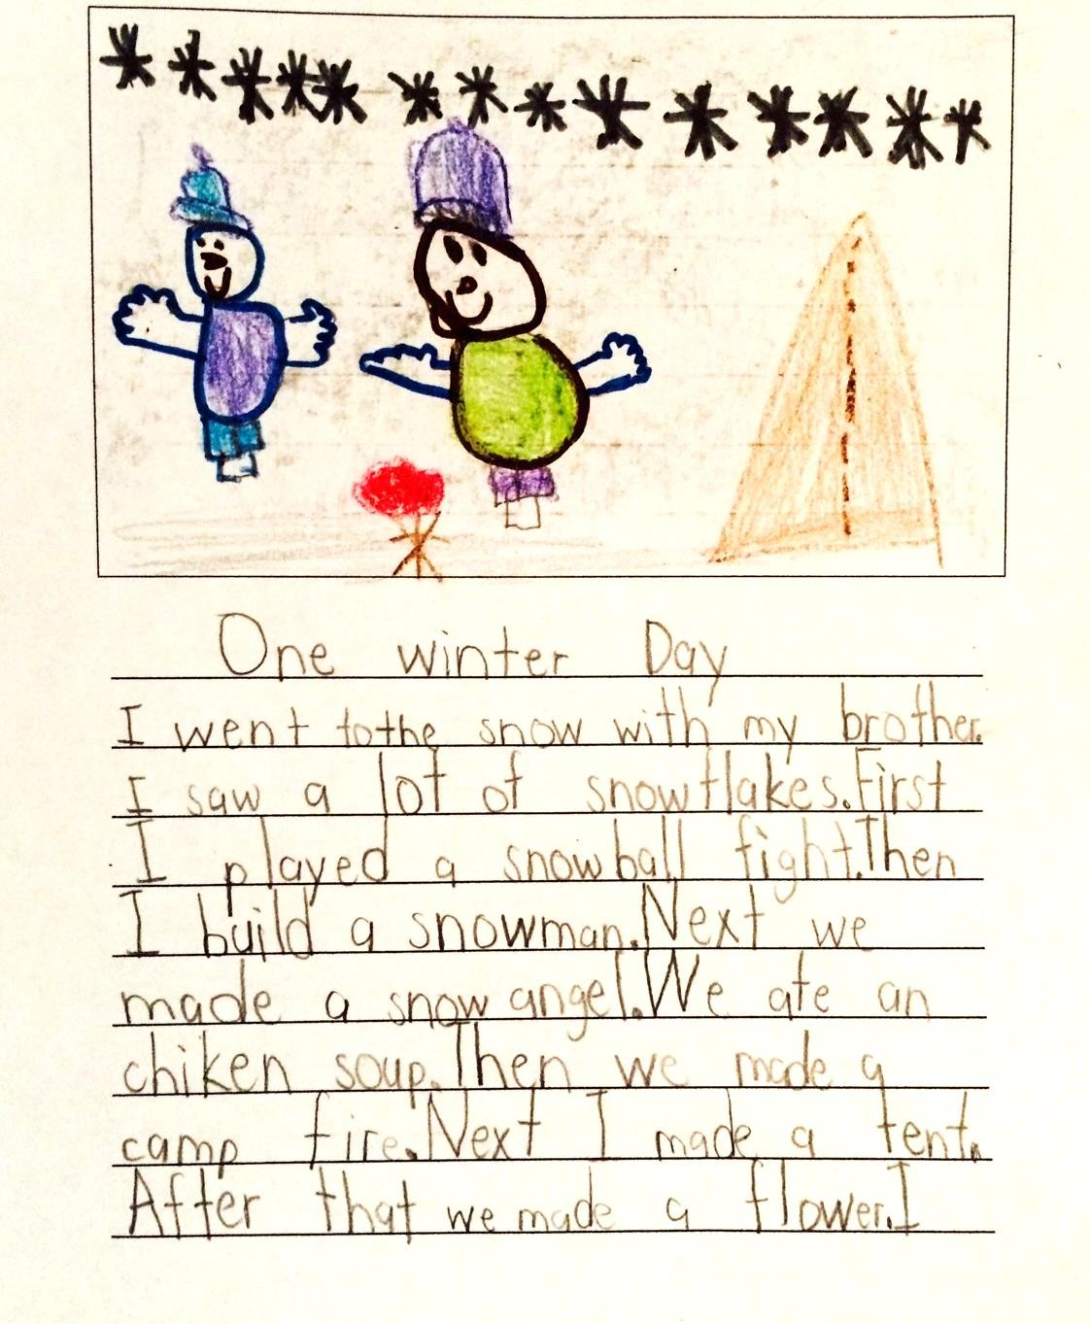
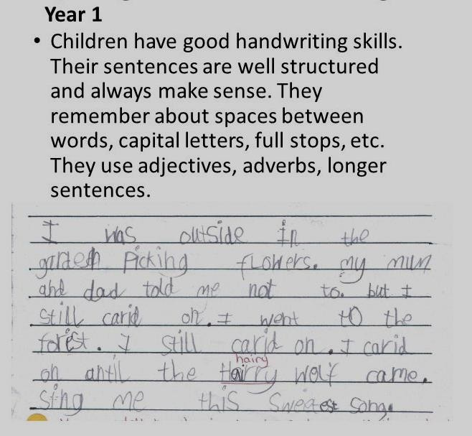
Year 1 Expectations

Slide 17
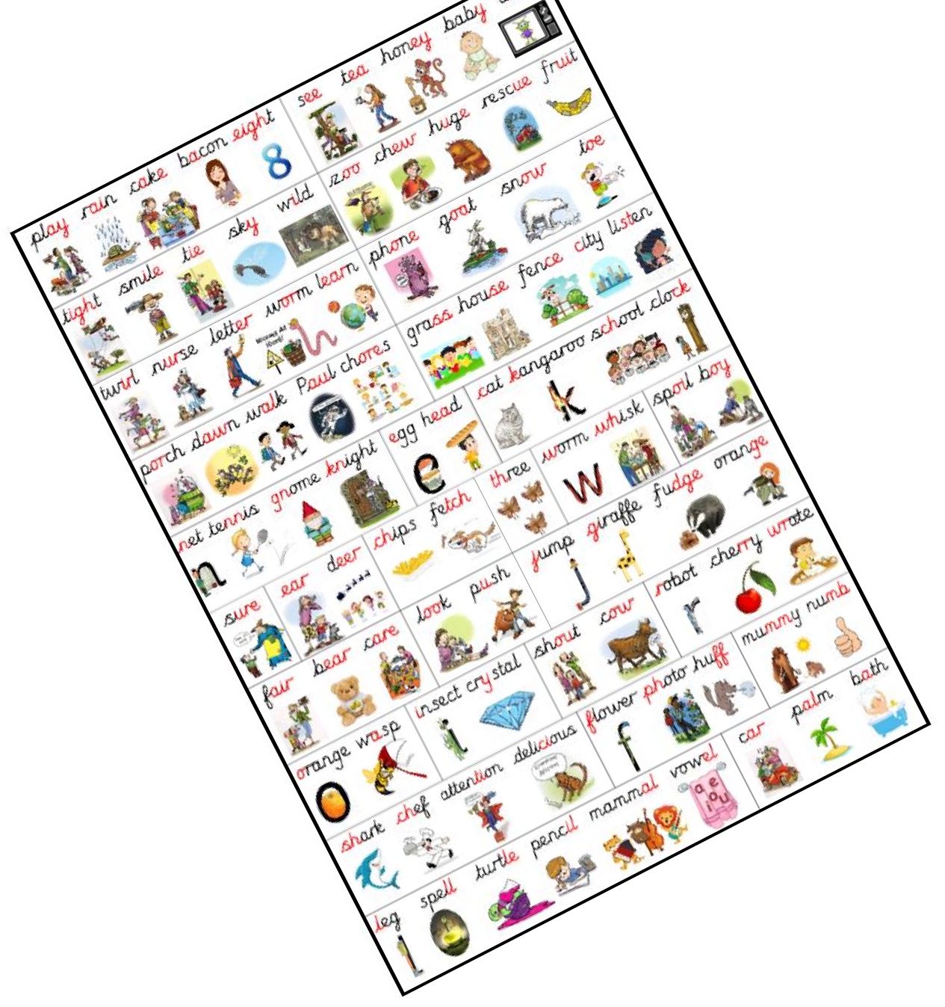
Year 2 Writing Targets
Say the sentence out loud before you write
Sound out unfamiliar words before attempting to spell using a complex sound mat
Use capital letters and full stops consistently
Form all letters correctly (using letter families) and begin to join up handwriting
Keep letters on the line
Use conjunctions to connect sentences e.g. because, so,
to, but
Spell most high frequency words correctly e.g. people, could, friend
Use adjectives to extend and embellish sentences
Write for a range of purposes

Slide 18
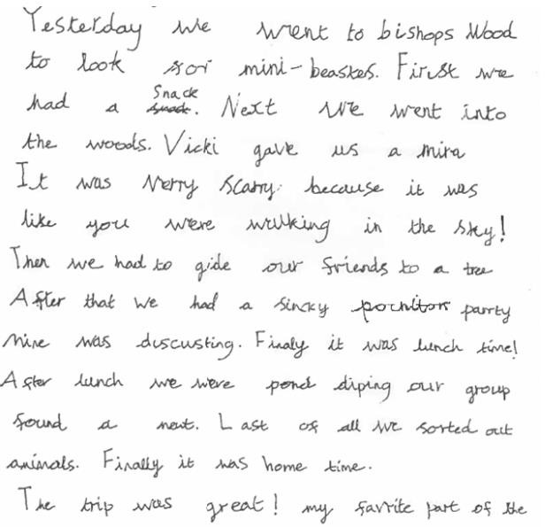
Year 2 Expected Standard.

Slide 19
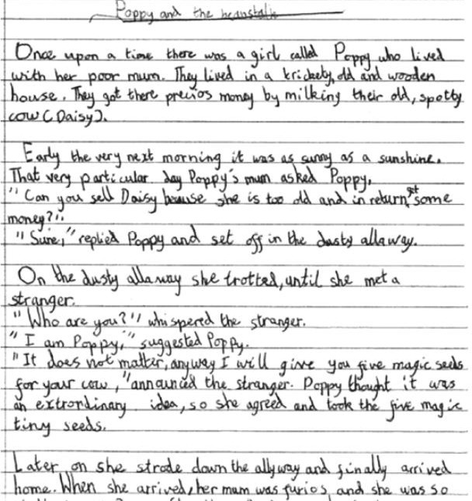
Year 2 Greater Depth

Slide 20
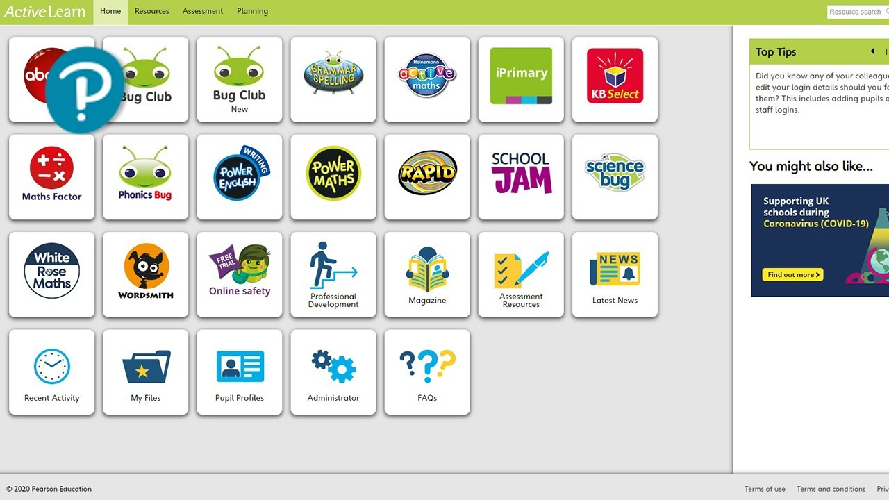
Spelling, Punctuation And Grammar (SPAG) PHONICS

Slide 21
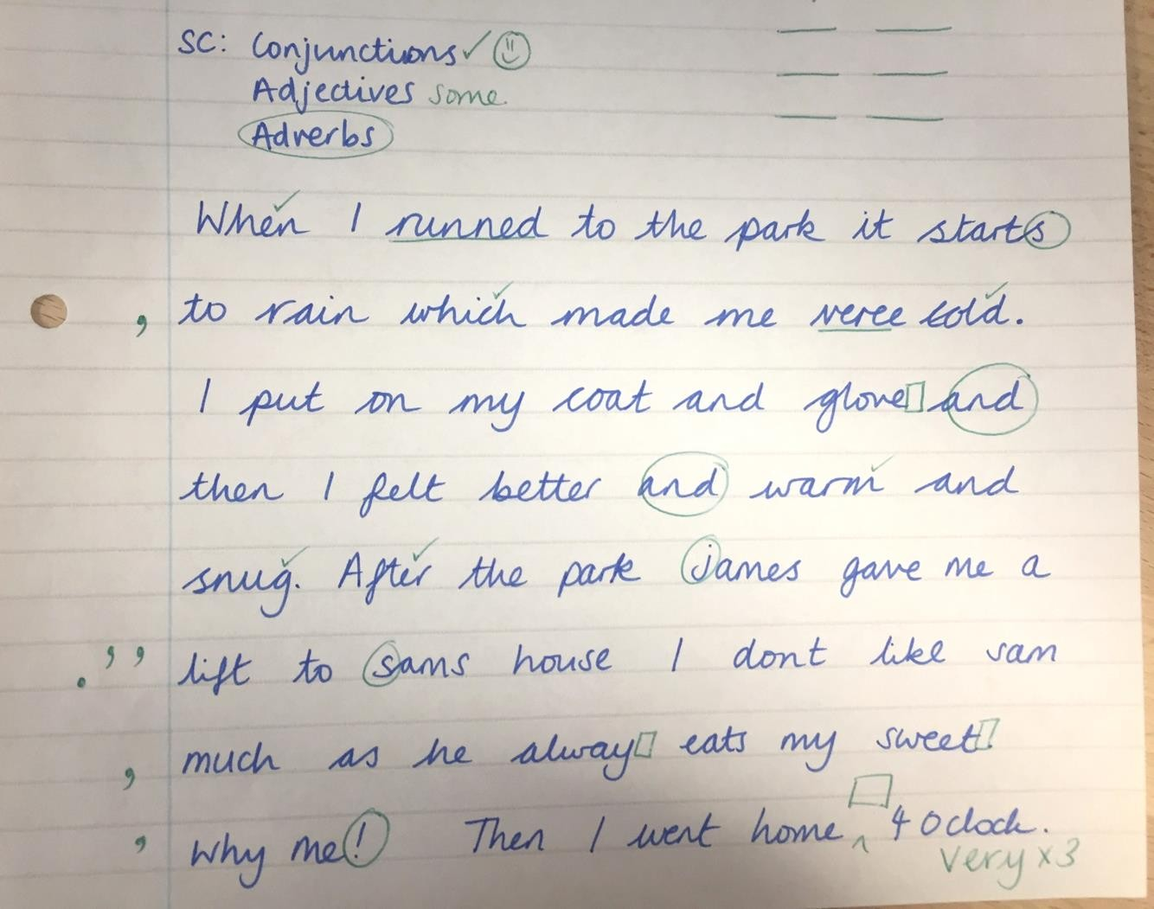
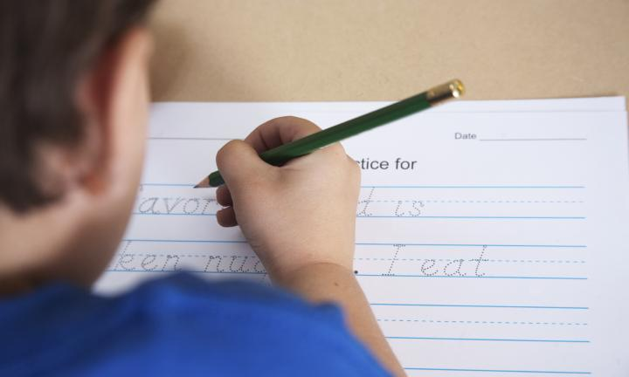
Editing: focuses
on SPAG and getting the children to correct their own mistakes using the Purple Pen of Power.

Slide 22
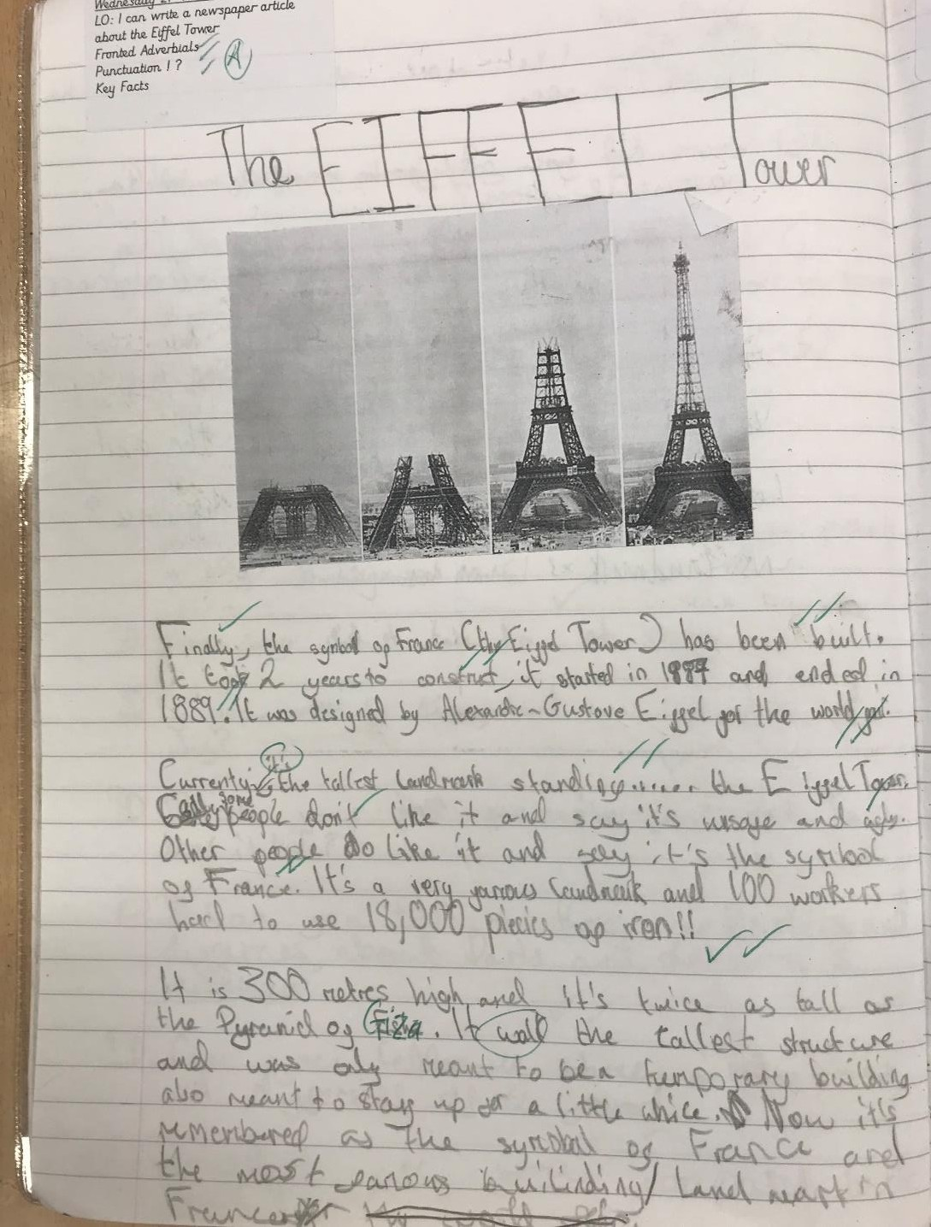
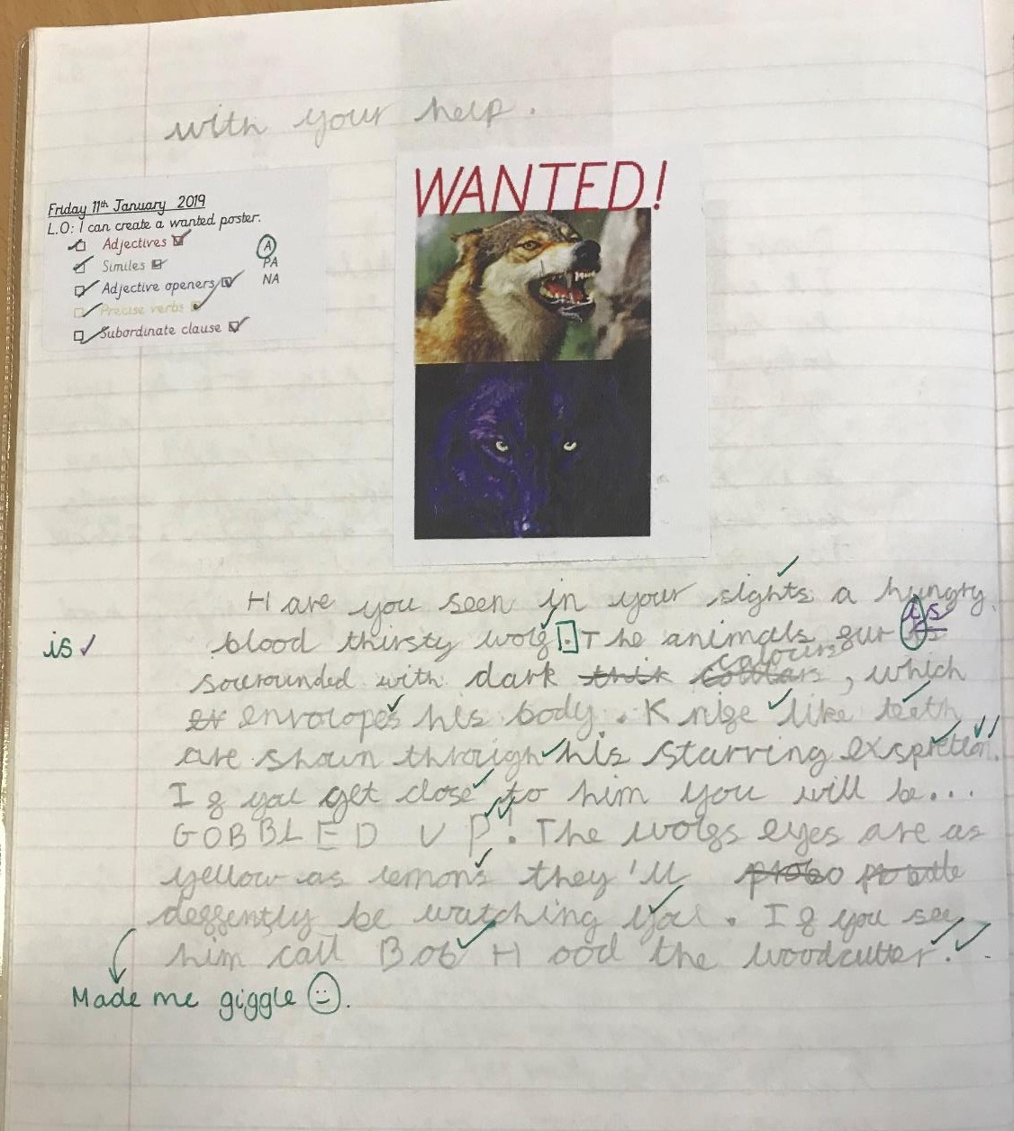
Examples of KS2 writing
Year 4

Slide 23
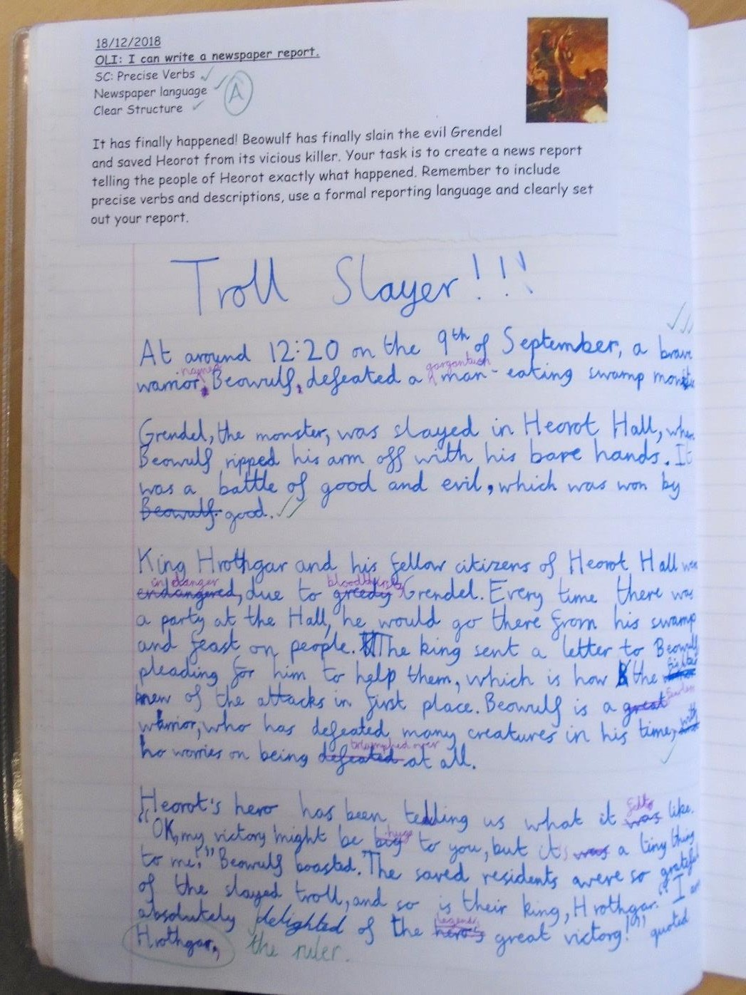
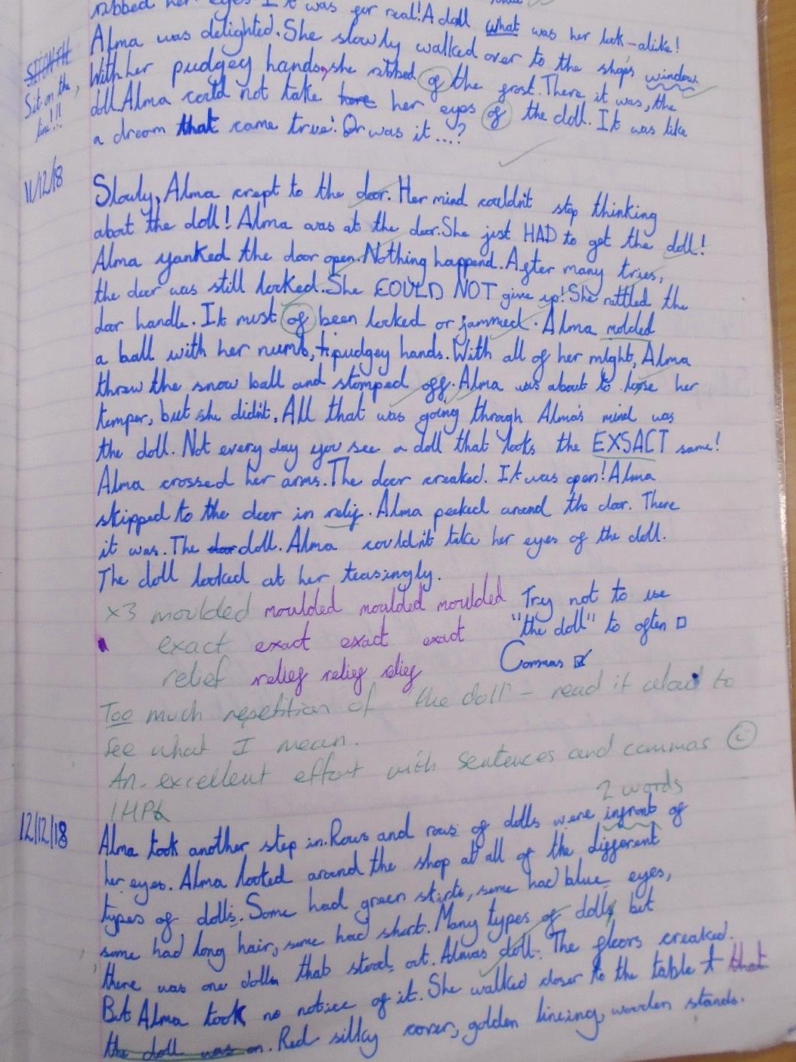

Slide 24
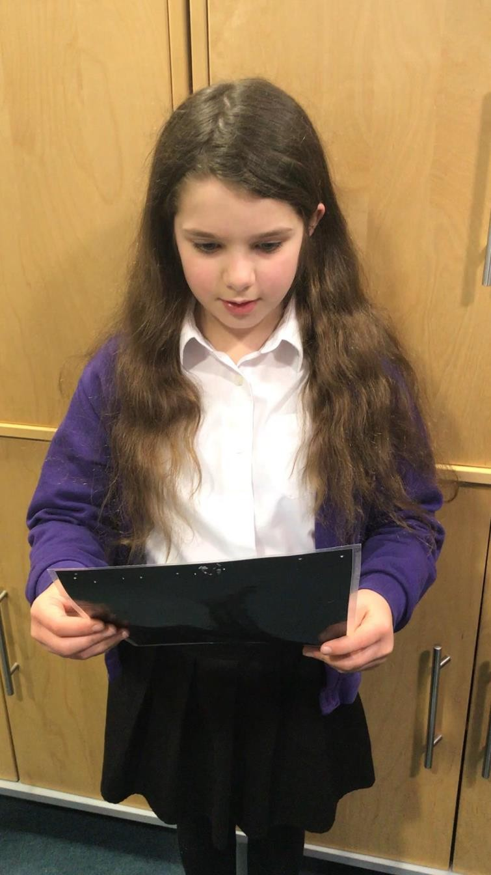
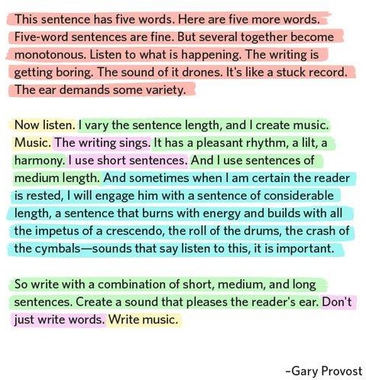

Slide 25
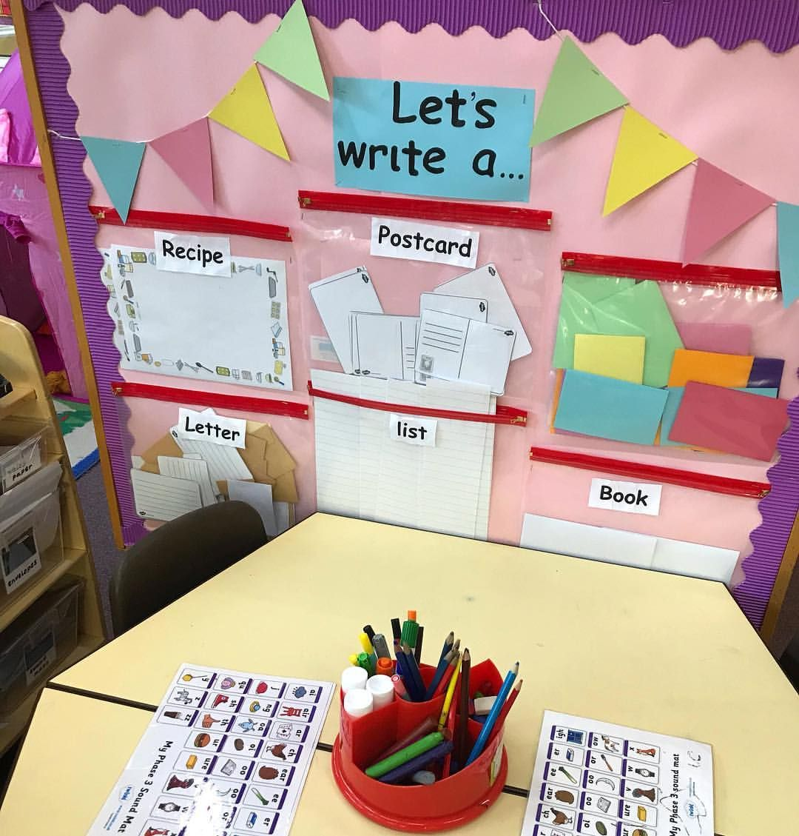
How to Help
Provide a place for your child to write
The area should be an area that is quiet and well lit. Stock the “writing center” with supplies such as paper, pencils and crayons. You can also gather family photos and magazines in the center that can be used as story starters.
Read, read, read
The best activity to improve writing is reading. If your child reads good books, he will be a better writer. Reading exposes students to general vocabulary, word study and content-specific vocabulary. Through reading, students see a variety of authors’ techniques that they can use in their own writing.

Slide 26
How to Help
Encourage your child to keep a reflective journal
This is excellent writing practice, as well as a good outlet for venting feelings. Encourage your child to write about things that happen at home and school. This reflective journal can be used to develop the “senses” of writing. Have your child write about what he saw, heard or felt on a trip or adventure. Provide experiences in your community that will interest your child and spark her writing. Especially encourage your child to write about personal feelings — pleasures as well as disappointments. When reading your child’s journal (only if your child invites you to, of course), share your own feelings and ideas paired with positive feedback about your child’s writing.
Provide authentic writing opportunities for your child
Have your child write his own thank-you notes, party invitations and letters to family. Let your child make the grocery list. Finding a pen pal for your child would make writing “real.” Helping children make the connection between writing and the “real” world will increase an interest in writing.

Slide 27
How to Help
Be a writing role model
Make sure your child sees you as a writer. Point out times that you use writing to communicate with others. Discuss authentic writing in the community such as articles and letters in the newspaper, on billboards or in written advertisements. Discuss the purpose of the writing and the target audience. When your child writes, you should write. You can schedule a day of the week that you will turn off the television and share your writing.
Start a vocabulary notebook
Teach your child new words each week and encourage her to use them. Make it into a game and give points for using the new words. Your child can keep a vocabulary notebook and get rewarded for the number of new words learned. The words will begin to appear like magic in her oral language and writing.

Slide 28
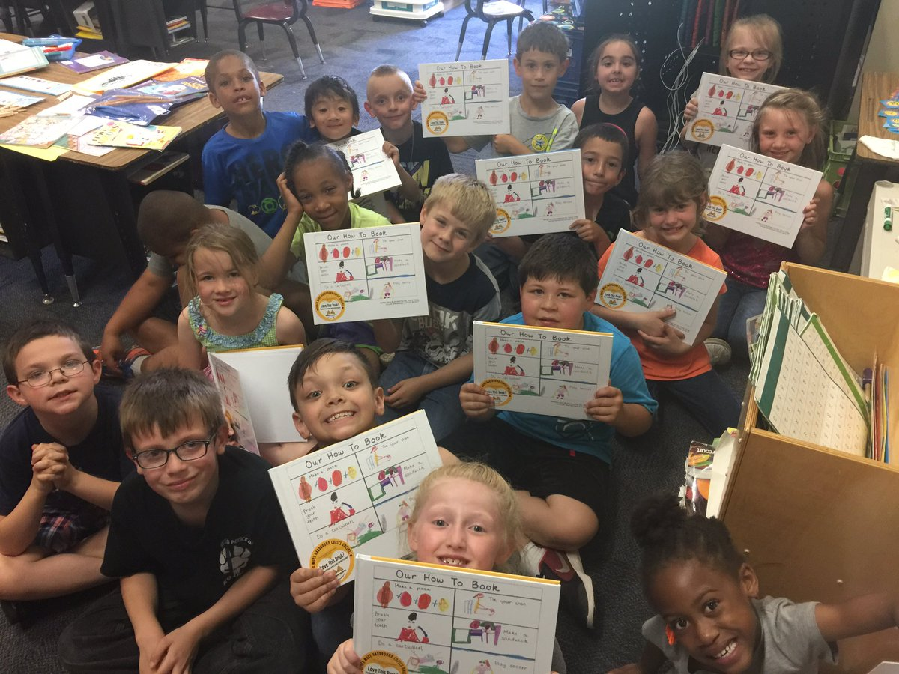
How to Help
Ask questions
Always ask your child questions when he writes. Ask specific questions about your child’s writing such as: “How did that happen?” “How did that make you feel?” “Can you tell me more about that…?” “What are some other words you could use to describe…?”
Help your child publish their writing
Share their writing with others, place it on the refrigerator or encourage them to write for kids’ magazines. When your child’s writing is published in a children’s book, they will be on their way to becoming a lifelong writer and author.

