Slide 1
Stanley St Andrews Football Training Program
By Elliot Sullivan

Slide 2
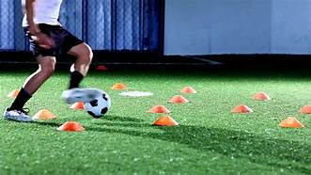
Equipment Needed: For an average training session you will need footballs (not air balls), cones, bibs, a whistle for the coach, and some medium sized football nets.

Slide 3
Contents of a Training session

Slide 4
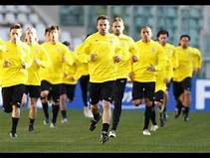
Warm up
If you ever wondered why there is a warm up in football training, it is because you need to get the heart pumping and warm your muscles up. This helps to prevent injuries. Some activities that you might like to have in you warmup are fun games like tag or British bulldog.

Slide 5
Ball skills
In this part of a lesson you will probably do some ball skills. For a fun game you could play a game where someone on the team chooses 4 skills. Each skill has a number. Someone else shouts out a number between 1 - 4 and whatever skill was the actual number they will have to do.
Another game is where there are 2 teams and you have 2 people from each team at a time run up and down the pitch. They are passing between cones, and when they get back to there team the other pair goes. This game will practise your passing skills.

Slide 6
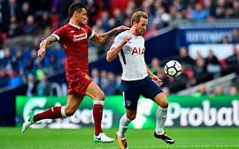
Match
In a match you need to split into 2 teams. There are 2 types of games. One is the position game where each player has a section and they have to stay in it until it is time to switch over. The aim of the game is to score a goal but players must remain in their sections. This teaches the players their positioning.
Another option is a normal match where everyone is allowed to be in all positions chosen by the coach. You are allowed out of your area but you need to remember to keep your position, or you may let your team down.

