Slide 1
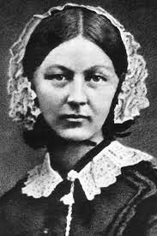
Florence Nightingale.

Slide 2
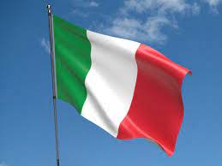
When was Florence born and where.
Born on May 12th, 1820. Born in Italy. She was named Florence because she was born in Florence in Italy.
On 12th of May we celebrate International Nurses Day. It’s a day where we celebrate nurses from across the world for all they do.
This day is also Florence’s birthday which is why it is celebrated on this day.

Slide 3
Who is Florence Nightingale?
Florence Nightingale was a very well known nurse. She made sure that nurses and hospitals were up to the correct standard to look after poorly people.
The Crimean War began in 1853. Florence travelled to lead a team of nurses to help poorly soldiers.
The soldiers were recovering in war hospitals.
The hospitals were very dirty. There wasn’t enough medical equipment.
Florence worked with her team to clean and give better care to the soldiers. She wrote a report that led to lots of changes to improve hospitals.
Many soldiers were dying from infections rather than from their injuries
She worked to make hospitals safer and cleaner.

Slide 4
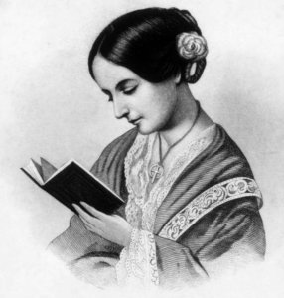
Education.
Florence was a lucky girl because she got a good education to help her to learn and become a nurse.
Helped to train other women to become nurses. Went to Germany to study to become a nurse

Slide 5
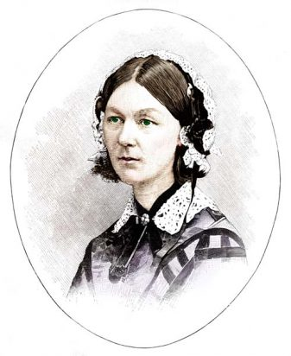
What other special things did Florence do?
She wanted nurses to be properly trained. She set up a special school. It was the first nursing training school.
She set up the Nightingale Training School for nurses in 1860.
Florence Nightingale changed the way that hospitals cared for their patients. Before, hospitals were very busy and also very dirty places with rats running around . This meant that germs and diseases were easily spread. There wasn't enough doctors or beds to go around, so often people didn’t get the care they needed.
Florence Nightingale changed all of this by making hospitals cleaner places. She also trained more nurses to help care for people. She made sure people were well looked after and had good food to eat, which saved many lives.

Slide 6
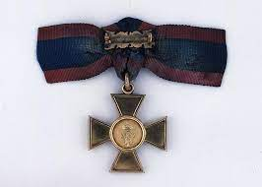
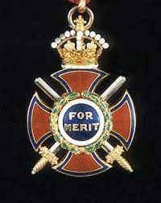
Special awards!
Queen Victoria was awarded the Royal Red Cross Medal in 1883.
She was the first person to ever be awarded this!
Florence got a special award from King Edward called the Order of Merit in 1907. She was the first ever lady to get this award and this helped her to change the way women were seen in work places.

Slide 7
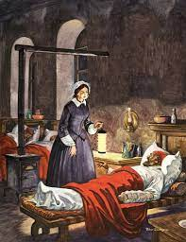
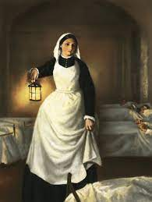
The lady with the lamp.
Florence would check on her poorly people at night.
She carried a lamp and so became known as ‘the lady with the lamp’
She made a lot of good changes to nursing.

Slide 8
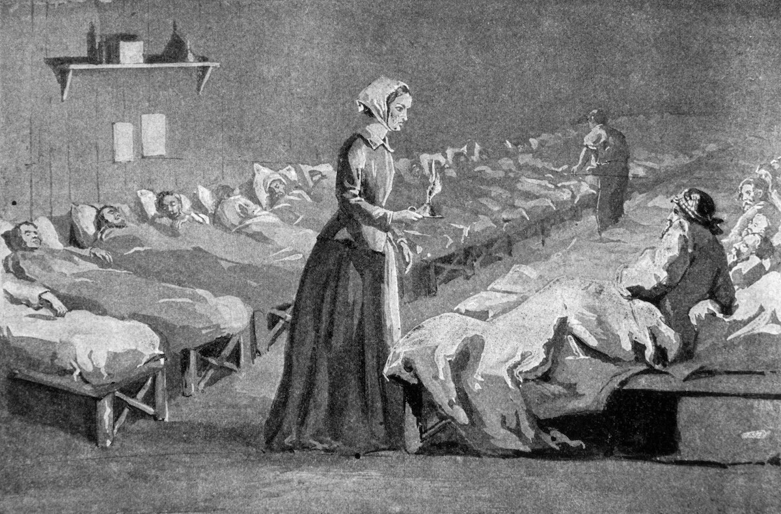
Hospitals became cleaner thanks to Florence.
Florence made sure that hospitals were kept clean to stop the spread off people getting poorly.
A lot more people got much better because of the care that they got from Florence.

Slide 9
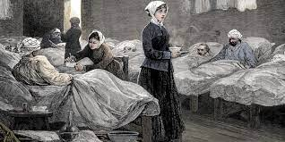
On the of 3rd August 1910 aged 90 she died.

